Slide 1

War Between States DIVIDES NATION&Splits RESTORATION MOVEMENT
By David Lee Burris

Slide 2
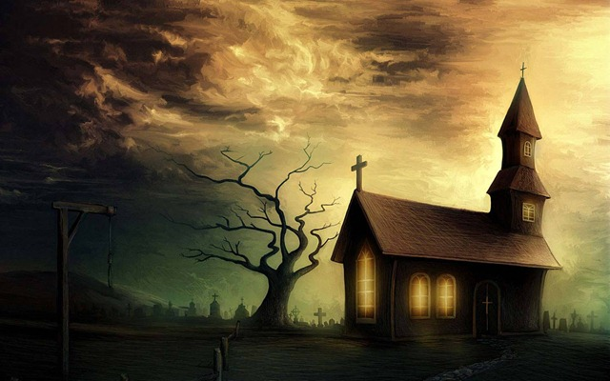
Uncle Tom’s Cabin:
O, church of Christ,
read the signs of the times!
Is not this power
the spirit of HIM whose kingdom is
yet to come?

Slide 3
The Moral Change Process: Cognitional & Conceptual Developments
1st Level: Pre-Conventional Is Structured In Terms Of An Obedience To Tools & Rules.
2nd Level: Critical Reflection Of Rule Roles & Basic Conventions; Accepted Tool Of Social Relation & Maintenance Of Social Order.
3rd Level: Post-Conventional Individual & Minority Focus On Rights & Universal Principles - Natural Law & Analogic Method
Source: Kohlberg, Psychology Of Moral Development

Slide 4

Symbiontic
What
People
Value
Must Match
How
Value
People

Slide 5

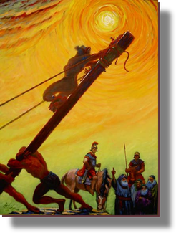

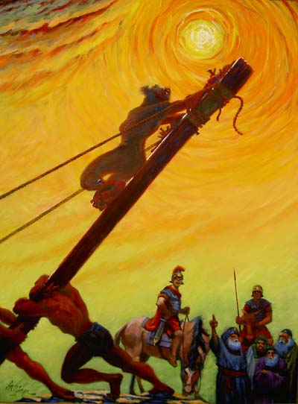
God’s Two Methods
Willing change:
  Reflect on the cross
  Soften the heart
  Yields to God’s way of thinking
Grudging change:
  External difficulties
  Soften the heart
  Yields

Slide 6

Does God Exist?\Oct90\Revolution Or Evolution?\Cecil Hook
David Lee Burris:
Notes On Roman Stylized Slavery: “Legally claiming personal bankruptcy opened the door for many to make their fortunes handling the affairs of the great houses of the prominent families of the cities. Slowly but surely these temporary slaves became essential to the maintenance of the household and then the dependency relationship would be reversed. Shortly thereafter these skilled individuals would buy out their contract and become manor caretakers – in other words – they went from self-enslavement to quoting their own salary in short order!” Myself
Was it sinful for christians to own slaves?
Would it have been proper to buy a slave?
What about one person enslaving another?
“Paul insists, ‘Do not become slaves of men?’ (1st Cor 7:23). If it is wrong for me to become a slave, it is wrong for me to enslave someone else. Through the working out of the Golden Rule, this great social change was to evolve…”

Slide 7
Does God Exist?\Oct90\Revolution Or Evolution?\Cecil Hook
David Lee Burris:
Notes On Roman Stylized Slavery: “Legally claiming personal bankruptcy opened the door for many to make their fortunes handling the affairs of the great houses of the prominent families of the cities. Slowly but surely these temporary slaves became essential to the maintenance of the household and then the dependency relationship would be reversed. Shortly thereafter these skilled individuals would buy out their contract and become manor caretakers – in other words – they went from self-enslavement to quoting their own salary in short order!” Myself
Was it sinful for christians to own slaves?
Would it have been proper to buy a slave?
What about one person enslaving another?
“Paul insists, ‘Do not become slaves of men?’ (1st Cor 7:23). If it is wrong for me to become a slave, it is wrong for me to enslave someone else. Through the working out of the Golden Rule, this great social change was to evolve…”
“God wants change in all individuals and societies. He does not, however, demand or expect that change to be an immediate leap from depravity to perfection. Conduct of a mature disciple is not demanded of a newborn in Christ; neither is infancy an acceptable standard for those who have had time and opportunity to grow toward the fullness of Christ!”

Slide 8


Slide 9

IN THE providential BOOK OF JOB

Slide 10
GOD’S LIGHTNING ARE CHARGED ARROWS!

Slide 11
THE THUNDER IS HIS VOICE!

Slide 12
Powerless in the face of authority
No man has authority to restrain the wind with the wind, or authority over the day of death; there’s no discharge in the time of war, and evil will not deliver those who practice it. (Ecl 8:8)

Slide 13
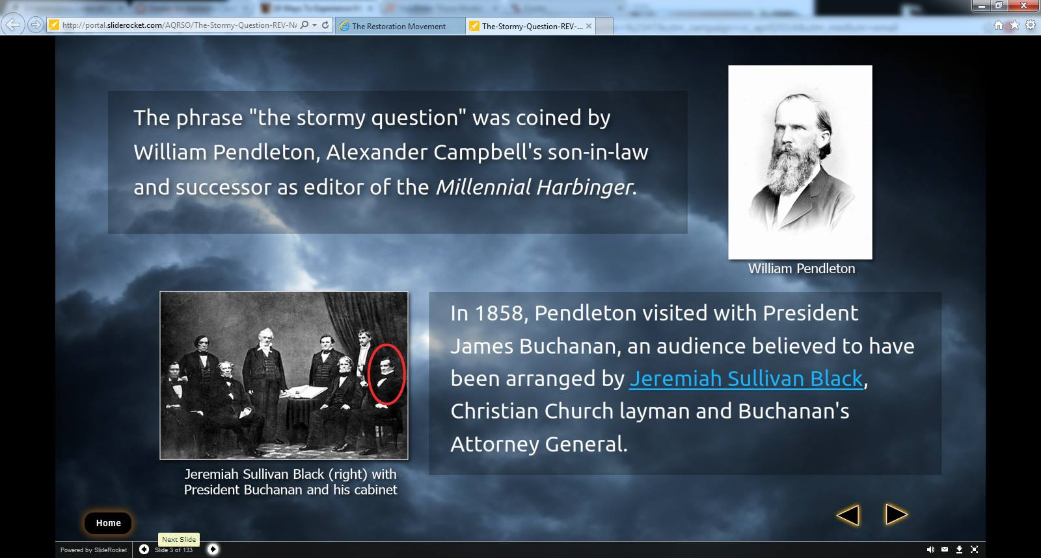

Slide 14
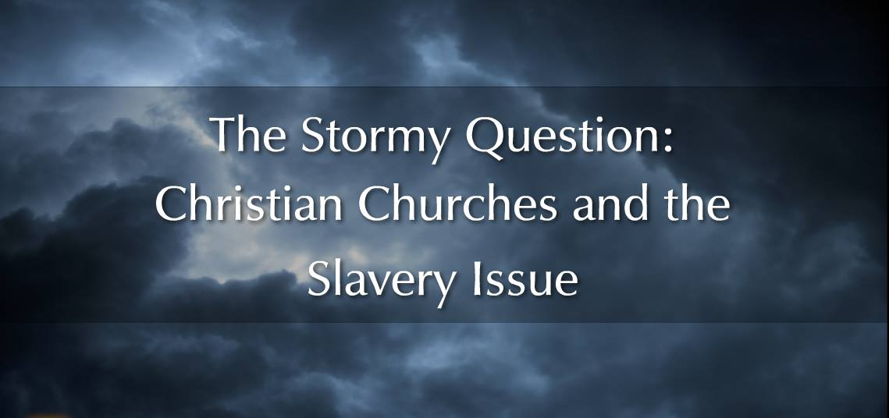


Slide 15


Slide 16
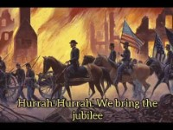

Slide 17


Slide 18
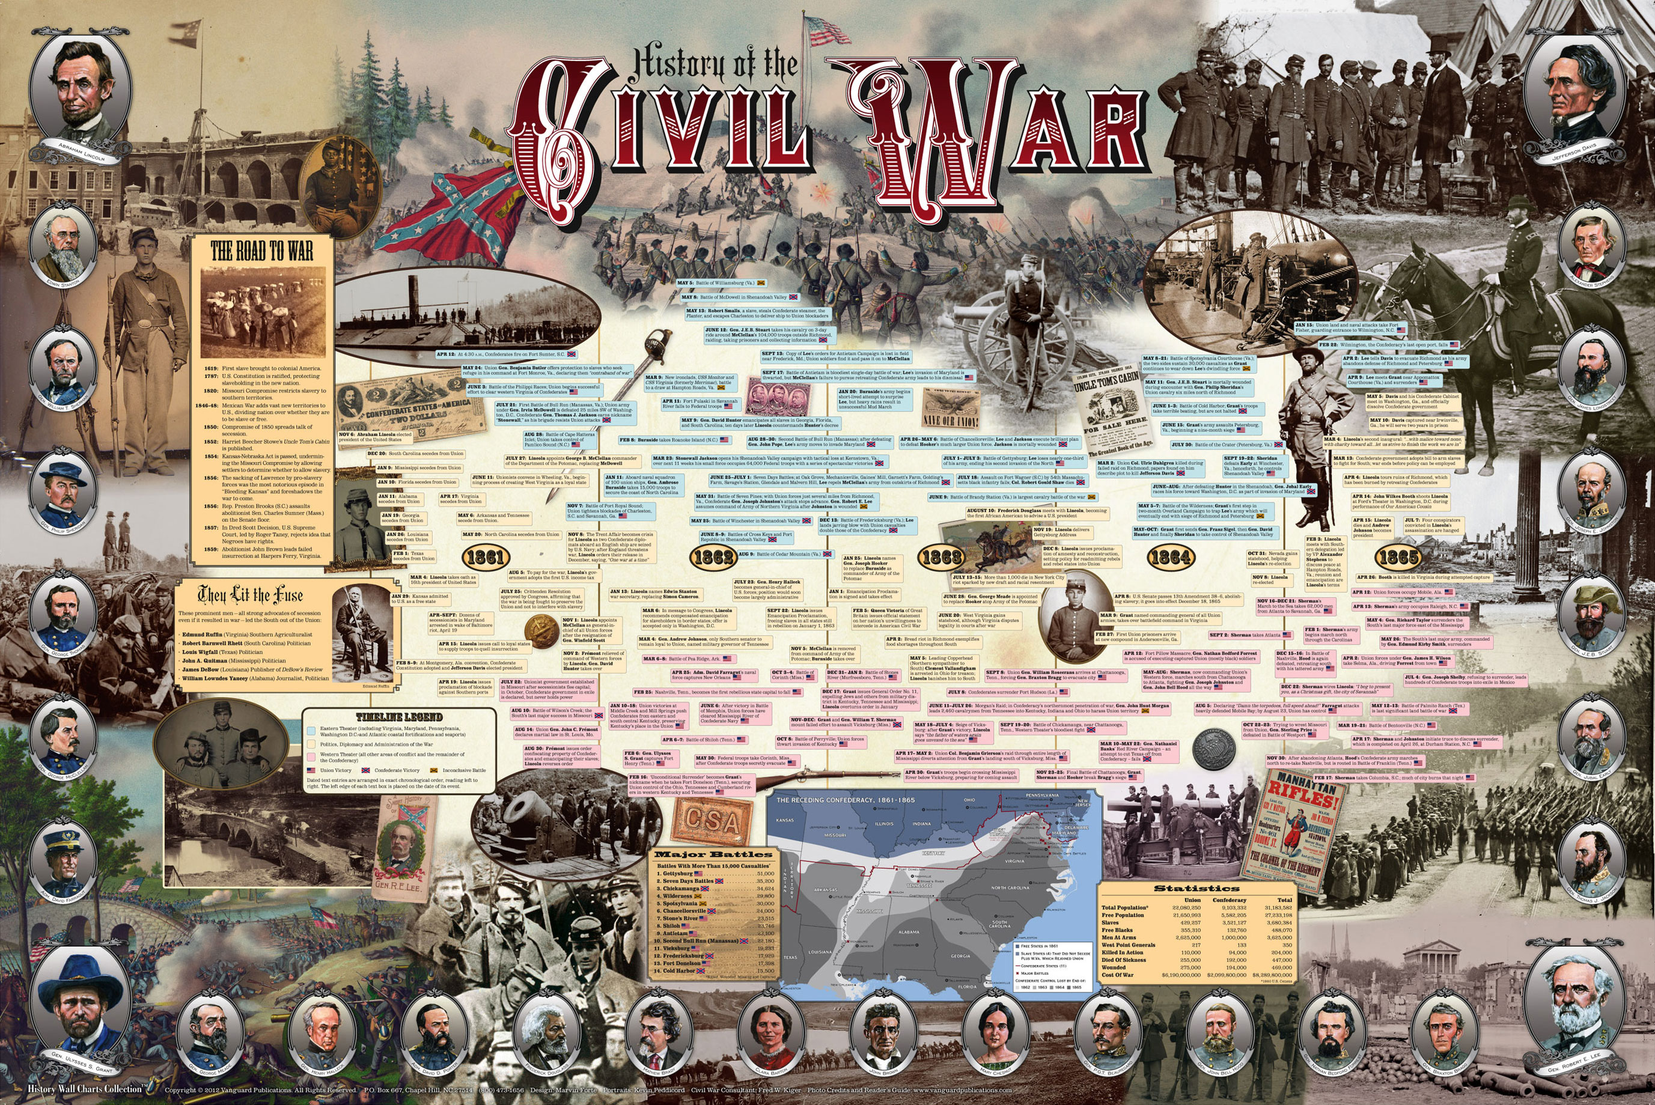


Slide 19
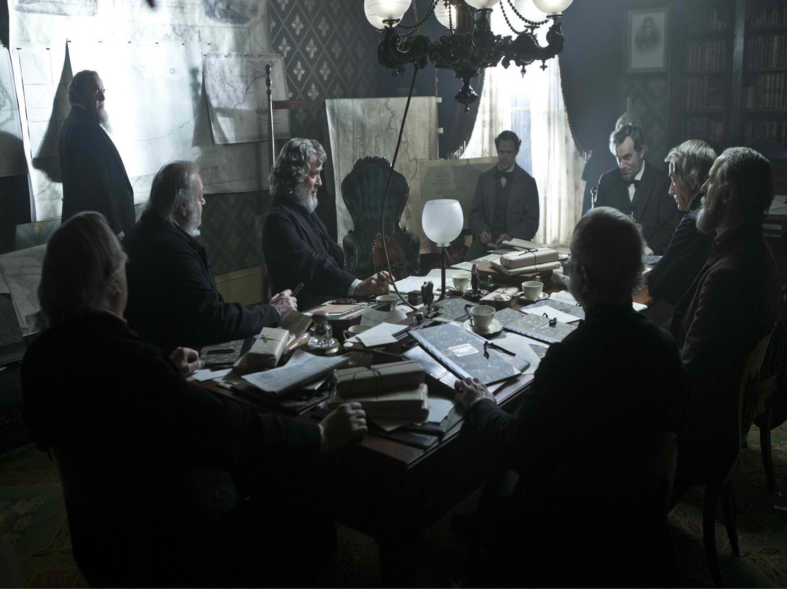


David Lee Burris: EARLY INDICATORS OF EMERGING PROBLEMS
Extra-Church Alliances: Campbells Opposed American Sunday School Union From The Start But Alexander Eventually Reversed On The American Bible Society Becoming Life Director; Intra-Church Organizing: During Decade Of The 1830’s “Area-Wide Cooperation Meetings” Began To Occur & By The 1840’s There Were Some Statewide Meetings To Coordinate Evangelism & Preacher Support; There Were Two Failed Efforts At National Bible Societies One Inter-Denominational & The Other Internal Each Was Headed By Alexander Campbell;
Alexander Wrote A Series Of 16 Articles Staring in 1849 Insisting On National Organizing To Expedite Efforts Of Evangelism In Terms Of Education – Benevolence – Overseas Missions
American Missionary Society Was Formed In Cincinnati In October Of That Year & With Article Three Of The Society Constitution Controversial In Its Requirement In Dues Of Membership
Alexander Campbell On The Structure Of The Church – “Creative Freedom In Action” & Slogan “Disorganization Is Death.”
CAMPBELL RESERVED THE TITLE ‘BISHOP’ FOR HIMSELF & THUS ‘BISHOP’S PRESS & BISHOP’S COLLEGE IN BETHANY
Until David Lipscomb The Disciples Moved Onward Under The Banner “Whatever Is Good For The Church As A Whole Should Be Done By The Church As A Whole”
“I made a solemn vow before God, that if General Lee were driven back from Pennsylvania, I would crown the result by the declaration of freedom to the slaves.”
“I made a solemn vow before God, that if General Lee were driven back from Pennsylvania, I would crown the result by the declaration of freedom to the slaves.”

Slide 20
Historic Formula Hinge Factor:
The Theory That World History Shaped As Much By Chance & Error As By Courage & Heroism
David Lee Burris:
Arranged Coincidence – “Jehovah-jireh’ or “the Lord will provide”
PRAYER ANSWERED THROUGH
ARRANGED COINCIDENCE

Slide 21
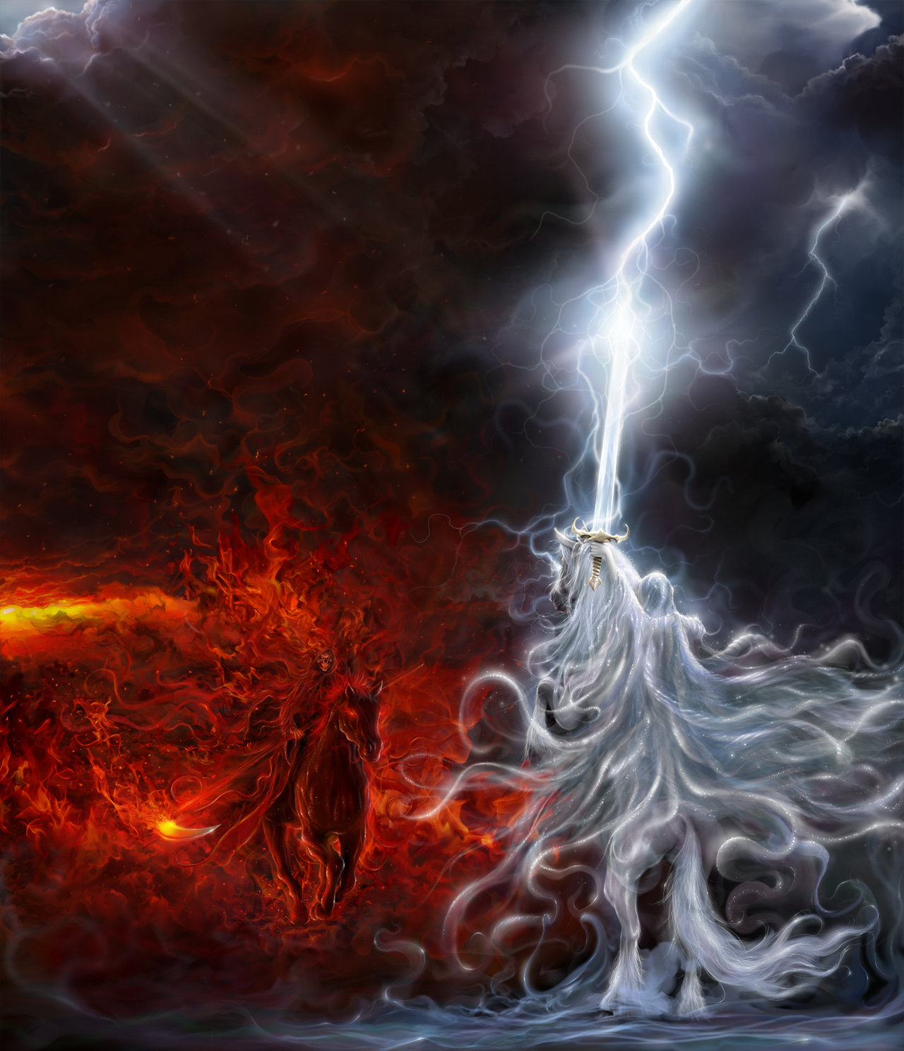
THE THUNDEROUS SILENCE OF GOD!

Slide 22
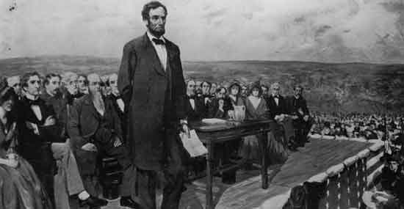


SILENT BATTLE OF GETTYSBURG
British Decide Against Southern Support
South Was To Negotiate End to Hostility
Southern Loss Due to Shadow Acoustic

Slide 23
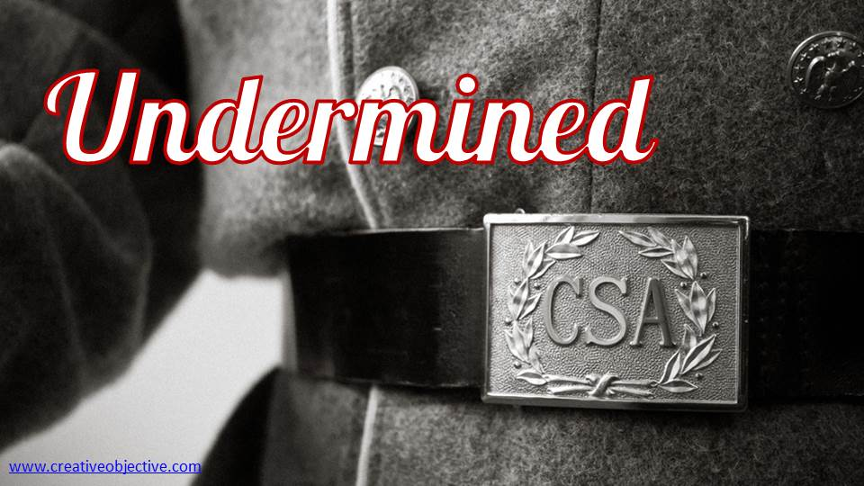
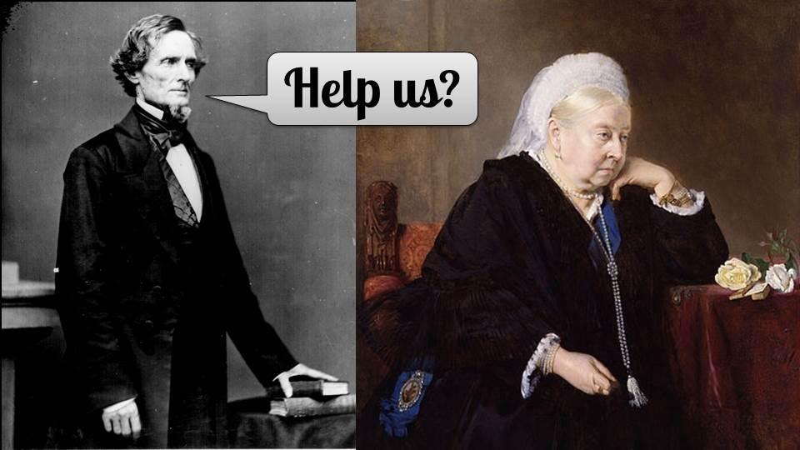

Slide 24
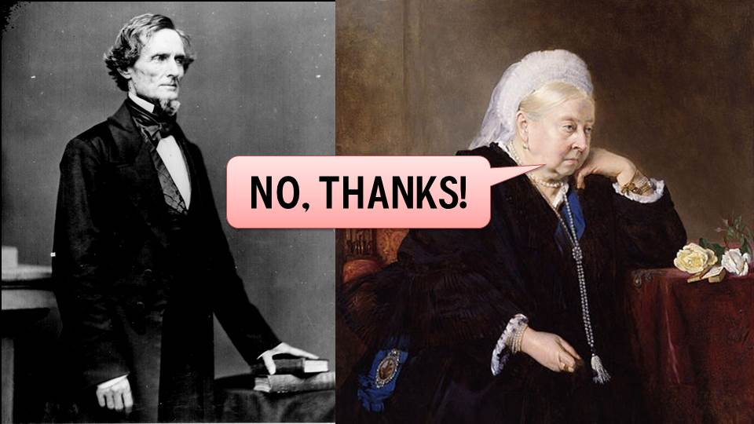
Question Ending National Anthem Forever Answered!

Slide 25
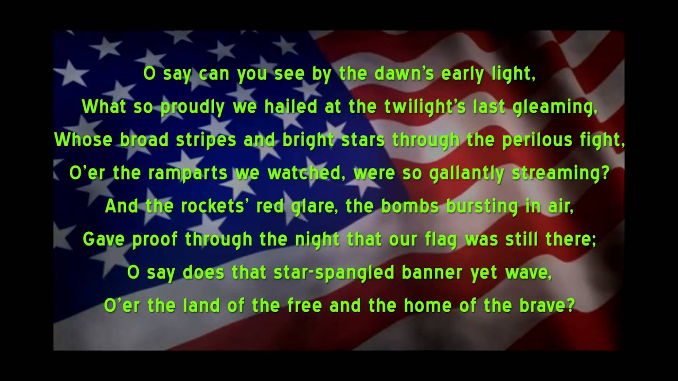

Slide 26

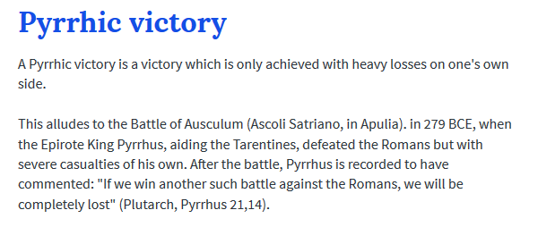


Slide 27
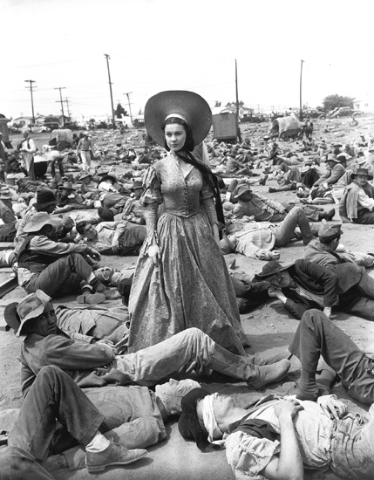
“Death Had A Carnival!”

Slide 28
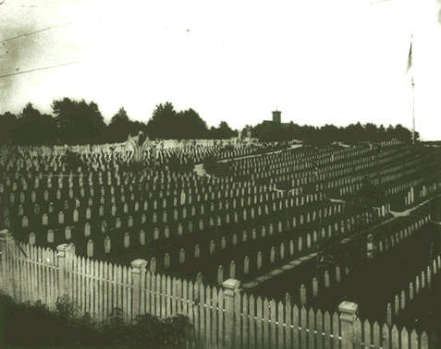
In Victorian literature, death was being sentimentalized. In America, the Civil War interrupted this concept in process of the ‘good death.’ How good can a death be when it’s far from family, in the midst of horror and carnage, with no loved one present to record last words, even if any were murmured?

Slide 29
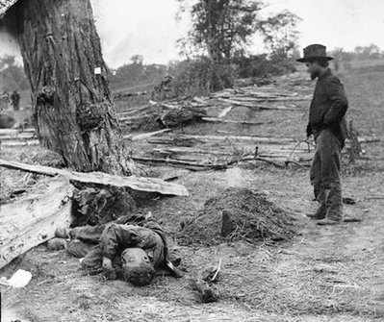
No terms softer than ‘die’ & ‘dead’ had enough gravity to describe the nearly seven hundred thousand soldiers who died during this conflict, two percent of the entire population. As Drew Gilpin Faust recounts in This Republic of Suffering : Death and the Civil War, Yankees and Confederates alike became consumed with what they called a ‘harvest of death.’

Slide 30
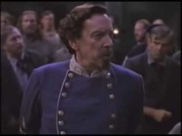

Slide 31
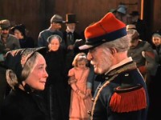

Slide 32
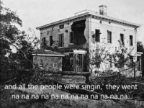

Slide 33
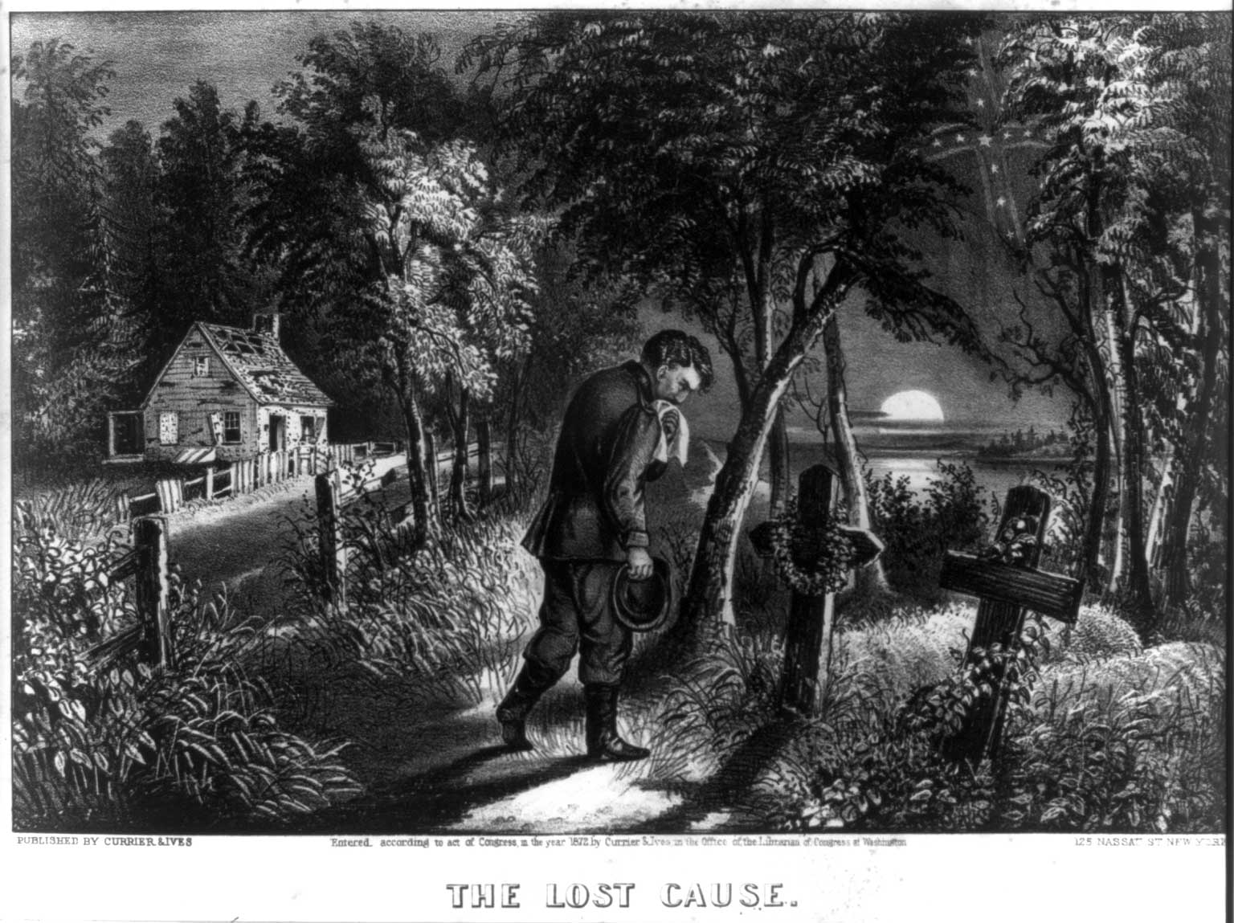

Slide 34
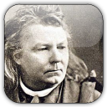
Abram Joseph Ryan
“A land without ruins is a land without memories -- a land without memories is a land without history.”

Slide 35
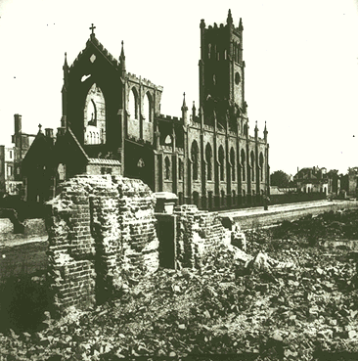
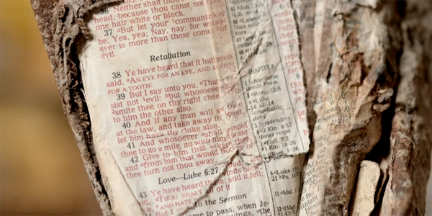

Slide 36
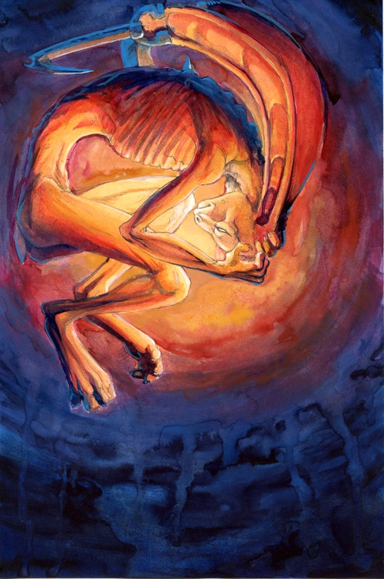
Speaking of the Bible, Mr. Lincoln said in 1864, "In regard to this Great Book, I have but to say, it is the best gift God has given to man. All the good the Savior gave to the world was communicated through this book. But for it we could not know right from wrong. All things most desirable for man's welfare, here and hereafter, are to be found portrayed in it."
Lincoln Proved Not To Be The Antichrist
But Was The Regional Conflict Providential?

Slide 37
Unanswered Prayer &
THE THEODICY TRIANGLE
David Lee Burris:
Our Universe – Perfectly Intelligent & Positively Purposed
Study Of Providence – Critique Of Irreducible Complexity
Providential Polemics – Degree Of Determinism Or Structure Vs. Choice Or Chance
Opposed Schools – Realism & Circumstance Vs. Happenstance & Phenomenalism
GOD IS POWERFUL
GOD IS GOOD
Supra-Natural Void
EVIL EXISTS
Notes:
“ Riddle Wrapped In Mystery Inside Enigma”
“Some problems are just too complicated for rational, logical solutions. They admit of insights, not answers.”

Slide 38
LINCOLN’S WAR THEODICY: YIELDED TO THE MYSTERY
David Lee Burris:
Our Universe – Perfectly Intelligent & Positively Purposed
Study Of Providence – Critique Of Irreducible Complexity
Providential Polemics – Degree Of Determinism Or Structure Vs. Choice Or Chance
Opposed Schools – Realism & Circumstance Vs. Happenstance & Phenomenalism
Theodicy is an attempt to answer the question of why a good(omni-benevolent) all powerful(omni-potent) God permits the manifestation of evil.
April 1864 Abraham Lincoln Said: “When war began neither party, nor any man, anticipated that domestic slavery would be much affected – but much affected it has. So True is That Man Proposes & God Disposes!”
September 1864 Abe Lincoln Wrote: “The purposes of the Almighty are perfect and must prevail, though erring mortals may fail to accurately perceive them in advance – we must acknowledge His wisdom and our own error. Meanwhile, we must work earnestly in the best light He gives us. Surely, He intends some great good to follow this mighty convulsion, which no mortal could make and no mortal could stay.”
March 1865 @Second Inauguration Speech Building on Recent Gettysburg Address:
God’s Hand - “The prayers of both could not be answered; that neither has been answered fully… I claim not to have controlled events, but confess plainly that events have controlled me… Impartial history will find therein new cause to attest & revere the justice & goodness of God!”
Notes:
“ Riddle Wrapped In Mystery Inside Enigma”
“Some problems are just too complicated for rational, logical solutions. They admit of insights, not answers.”

Slide 39
LINCOLN’S DISCIPLE’S BAPTISM?
David Lee Burris:
Our Universe – Perfectly Intelligent & Positively Purposed
Study Of Providence – Critique Of Irreducible Complexity
Providential Polemics – Degree Of Determinism Or Structure Vs. Choice Or Chance
Opposed Schools – Realism & Circumstance Vs. Happenstance & Phenomenalism
Historicity of Lincoln’s Late in Life Believer’s Baptism:
Churches of Christ had a presence (1832) in Illinois in the region where Lincoln’s parents lived(1830)and where he owned property on the Sangamon River (1836). Lincoln’s parents, Thomas and Sarah, became members of the Church of Christ(1830’s)in Coles County, Illinois. Lincoln himself denied religious affiliation in a paper (1846) written15 years before his inauguration as President. Lincoln’s close friend E.D. Baker was a preacher for the Church of Christ and introduced Lincoln at his inauguration in 1861. The following year (1862), Lincoln and his cabinet with a number of union soldiers attended a meeting in Arlington Heights, Virginia, led by W.H. Morris, preacher for the Church of Christ. During a visit with G. M. Weimer in Eureka, Illinois (1866-78) while attending one of the regional meetings of the churches of Christ, the baptism of Lincoln in the Sangamon River was reported by John O’Kane (well-known preacher for the Church of Christ) who baptized him. The above details support the plausibility that Abraham Lincoln was baptized to become a Christian only sometime after the Morris meeting in 1862.
Critique 0f Abe Lincoln Church Membership Claim:
A book by Edward Steers (University Press of Kentucky, 2009) gives three different accounts of the baptism of Lincoln by several Baptists, German Brethren, and the Church of Christ. The latter two groups hold the same view of baptism for the forgiveness of sins, and all three groups practice total immersion. The German Brethren are pacifists and are unlikely to have baptized Lincoln especially on short notice. Since Lincoln’s parents previously became members of the Church of Christ in Illinois, it is most likely he was baptized by the preacher of that group on short notice, as is their custom, in the Sangamon River as all three accounts claim. All three accounts describe the event as a secret baptism at night because of the objections of Lincoln’s wife. Another important reason to keep the event secret was to protect support for the impending vote for the Emancipation amendment.
Notes:
“ Riddle Wrapped In Mystery Inside Enigma”
“Some problems are just too complicated for rational, logical solutions. They admit of insights, not answers.”

Slide 40
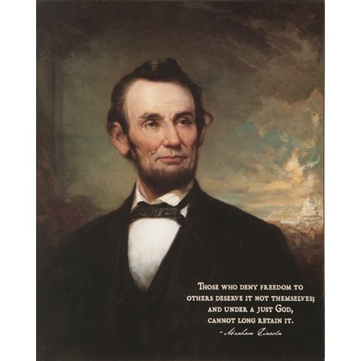
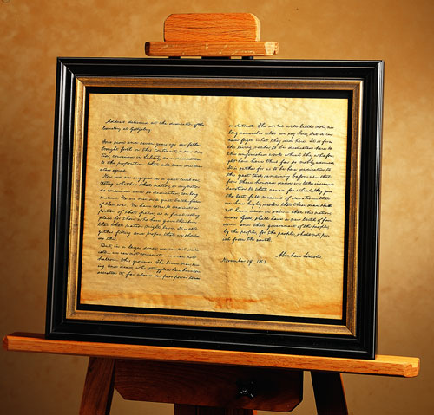
David Lee Burris: EARLY INDICATORS OF EMERGING PROBLEMS
Extra-Church Alliances: Campbells Opposed American Sunday School Union From The Start But Alexander Eventually Reversed On The American Bible Society Becoming Life Director; Intra-Church Organizing: During Decade Of The 1830’s “Area-Wide Cooperation Meetings” Began To Occur & By The 1840’s There Were Some Statewide Meetings To Coordinate Evangelism & Preacher Support; There Were Two Failed Efforts At National Bible Societies One Inter-Denominational & The Other Internal Each Was Headed By Alexander Campbell;
Alexander Wrote A Series Of 16 Articles Staring in 1849 Insisting On National Organizing To Expedite Efforts Of Evangelism In Terms Of Education – Benevolence – Overseas Missions
American Missionary Society Was Formed In Cincinnati In October Of That Year & With Article Three Of The Society Constitution Controversial In Its Requirement In Dues Of Membership
Alexander Campbell On The Structure Of The Church – “Creative Freedom In Action” & Slogan “Disorganization Is Death.”
CAMPBELL RESERVED THE TITLE ‘BISHOP’ FOR HIMSELF & THUS ‘BISHOP’S PRESS & BISHOP’S COLLEGE IN BETHANY
Until David Lipscomb The Disciples Moved Onward Under The Banner “Whatever Is Good For The Church As A Whole Should Be Done By The Church As A Whole”
Principle Of Human Worth Compromised
To Paraphrase C.S. Lewis:
“THE ACTUAL WORLD WE LIVE IN IS LIKE A CHESS BOARD WHERE HALF THE PIECES ARE INVISIBLE.”

Slide 41
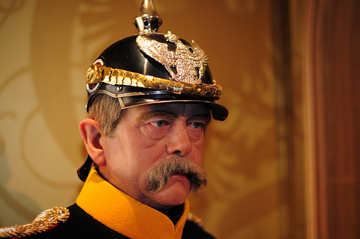
After Our Civil War
“god looks after
alcoholics,
little children,
The Prussian Leader Remarked

Slide 42
After Our Civil War
and the
United
States
Of america!”
The Prussian Leader Remarked

Slide 43

“Because Lincoln held the Union together[in the 19th Century], the United States of America succeeded in saving the world in the twentieth century from the oppressive and tyrannical ideologies of fascism and communism.
Without a Union victory in the Civil War there likely would not have been an Allied victory in World War II and in the Cold War.”
KENNETH SAMPLES SAYS:
Optional Viewing: AMERICA Imagine The World Without Her

Slide 44
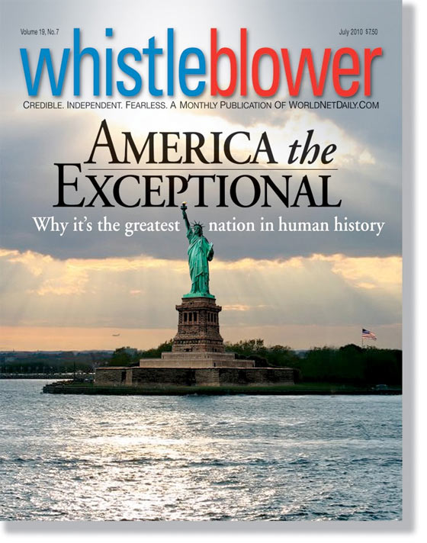
A U.S. Navy Admiral was attending a naval conference that included Admirals from the U.S., English, Canadian, Australian and French Navies. At a cocktail reception, he found himself standing with a large group of Officers that included personnel from most of those countries.
Everyone was chatting away in English as they sipped their drinks but a French admiral suddenly complained that, whereas Europeans learn many languages, Americans learn only English. He then asked, 'Why is it that we always have to speak English in these conferences rather than speaking French? Without hesitating, the American Admiral replied, 'Maybe it's because the Brit's, Canadians, Aussie's and Americans arranged it so you wouldn't have to speak German.‘
You could have heard a pin drop.

Slide 45
REVIEW: ANCIENT ORDER RESTORE POINT
RESTORATION MOVEMENT: ADOPTS THE FIVE STEPS TO SALVATION
5 STEPS: Believe – Repent – Baptism – Forgiven – Get the Holy Spirit
ALEXANDER CAMPBELLS DEBATES LINK ON WORSHIP & SALVATION:
ALEXANDER CAMPBELL DEBATES DEFEND NO WORTHINESS EXAM
RACOON SMITH ENVOY CAMPBELL DISCIPLES TO STONE FOLLOWERS
RACOON SMITH EXTENDS THE RIGHT HAND OF FELLOWSHIP(1832)
RIGHT HAND METAPHOR – OATH, POWER, STRENGTH, ALLEGIANCE
RESTORATION COMMITMENT: TO USE BIBLE WORDS IN BIBLE WAYS
1832 HANDSHAKE REPRESENTS: RATIONALISM JOINS REVIVALISM
DISCIPLES DEVELOP RESTORED AUTHORITY LEVEL DECISION TREE
LEVELS: COMMAND – EXAMPLE – NECESSARY IMPLICATION/INFERENCE
COUNTERING CORRUPTION META-NARRATIVE WITH MILLENNIAL

Slide 46
Uncle Tom’s Cabin:
O, church of Christ,
read the signs of the times!
Is not this power
the spirit of HIM whose kingdom is
yet to come?

Slide 47
Kingdom Models
Historical Heritage
FUTURE
TERTULLIAN
INTERIOR
ORIGEN
EXEGETICAL ERROR:
REVERSING ORDER
TYPE & ANTITYPE
INSTITUTIONAL
AUGUSTINE
COUNTER-SYSTEM
MONASTIC
THEOCRATIC
CALVIN
UTOPIAN
ANA-BAPTIST

Slide 48
Excerpts of Religion & American Culture: Journal Of Interpretation, Vol. II, # 2
“The Apocalyptic Origins Of Churches Of Christ”
In 1906, the United States Bureau of the Census recognized for the first time a division in the ranks of the Stone-Campbell restoration tradition and listed two separate denominations: Churches Of Christ & Disciples of Christ. Until 1964, most historians rooted this division in a late nineteenth century dispute over missionary societies and instrumental music…However, in 1964, David Edwin Harrell took sharp exception in this interpretation and rooted the division in social forces related to the Civil War. Thus, he concluded, ‘the 20th century Churches of Christ are the spirited offspring of the religious rednecks of the postbellum South.”
There is considerable truth in both the traditional reading and in Harrell’s revisionist interpretation. At the same time, neither of these interpretations recognizes the pivotal role played by the separationist and apocalyptic tradition of Barton W. Stone in shaping Churches Of Christ, much less the cultural split that undergirded the differences between the Campbellite and the Stoneite perspectives…Alexander Campbell – a man who represented the “party of hope” as fully as any man of his age. Churches of Christ, ultimately descend, at least in part, from the separatist, anti-modern perspective of Barton W. Stone, who stood squarely in the “party of memory.”
Finally, the Stoneites were every bit as utopian and restorationist as Alexander Campbell, but for them, restoration had less to do with the forms and structures of the primitive church and more to do with lives of simple holiness.
That outlook, in turn, expressed itself in three specific ways: their insistence on a radical separation from the world; an eschatology that often manifested itself in premillennial terms, and their disdain for political involvement of any kind.
The Stoneites radical sense of separation from the world grew quite naturally from their apocalyptic orientation – an outlook that often gave expression to an explicitly premillennial eschatology. (some say postmill)
Indeed, millennial excitement was central to the Stone movement from its start at the 1801 Cane Ridge Revival.
While the Millerite excitement of the early 1840’s exacerbated Stone’s interest in this theme, his convictions regarding the premillennial kingdom of Christ predated those events by many years.
This is typical here of our man Barton Stone on this subject of Apocalyptic Origins & Millennial Orientation:
‘The 2nd coming of Christ is at the commencement of his millennial reign on earth – here on earth he will reign till the 1000 years be finished – nor will he cease to reign on earth till he has raised from death the wicked, & judged them according to their works.’

Slide 49
AN END TIMES MOVEMENT
Christadelphians – Prophesies and Pacifism
Christadelphians, a religious sect, was founded by Dr. John Thomas, son of a British Congregationalist minister. During Thomas’ immigration to the United States in 1832, the ship encountered several violent storms. Thomas vowed that he would devote his life to the study of religion if God would spare his life. Shortly after his arrival in the United States, Thomas briefly associated himself with the Campbellites, while sharing their belief that Jesus Christ would return to earth in 1866. But as he continued study with the Cambellites, he soon disagreed with their teachings, left the group disfellowshipped, and began his own religious sect called the “Brethren of Christ.”

Slide 50
DISPENSATIONAL PREOCCUPATION
FATALISTIC ATTITUDE
Those who believe the Second Coming is immediate adopt a fatalistic attitude and then fall prey to a siege mentality:
“There’s nothing that can be done about the world’s problems. Don’t prepare for any future; just hunker down and wait.”

Slide 51
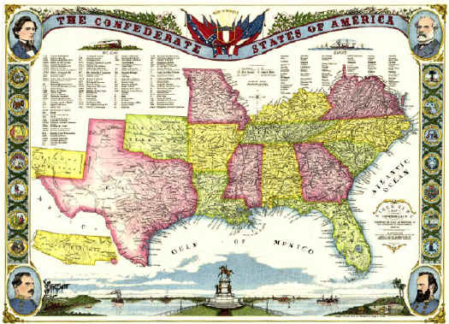
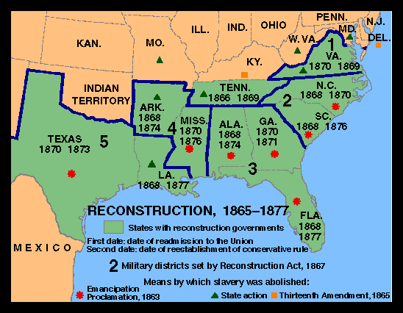
After The Great Awakening
The Great Disappointment

Slide 52
THE MILLENNIAL GLUE IS GONE!
NOTE: Correlation Isn’t Causation

Slide 53
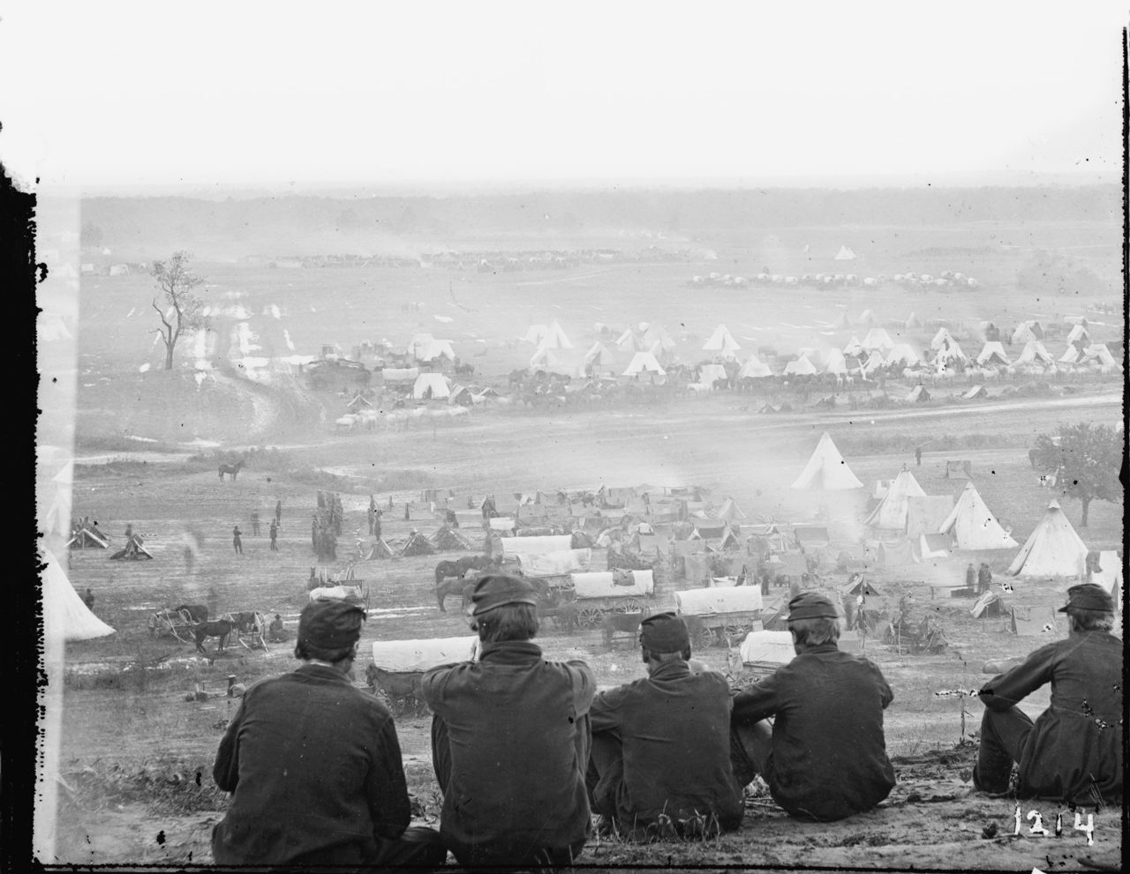
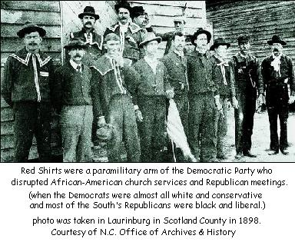
The Religious Landscape Changed Forever!

Slide 54
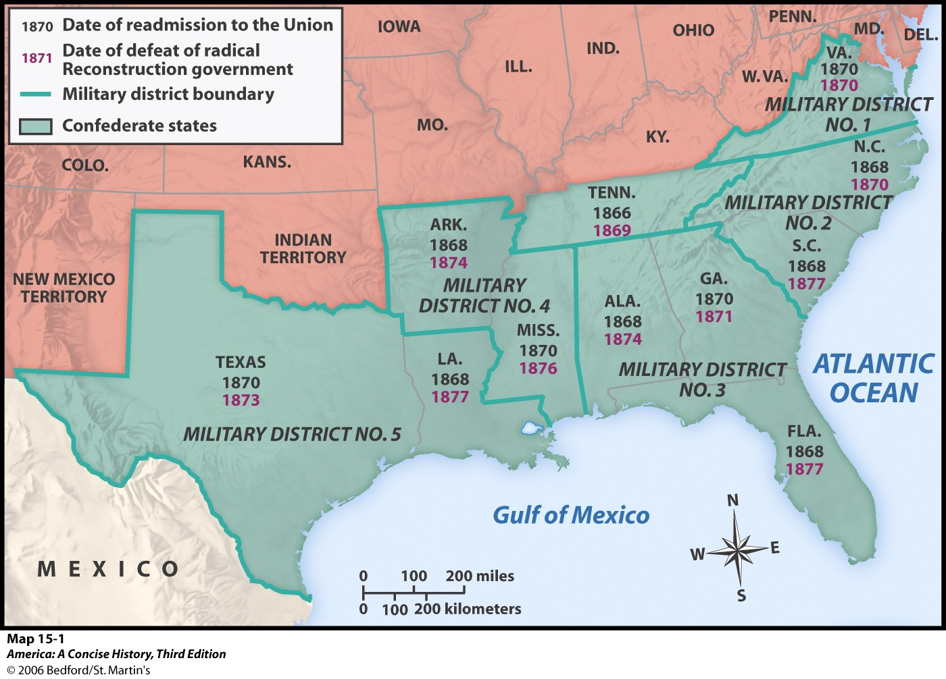
CORDONED RESTORATION

Slide 55
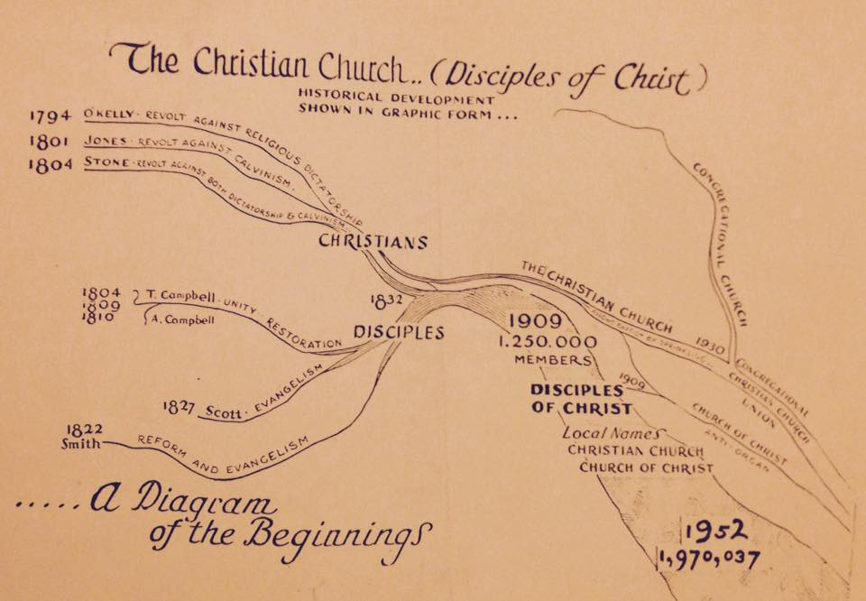

Slide 56


Slide 57
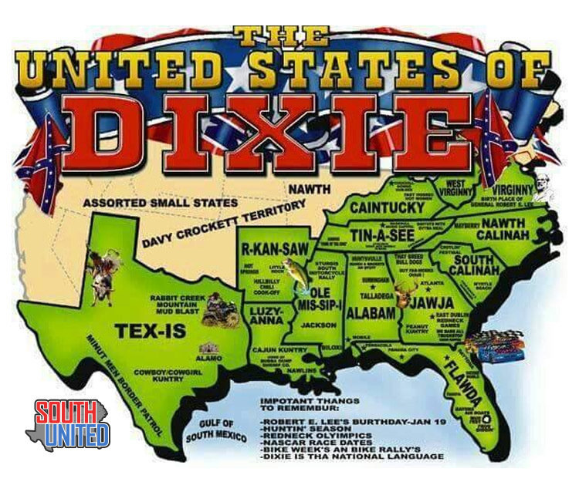

Slide 58
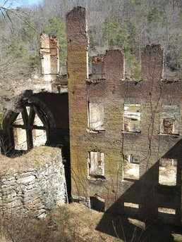
“In the postwar South, Methodists, Baptists, and Presbyterians remained separated from their northern counterparts. Furthermore, in the Reconstruction period, southerners found themselves overrun by northern occupation forces and opportunists. Consequently, southern culture maintained nostalgic views of the antebellum past, visions that reinforced southern resistance to change. In the postwar South, religion would become a crucial means of preserving traditional beliefs and customs associated with an idealized vision of antebellum Christian culture.”
Dixie: Old Times Not Forgotten

Slide 59
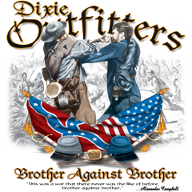
Civil War: Brother Faces Brother
From Flaws & Fissures To Faults
David Lee Burris:
Definition: Presentism - “Present-day standards of behavior are used to evaluate people who lived in the distant past – when such standards would have been unthinkable.”; James A. Garfield -
“If there is one thing on this earth that mankind love and admire better than another, it is a brave man; It is the man who dares to look the devil in the face and tell him he is a devil.”; On The Evil Of Slavery Was “Inclined To Believe That The Sin Of Slavery Is One Of Which It May Be Said That Without The Shedding Of Blood There Is No Remission.”
J. W. McGarvey -- “We will not take up arms against, fight and kill the brethren we have labored for twenty years to bring into the kingdom of God.”
“The Texas chaplain told of his friend, Alf Johnson, who when he saw wounded federal soldiers beg for medical help, instead ruthlessly shoot them… Graham asked Hall how he could feel this way toward his brethren in the North, and Hall replied that they were all infidels.”
The Hollywood Epic Length “Gods & Generals” Was Limited Still
Independence Declaration Ideals Constitutionally Compromised
Plus 100 Years: Concept Of National Sin Causes Regional Conflict
Causes Church Loss Of Moral Authority & Divisions North-South
Both Campbell’s & Barton Stone’s Sons Wore Confederate Grey {Campbell Family Slaveholders & After War Stand Stayed Same}
War & Conscience by Allen Isbell on page 189: “…(Future U. S. President) Garfield delivered recruiting speeches on the steps of many churches(of Christ) through the Western Reserve.”

Slide 60



Slide 61
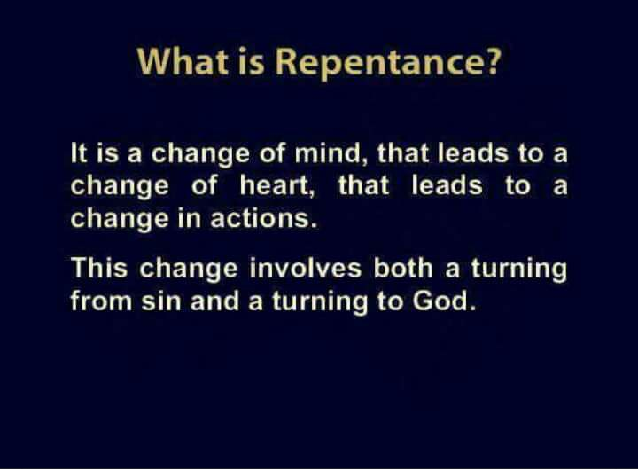

Slide 62
The Concept Of Corporate Repentance:
“Throughout church history, leaders have changed their teachings to comply with better understanding of Scripture. This represents a form of corporate repentance. To be alive, the church must be dynamic entity – not just in numbers but in spiritual maturity. Growth in knowledge and understanding is mandated in Scripture (2nd Peter 3: 18). This requires the ongoing repentance of inferior understanding and adoption of better understanding. Such a repentance is a function of leadership.”
- Church Of God\ Bible Advocate\ April - May 2008

Slide 63
Civil War: Brother Faces Brother
From Flaws & Fissures To Faults
David Lee Burris:
Definition: Presentism - “Present-day standards of behavior are used to evaluate people who lived in the distant past – when such standards would have been unthinkable.”; James A. Garfield -
“If there is one thing on this earth that mankind love and admire better than another, it is a brave man; It is the man who dares to look the devil in the face and tell him he is a devil.”; On The Evil Of Slavery Was “Inclined To Believe That The Sin Of Slavery Is One Of Which It May Be Said That Without The Shedding Of Blood There Is No Remission.”
J. W. McGarvey -- “We will not take up arms against, fight and kill the brethren we have labored for twenty years to bring into the kingdom of God.”
“The Texas chaplain told of his friend, Alf Johnson, who when he saw wounded federal soldiers beg for medical help, instead ruthlessly shoot them… Graham asked Hall how he could feel this way toward his brethren in the North, and Hall replied that they were all infidels.”
The Hollywood Epic Length “Gods & Generals” Was Limited Still
Independence Declaration Ideals Constitutionally Compromised
Plus 100 Years: Concept Of National Sin Causes Regional Conflict
Causes Church Loss Of Moral Authority & Divisions North-South
Both Campbell’s & Barton Stone’s Sons Wore Confederate Grey {Campbell Family Slaveholders & After War Stand Stayed Same}
War & Conscience by Allen Isbell on page 189: “…(Future U. S. President) Garfield delivered recruiting speeches on the steps of many churches(of Christ) through the Western Reserve.”

Slide 64
After The Civil War: Testing Boundaries
Many Issues That Were Before The War Started Up Again
  ACMS & The Instrument Of Music In Worship – Next 40 Years Takes Its Toll
  Can Christians Fight In War Or Participate In Governmental Activities – e.g. President Garfield {His Freemason Affiliation Also Of Concern}
Alexander Campbell Dies March 4, 1866
1866 Christian Standard Begins With Isaac Errett As Editor – Devoted To A More Progressive Approach To Christianity
1866 The Gospel Advocate Restarts With Tolbert Fanning And A Young David Lipscomb As Co-Editors
1869 Henderson, Tennessee, Henderson Male & Female Institute Begins, Root School Out Of Which Would Later Come Freed-Hardeman University

Slide 65
David Lee Burris: TO MORE OF AN EMPHASIS ON STONE
David Lipscomb Along With Tolbert Fanning & Ben Franklin Were Against The Missionary Society Approved By Alexander Campbell; Of 10,900 Restoration Movement Congregations Only 559 Of Those Outside The Region Sympathetic To The Confederacy Sided With The Church Of Christ; Figures From 1830 American Almanac Reveal The Early Membership At ~ 30,000 & In-House Approximation At 1850 At 300,000 – A Ten Fold Increase In One Generation. The Growth Rate 10 Years Prior To The Civil War Up To Moses Lard’s Estimate In 1866 Of A Half Million Show Indications Of A Slowing Of Momentum & So Do Department Of Interior Estimates Of Accommodations Size Included With Property Valve From The Period Between 1850 & 1870. Unfortunately, There Are No Measures Of The Interval Between 1850 & The Critical Year 1860 To See If Progress Had Plateaued With The Advent Of Fraternal Hostility.
During The Time Of David Lipscomb
Following Civil Society Failure We Find
Non-Engagement & Non-Participation
“Assassination can no more be guarded against than death by lightning, and is not best to worry about either.” – James Garfield

Slide 66

David Lee Burris: TO MORE OF AN EMPHASIS ON STONE
David Lipscomb Along With Tolbert Fanning & Ben Franklin Were Against The Missionary Society Approved By Alexander Campbell; Of 10,900 Restoration Movement Congregations Only 559 Of Those Outside The Region Sympathetic To The Confederacy Sided With The Church Of Christ; Figures From 1830 American Almanac Reveal The Early Membership At ~ 30,000 & In-House Approximation At 1850 At 300,000 – A Ten Fold Increase In One Generation. The Growth Rate 10 Years Prior To The Civil War Up To Moses Lard’s Estimate In 1866 Of A Half Million Show Indications Of A Slowing Of Momentum & So Do Department Of Interior Estimates Of Accommodations Size Included With Property Valve From The Period Between 1850 & 1870. Unfortunately, There Are No Measures Of The Interval Between 1850 & The Critical Year 1860 To See If Progress Had Plateaued With The Advent Of Fraternal Hostility.
DAVID LIPSCOMB STATED:
“Be true to the truth, oppose the error,
but forbear with humanity!”

Slide 67

A PREACHER WHO WOULDN'T DO
A church was in need of a preacher. One of the elders was interested in finding out just what kind of a preacher the church wanted. In order to do this he composed a letter as though it had been received from a preacher and read it to the committee selecting a new preacher.
"Gentlemen:
Understanding that you need a preacher, I would like to apply for the position. I have many qualifications that I think you would appreciate. I have been blessed to preach with power and have some success as a writer. Some say that I am a good organizer. I have been a leader in most places I have gone.
Some folks, however, have some things against me. I am over fifty years of age. I have never preached in one place for more than three years at a time. In some places I have left town after my work caused riots and disturbances. I have to admit that I have been in jail three or four times, but not because of any wrong-doing. My health is not too good, though I still get a good deal done. I have had to work at my trade to help pay my way.
The churches I have preached in have been small, though located in several large cities. I have not gotten along too well with the religious leaders in different towns where I have preached, and I am sure that they will not recommend me. In fact, some of them have threatened me, taken me to court, and even attacked me physically. I'm not too good at keeping records. I have been known even to forget whom I have baptized. However, if you can use me, I shall do my best for you, even if I have to work to help with my support."
The elder read this letter to the committee, and asked if they were interested in the applicant. They replied that he would never do for their church. They were not interested in an unhealthy, trouble-making, contentious, ex-jailbird; and were insulted that his application had ever been presented! But one of them did ask the preacher's name and the elder replied, "The Apostle Paul."

Slide 68
Post- Restoration Indices:
Divisions - & - Separations

Slide 69
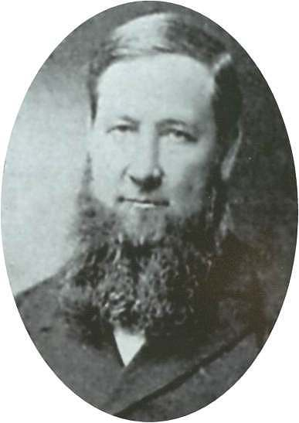
Sand Creek Meeting
August 18, 1889, Shelby County, Illinois
An annual gathering place of
conservative Disciples since 1871
Above 6000 in attendance
Daniel Sommer (1850-1940) presented the gospel in two speeches
  Speech one outlined the differences that took place within the disciples movement
  Speech two, in the afternoon, was an evangelistic sermon
  A formal signing of a written declaration to separate from liberal Disciples was signed

Slide 70
Sand Creek Meeting
Sommer discussed the intention
of the “Declaration and Address” of
September 7, 1809 by T. Campbell
He reviewed the distinctive position of Disciples between faith and opinion, and between testimony and inference
He then discussed the effect it had on the Disciples - - Two Different Approaches Since 1832
  Men who held that the plea for unity at all costs was paramount
  Men who regarded the restoration principle as paramount
Lastly, a bold charge that the former had abandoned soundness, and through innovation had “produced evils plaguing the brotherhood”

Slide 71
Sand Creek Meeting
Sommer Charged — Disciples
Innovation Included:
  One-Man Pastorates
  Missionary Societies
  Modern Methods of Raising Money
    Ladies Festival in one Ohio church to raise money for curtains and carpet for the meetinghouse
    Children with “brown jugs on begging expeditions”
    Box Suppers and Pound Parties
  Instrumental Music In Worship
Claimed That Urban Churches Were The Main Culprits In This Departure

Slide 72
Breakdown Of Movement
Class | Conservatives | Liberals
Religious Authority | Faith/Testimony | Opinion/Inference
Church Government | Plurality Of Bishops | One-Man Pastorate
Preaching The Gospel | Through The Church | Through Missionary Society
Finances | Giving Through Simplicity | Fairs, Festivals & Begging
Music | Congregational Singing | Instrumental Music
Character of Members | Poor, pious, simple, humble, peace-loving, honest | Rich, shameless, arrogant, divisive, “usurpers of other men’s labors”

Slide 73
Confluence Conversed
Campbell & Stone Group
Backwards Bifurcated

Slide 74


Thomas Campbell’s Assessment: The Two Principles In Tension
David Lee Burris:
Thomas Confessed He Had Overlooked The Importance Of Baptism In His Efforts To Obtain Christian Unity!
“The authority of primitive Christianity and obligation of Christian unity should be cooperative and mutually corrective.”

Slide 75
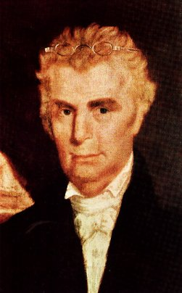
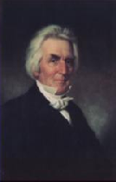
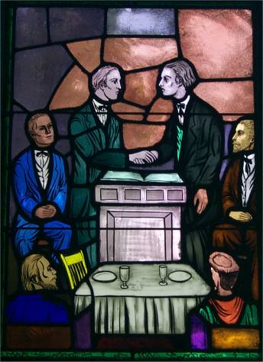
Growth And Departures
Christians & Disciples Together In 1832 & Slow Separate By 1912

Slide 76
After The Civil War Cont.
1884 – Firm Foundation Begins In Austin, Texas, Austin McGary Editor
1891 – Nashville Bible School Begins, Later Lipscomb University
In The 1906 U.S. Census The Church of Christ And The Christian Church Was Recognized As Different Entities
*March 1917: Christian Church & Disciples Split @Hermeneutic

Slide 77
CHRISTIAN DISUNITY &
Restoration Divergence
RELIGIOUS UNIFICATION MOVEMENT
RESULTS IN THREE CHURCHES:
CHRISTIAN CHURCH
DISCIPLES OF CHRIST
CHURCHES OF CHRIST

Slide 78
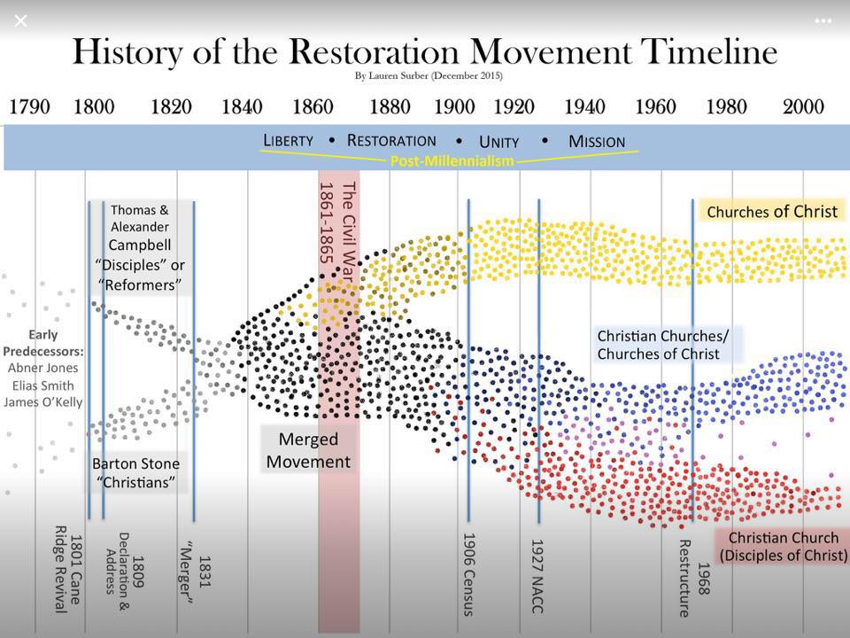

Slide 79
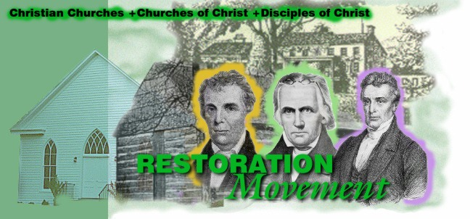
MODERNISM &
WORLDLINESS

Slide 80
Review of David Edwin Harrell’s
“Emergence – ‘Church Of Christ’ – Denomination”
From Conservative & Exclusive Into Liberal & Tolerant Church
Worker Class & Fervent Faith Into Worldly Wealthy & Satisfied
Sect (The Truth/Thee Church) Into Denomination(Less Dogmatic)
Divergence - Different Christianities – Doctrinally Inconsequential
Census: Bifurcation Disciples & Christians Socio-Economic Status
With Each: Three Cycles Of Separation Started - Completed Since
Index: Liston Pope’s - 21 Item List - Transition Progress Criteria
*
“The New Testament is loaded with the sociological (sect-to-denomination process) message. Again and again Jesus said that His message was peculiarly
directed to the poor. James (2:5) clearly states the case: ‘Hearken, my beloved
brethren, Hath not God chosen the poor of this world rich in faith, and heirs of
the kingdom which he hath promised to them that love Him?” …
In 1st Corinthians 1:26 the Apostle Paul includes not only wealth but also success and sophistication as barriers to spiritual success: ‘For ye see your calling, brethren, how that not many wise men after the flesh, not many mighty, many noble, are called’.” 3rd paragraph, pg. 8

Slide 81

Splintering Continues In The 20th Century
“Misunderstanding of the present grows fatally from the ignorance of the past.”
March, 1917 Major Controversy In The College Of The Bible Exists Over The Subject Of Higher Criticism, Leading To A Major Split Among Christians, Enter: The Disciples Of Christ
1920s Controversies With R.H. Boll Over Premillennialism
1930s & 40s Relative Quietness Due To Economic Depression & War
1950s To 1970s Battles Over Support Of Institutions/Sunday School/Located Preachers/Christian Colleges/etc.
1980 To Today – The Change Movement – New Hermeneutics/Worship Styles etc.

