Slide 1
sWitzerland protestantreformers v.“radical” rebaptizers
By David Lee Burris

Slide 2
Sociology Of Denominationalism Social Sources; H. Richard Niebuhr; 1929
“One will fail completely to understand Roman Catholicism if one blinds one’s eyes to influence of the Latin spirit and the institutions of the Caesars upon its conception of Christianity and its formulation of doctrine. The spirit and the doctrines of Lutheranism derive not only from the New Testament but from Luther’s German temperament & from the political conditions of the church in Germany. Calvinism was no less influenced in its temper & theology by national character and by the interests of the economic class to which it especially appealed…” pg. 16

Slide 3
Wealth Year One
WEALTH @1500

Slide 5
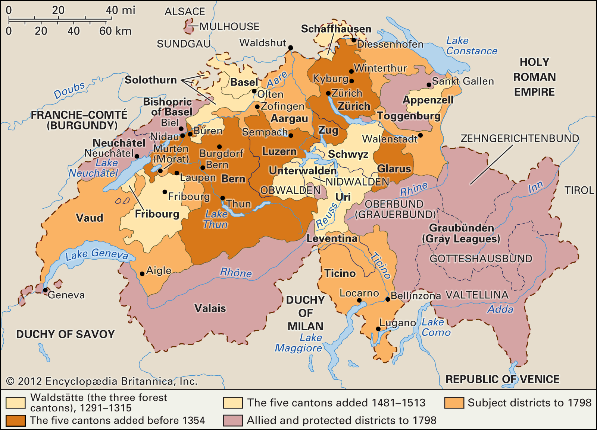

Slide 6
THE SWISS CANTON REFORM “Boundaries Drawn & Limits Set”
THE IMPORTANCE OF ULRICH ZWINGLI:
In the introduction of a book by Edward Peters: “Like Erasmus and Luther, Zwingli influenced the thought of reformers & Catholics alike, and the dissident strains of the Zurich reform movement influenced many communities and touched the reformation of England & Scotland. With Erasmus and Luther, Zwingli represents both traditional and novel strains of thought and programs for ecclesiastical and social reform.”

Slide 7
THE SWISS CANTON REFORM “Boundaries Drawn & Limits Set”
In the introduction of a book by Edward Peters:
“The intellectual and institutional world in which these men lived & worked was that of late medieval Christendom. They reflected & extended that world & the influence of their work helped to change it.”
“Erasmus was a former monk released from his vows who practiced the still-novel career of an independent man of letters. Luther was a professor of theology at the new University of Wittenberg in Saxony. His theological development was highly personal and concentrated upon the reform of dogma and the eradication of institutional abuses. Both men’s thought reached out into a wider and more cosmopolitan world. Erasmus was the friend of popes, the emperor’s tutor, a correspondent of kings, prelates, civil servants, and scholar’s alike. Luther came quickly to the attention of the highest authorities in the Christian world. Zwingli shared at different times the interests of Erasmus & Luther…

Slide 8
THE SWISS CANTON REFORM “Boundaries Drawn & Limits Set”
In the introduction of a book by Edward Peters:
“The intellectual and institutional world in which these men lived & worked was that of late medieval Christendom. They reflected & extended that world & the influence of their work helped to change it.”
“The reform programs of Erasmus and Luther concentrated upon learning, individual spiritual development, and broad problems of ecclesiology; hence, they appealed to a wide range of thought and could be applied across a broad band of social and political structures. Zwingli, on the other hand, concentrated his reform ideas upon a practical, almost juridical center and his work shaped the unique social institution created by the Reformation, the urban theocracy. His work in Zurich set the pattern for later reforms at Geneva under Calvin.”

Slide 9
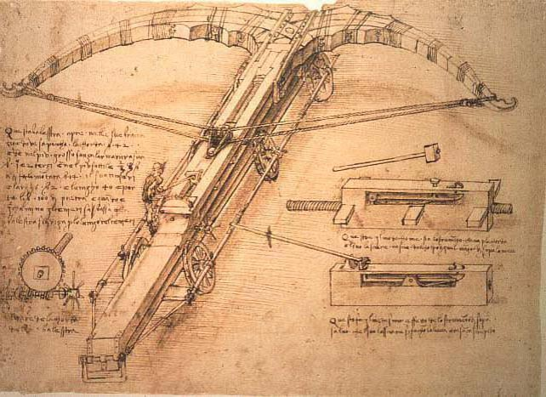
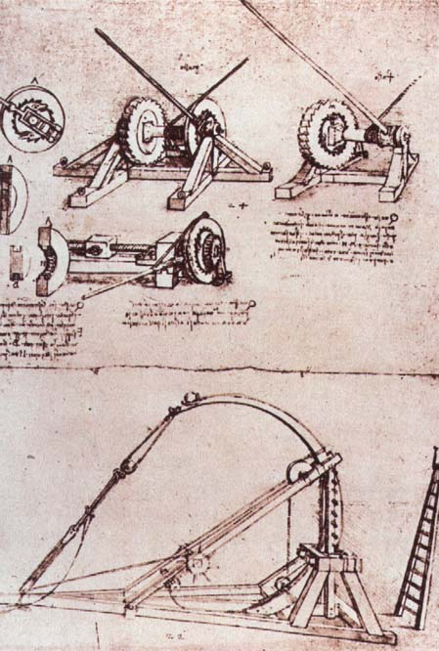
Epic Tales
Of Nemesis
Antagonists
Protagonists
Contemporary
Intergenerational
Intragenerational

Slide 10
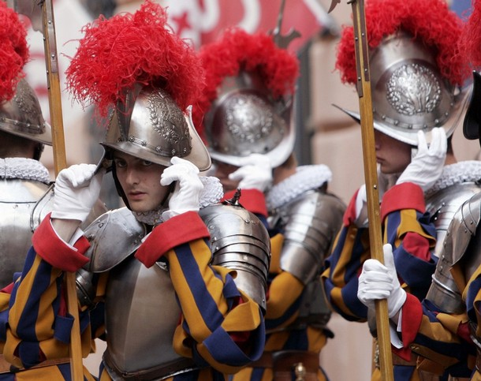
FAREWELL TO THOSE WHO WANT AN ENTIRELY PURE AND PURIFIED CHURCH. THIS IS PLAINLY WANTING NO CHURCH AT ALL!
Martin Luther

Slide 11
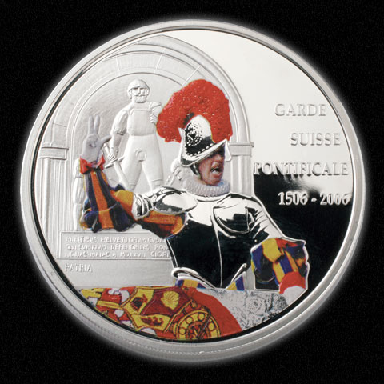
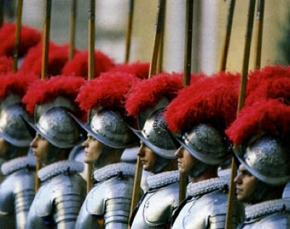
Rome was sacked by the troops of the Holy Roman Empire under Emperor Charles V in 1527. When the troops, mostly rabble and mercenaries, of the empire breached the city, they immediately ignored the orders of Charles and pretty much everyone else in command and made straight for Vatican Hill intent on pillaging the richest treasures in Christendom. They also had murder on their mind and Pope Clement VII was high on the list of targets. The famous Swiss Guards, who used to do more than just stand around looking pretty for tourists, formed a fighting square on the steps of St. Peter’s Basilica to face upwards of 20,000 bloodthirsty troops who were storming the city. Only 189 Guardsmen remained after the fighting to take the city, but these troops chose to make their stand in hopes of buying Clement time to escape the city through one of the warrens of tunnels under Rome. Clement made good his escape as the Guard managed to hold the porch of the church and prevent the doors from falling, but only 42 Swiss Guards survived and none of them were uninjured. This event once more proves that when the Swiss decide not to be neutral, they aren’t a bunch to take lightly.

Slide 12
The Church Across The Ages
David Lee Burris:
European Royal Dynasties – including Louie & Marie – related across national boundaries – uniformly used personal Swiss Body Guards – lacking basic trust in their own countrymen!
of people, events
life and faith from
Glimpses
ZURICH REFORM UNDER ZWINGLI
“Born in Wildhaus, Switzerland, on New Year’s Day in 1484, Zwingli received a good education in the classics and was ordained a priest in 1506. He served as parish priest in Glarus from 1506 to 1516.
A key event during that period aroused his patriotic fervor and perhaps began to undermine his confidence in the Roman church. One of the major industries for the Swiss then was mercenary service. They would hire out their young men to fight in others wars, including battles for the pope. (You can see the Swiss Guard today policing the Vatican in their colorful uniforms.) Zwingli accompanied the Swiss troops as chaplain in September of 1515, and saw 6000 of his young countrymen slaughtered in the service of the pope at the Battle of Marignan in Italy. He returned home determined to abolish the mercenary practice of ‘selling blood for gold.’ It would cost him his parish at Glarus but helped pave the way for his call to Zurich later.”

Slide 13
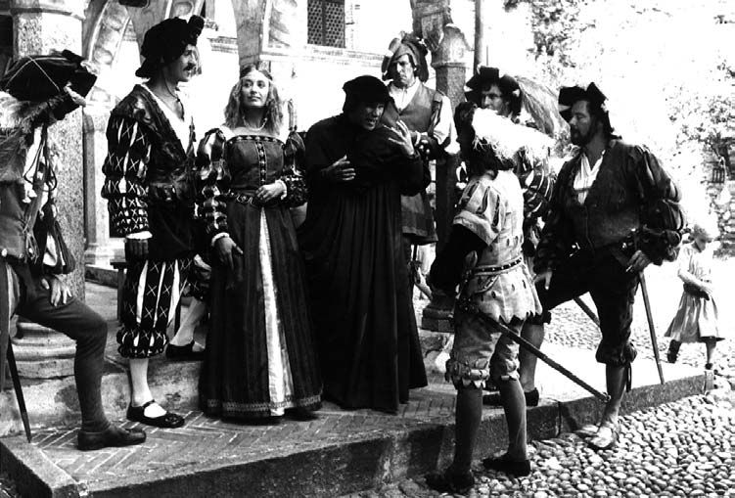
The Church Across The Ages
of people, events
life and faith from
Glimpses
ZURICH REFORM UNDER ZWINGLI
“The year 1516, was decisive for him. He moved on to become priest at Einsiedein, apparently put a sexual affair with a barber’s daughter behind him, and met the great scholar Erasmus. He immersed himself in the Greek New Testament published by Erasmus. (He actually hand copied out of this edition all of Paul’s epistles and learned them by heart.) His preaching began to take on a decidedly evangelical tone.
On January 1st 1519, his 35th birthday, he became pastor at the central church in Zurich. Here he was able to work toward prohibiting the mercenary service. As soon as he arrived, he announced that, rather than preach from prescribed texts of the lectionary, he was going to preach through the Gospel of Matthew. This was a bold step in that day!
The dreaded plague arrived in Zurich the same year as Zwingli. He did his best to minister to his people. More than one-fourth of the 9,000 people of the city fell victim. Zwingli caught the plague, too. In his three-month recovery, he learned life-changing lessons of man’s dependence on God that made his trust in God’s Word rock-solid.

Slide 14
The Church Across The Ages
of people, events
life and faith from
Glimpses
ZURICH REFORM UNDER ZWINGLI
“The rituals & doctrines of the Church did not square with his reading of Scripture. He preached what he found in the Bible – even when it meant going against long-accepted church teachings. As a result, controversy spread. A public debate was held on disputed matters of faith and doctrine by the Zurich city council. On January 29, 1523, the council issued a ruling backing Zwingli and issued a decree that he and the other pastors in the region were ‘to preach nothing but what can be proved by the holy gospel and the pure holy scriptures.’
Reforms were implemented, Catholic images removed, the mass replaced with a simplified service emphasizing preaching, and communion celebrated more as a‘spiritual’ reception of Christ.”

Slide 15
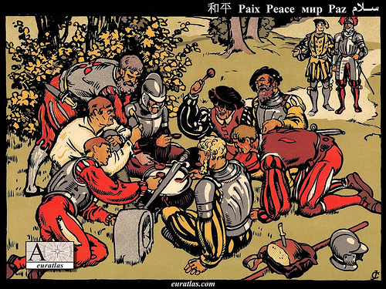
The first war of Kappel was a conflict in 1529 between the Protestant and the Catholic cantons of the Swiss Confederacy. It ended, without any battle, with the first peace of Kappel. Under the lead of Ulrich Zwingli, the Protestant canton and city of Zürich had concluded with the other Protestant cantons a defence alliance. The Catholic cantons in response had formed an alliance with Austria. After numerous minor incidents and provocations from both sides, Zürich declared war on 8 June and marched to Kappel at the border to Zug. By mediation of the Federal Council, open war was barely avoided. Legend has it that instead of fighting, the two armies peacefully shared a milk soup, the Kappeler Milchsuppe, cooked in a pot placed exactly on the cantonal border between Zürich and Zug, while a peace was negotiated. The Catholics provided the milk, the Protestants the bread.

Slide 16
The Church Across The Ages
of people, events
life and faith from
Glimpses
ZURICH REFORM UNDER ZWINGLI
“Despite this vote of confidence, Zwingli could expect that the Catholic loyalists would resist him, and they did. He did not expect that perhaps his greatest trials would come from within – some of his closest followers were not content with the speed at which he was pressing the church reforms. They became known as Anabaptists. They were particularly agitated over the practice of infant baptism, which they rejected. Another public debate was called to consider the issue. The Zurich council ruled against the Anabaptists, so these ‘radicals’ defied the council. They ‘re-baptized’ themselves as adult believers. When they continued in their legal defiance, some were put to death.”

Slide 17
MAJORITARIAN
MAGISTERIALS

Slide 18
“The militant, Constantinian Mindset carried into the Protestant Reformation. So long as they remained a persecuted minority, Reformers generally decried the use of violence for religious purposes. But once given the power of the sword, most used it as relentlessly as it had previously been used against them. Indeed, with the exception of the Anabaptists, every splinter group of the Reformation in the 16th & 17th centuries spilled blood. Lutherans, Calvinists, Anglicans, and other Protestant groups fought each other, fought the Catholics, & martyred Anabaptists & other ‘heretics’”.
- Gregory Boyd, Myth Of A Christian Nation

Slide 19
"You can stand tall without
standing on someone. You can
be a victor without having victims."
~ Harriet Woods

Slide 20
"Power always thinks it has a
great soul and vast views beyond
the comprehension of the weak;
and that it is doing God's service
when it is violating all his laws."
~ John Adams

Slide 22
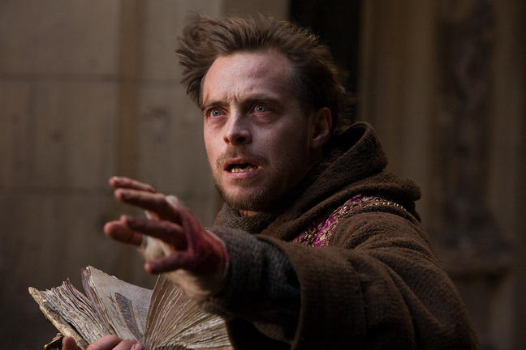

Slide 23
The Church Across The Ages
of people, events
life and faith from
Glimpses
Reformation Radicals: THE ANABAPTISTS
“The Anabaptists (or ‘re-baptizers’) were one of several smaller groups in church history that endured unspeakable suffering to establish and maintain their witness.
They began in the midst of reform at Zurich under Zwingli in the 1520’s. Some felt that Zwingli and the reform there were not going far enough or fast enough. More was needed, they felt, than to reform a corrupt, unfaithful church. They wanted to return to a New Testament church.”

Slide 24
The Church Across The Ages
of people, events
life and faith from
Glimpses
Reformation Radicals: THE ANABAPTISTS
“Two issues are important to mention. First, they thought that reformers like Luther and Zwingli were still captive to a political marriage of church and state. The Anabaptists insisted that the church be separate, govern itself, and have no official ties to the state. This sounds rather sane and acceptable to us today, but then it set off a frightening explosion. Throughout history until that time, religion and government had always been linked together.
Second, these believers could find nothing about infant baptism in the Bible, so they concluded it was an invention of a corrupt church, and therefore illegitimate. They would get baptized all over again as believers & form a believer’s church that was composed only of the converted.”

Slide 25
The Church Across The Ages
of people, events
life and faith from
Glimpses
Reformation Radicals: THE ANABAPTISTS
“Zwingli gave them room at first, and a public debate on baptism was held at Zurich in 1525. The conclusion by the council: infant baptism was to be main- -tained. The dissidents did not accept the council’s judgment & continued to press their points & stir unrest. When they would not accept ‘correction,’ scores were jailed and drowned.’”

Slide 26
The Church Across The Ages
of people, events
life and faith from
Glimpses
Retro Church: Underground
“One of the early Anabaptist leaders was Michel Sattler. Born around 1490 in southwestern Germany, Sattler became a monk at the monastery of St. Peter’s of the Black Forest and rose to the position of Prior, next in authority to the Abbot. Disillusioned by the corruption he saw in church life, perplexed by his study of the Bible, and moved by the horrible conditions of peasant life, Sattler left the monastery. He was a man in painful search for truth. He lived for a while with Anabaptists nearby Zurich, becoming familiar with their convictions, as he learned the weaver’s trade to support himself.”

Slide 27
The Church Across The Ages
of people, events
life and faith from
Glimpses
Retro Church: Underground
“Sattler’s association with with Anabaptists led to his arrest in 1525 at Zurich, but he was released once he renounced Anabaptism and agreed to permanently leave the Zurich area.
In 1526, he married Margaretha who had recently left a Catholic religious community of women. She would prove a courageous companion for the brief marriage they shared.
Sattler’s convictions strengthened, after a while he came back to the Anabaptists, or the Swiss Brethren, as they were then called. The movement was spreading, but severely opposed, practically everywhere. It attracted its fair share of colorful opinionated dissidents. It had no structure. Pressure from without, combined with confusion and discord from within, threatened the survival of the embryonic Anabaptist Brethren cause.”

Slide 28
The Church Across The Ages
David Lee Burris:
This Today’s Basic Creed Of Mennonites – Amish – Hutterites –Brethren In Christ, etc.
of people, events
life and faith from
Glimpses
“A secret meeting of the Anabaptist’s key leaders was convened in Schleitheim, Switzerland on February 24, 1527. A confession was drawn up to try to bring some order within their ranks. Scholars are convinced it was former monk, Michael Sattler, drawing upon his own disciplined structured monastery experience who wrote the ‘Schleitheim Confession’ which was at first titled The Brotherly Union of Some Children of God. It was the necessary catalyst to give these Swiss Anabaptist Brethren a needed sense of identity and direction.”
Anabaptist Manifesto Seven Points: 1) Baptism 2) Banning 3) Communion 4) Worldliness 5) Ministerial 6) Pacifism 7) Swearing

Slide 29
The Church Across The Ages
of people, events
life and faith from
Glimpses
Retro Church: Underground
“Sattler moved on to take up pastoral duties at Horb, an area under the Austrian control of Ferdinand, an aggressive Catholic persecutor of alleged heretics. Michael, his wife, and others were arrested and kept in jail for nearly twelve weeks. He was brought to trial and his calm, reasoned, and brilliant defense of his now fervently held Ana- -baptist convictions failed to move his accusers. Awaiting death, he wrote to his flock: ‘In such dangers I have surrendered myself to the will of the Lord and am, with all my brothers, my wife, and some other sisters, prepared for witness to him even unto death.’
On May 20, 1527, his tongue was cut out, he was tortured, and then burned alive. As the flames consumed him, he held up his forefingers as a prearranged sign to his fellow believers, verifying that God would give the strength to endure faithful to the end. A few days later, after refusing a final opportunity to recant, Margaretha followed her husband in martyrdom and was drowned.”

Slide 30
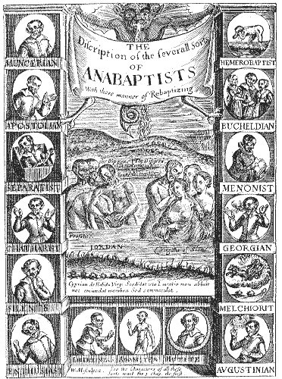
David Lee Burris:
So Reasoned Do To The Great Excess Of Female Converts.
Practicing Polygamists!

Slide 31
“Anabaptism” is an umbrella designation for the groups in the radical Reformation that rejected infant baptism in favor of adult commitment as basis for becoming a Christian and forming a Christian community.

Slide 32
Radical Reformation Period Inclusive Of Socinian Rationalists, Zwickau Militant Socialists & Ana-baptists

Slide 33
Three early German-speaking Anabaptist groups first emerged in the 1520’s. They were the Swiss Brethren, the South German and Austrian Anabaptists, and finally, the Hutterites, who were really an outgrowth of Austrian Anabaptism.
1525 is the official beginning of Anabaptism proper, if we go by the date when the first adult baptisms were conducted.

Slide 34
The early Swiss Anabaptists drew different conclusions than Zwingli as regards sola scriptura. They thought him wrong and accused him of selling out to magistrates by not opposing the traditional system of tithing and agreeing to a timetable compromise for the gradual removal of images and for the end of the Catholic Mass in church services.

Slide 35
“Why,” they questioned, “should the imperatives of God’s word make concessions to worldly city politicians?”
JUSTIFICATION BY FAITH ALONE:
They asked, “If human beings were saved by faith alone, and precognizant infants did not have faith, what sense did infant baptism make?

Slide 36
The Anabaptists started to interpret New Testament passages pertaining to the relationship between faith and baptism in a different way than magisterial reformers did.
For example, the Gospel of Mark, chapter 16, verse 16, refers to the “one who believes and is baptized; with that, one shall be saved.” They took this as implying a sequential relationship between them.

Slide 37
WHAT WAS THE BIG DEAL? Specifically, in a society in which everyone was baptized as an infant, the sacrament also doubled as a rite of passage into the community. To refuse to have one’s child baptized was repudiation of the community. Moreover, it was taken as a defiant gesture to the community authorities.
For Zwingli, membership in the Church and citizenship were two sides of the same coin. For him, you could not opt out of one and still be part of the other.

Slide 38
MAJORITARIAN
MAGISTERIALS

Slide 39
“Why,” they questioned, “should the imperatives of God’s word make concessions to worldly city politicians?”
INNER BAPTISM OF THE MATURE:
Traditional infant baptism, whether it was practiced by Catholics or magisterial Protestants, was for them nothing more than the superstitious pouring of water on an unthinking being. They described it in that banal a language.

Slide 40
The term “Anabaptism” means “rebaptism.” It’s a term of opprobrium, of insult, used by the enemies of Anabaptists. For them, of course, this was not a rebaptism at all. It was a first baptism that took the place of what never really was a baptism to begin with – infant baptism!

Slide 41
Anabaptists (“re-baptizers” from the Greek) were Christians who believed that infant baptism was not valid.
They “re-baptized” adults who had been baptized as infants.
Distinctive principles included:
Restoration of “primitive Christianity,” including the rejection of oaths and capital punishment, and the refusal of roles in civil government.
Congregational
Decisionmaking

Slide 42
Distinctive principles included:
Belief in the absolute supremacy of the Bible as sufficient for faith, but with private inspiration playing an important part.
Rejection of infant baptism and the doctrine of justification by faith alone.
Holding of goods in common was to be the underlying principle of new Kingdom of God.

Slide 43
NOT TRUE!

Slide 44
Anabaptist Doctrinal Emphases:
“Therefore we beg and admonish thee as a brother that thou wilt take earnest heed to preach only the divine word without fear, to set up and guard only divine institutions, to esteem as good and right only what may be found in pure and clear Scripture, to reject, hate, and curse all devices, words, customs, and opinions of man, including thine own… whatever we are not taught by clear passages or examples must be regarded as forbidden.” – Conrad Grebel

Slide 45
VOLUNTARY ASSOCIATION:
“One cannot and should not compel anyone to accept the faith, for faith is a free gift of God: (therefore) the church of Christ endures persecution but doesn’t persecute!”

Slide 46
Faith Bonding Through Banning:
“In order to preserve the purity of the church excommunication was rigorously enforced. The ethical emphasis & seriousness of the effort to have a church of the pure alone are shown by the fact that the ‘ban’ has been the major cause of division within the Anabaptist ranks.”
- Church History, E. Ferguson

Slide 47
Principles & Emphasis In Combination:
Their Very Basic & Supreme Conviction In Non-Separatism; They Explained That They Were Not Separating From Rome But Rome Separated From Them & That They Were In Continuation Of Biblical & Earlier Christianity!
WHY WOULD THIS ATTITUDE OF IDENTITY HOLD PROMISE?
*** PLEASE DISCUSS ***
~ CLASS DISCUSSION ~

Slide 48
1524
1524 Anabaptist Pronunciamento:
“Just as our forebears [the Roman Catholic Church] fell away from the true God and knowledge of Jesus Christ and of the right faith in him, and from the one true, common divine word, from the divine institutions, from Christian love and life, and lived without God’s law & gospel in human, useless, un-Christian customs & ceremonies, and expected to obtain salvation therein, yet fell far short of it, as the evangelical preachers Luther & Zwingli have declared; so today, too, every man wants to be saved by superficial faith, without fruits of faith, without love and hope, without right Christian practices, and in the common ritualistic and anti-Christian customs of baptism and of the Lord’s Supper. In respecting persons & in manifold seduction there is grosser and more pernicious error now than ever has been since the beginning of the world.”

Slide 49
1538
The Berne Colloquy To The Reformed Church Leaders:
“While yet in the national church, we obtained much instruction from the writings of Luther, Zwingli, and others, concerning the mass & other ceremonies, that they are vain. Yet we recognized a great lack as regards repentance, conversion, and the true Christian life. Upon these things my mind was bent. I waited and hoped for a year or two, since the minister had much to say of amendment of life, of giving to the poor, loving one another, and abstaining from evil. But I could not close my eyes to the fact that the doctrine that was preached and which was based on the Word of God, was not carried out. And although the mass and the images were finally abolished, true repentance and Christian love were not in evidence. Changes were made only as concerned external things...”

Slide 50
Zwingli LED THE PROTESTANT REFORMER OPPOSITION TO ADULT RE-BAPTISM
David Lee Burris:
Heinrich Bullinger was the conciliatory successor to Zwingli & after he was removed from the religious scene most Zwingli groups merged with those of Calvin forming the Reformed Churches of Switzerland.

Slide 51
MAJORITARIAN
MAGISTERIALS

Slide 52
VOLUNTARY ASSOCIATION:
“One cannot and should not compel anyone to accept the faith, for faith is a free gift of God: (therefore) the church of Christ endures persecution but doesn’t persecute!”

Slide 53
ALL CONSIDERED
ADULT CONVERSION
AS CULTURALLY ALIEN

Slide 54
1529
The Same Diet Of Spires – Which Protested Restrictions Of Religious Liberty – Condemned Anabaptists:
“Every Anabaptist and rebaptized person of either sex should be put to death by fire, sword, or some other way.”

Slide 55
1551
The Diet Of Augsburg Decreed:
“Judges and jurors who have scruples against pronouncing the death sentence on Anabaptists will be removed from office and punished by fine and imprisonment.”

Slide 56
THE M I L L S T O N E
MATTHEW EIGHTEEN: VERSE SIX
OFTEN APPLIED LITERALLY
IN PROTESTANT INQUISITION

Slide 57
1528
The Count Of Alzey in area of the Palatinate, after he had 350 Anabaptists executed, exclaimed:
“What shall I do, the more I kill, the greater becomes their number!”

Slide 58
Pretext: Text Outside Of Context
David Lee Burris:
Hubris Followed By Nemesis – God Of Arrogance Precedes Goddess Of Vengeance
Webster’s Definition Of Pretext: A purpose or motive alleged or an appearance assumed in order to cloak the real intention or state of affairs.
Previous To Pretext: Fear & Pride

Slide 59
Reason For Resistance To Re-Baptism Ana-Baptists: Light - End Of Tunnel – Oncoming Train Opposition Invested: Out On Far Limb - Good / Evil Decision Tree
Counter-Intuitive Doubting:
“The Philosophy Of One Century Is The Common Sense Of The Next.”
Henry Ward Beecher
Derailment Of Entrainment Thought:
“The low. almost imperceptible process, part biological, part
cognitive, by which people adapt
& eventually adopt, the prevailing
rhythms surrounding them.”
“Traditio” – ritual handed down generation to generation supposedly from church fathers. A situation similar to the twisted traditions addressed by Jesus in the Beatitudes; Ritual Tradition – incremental from deathbed exception to routine norm. The necessity of clinical baptism of Constantine by pouring was now the convenient option preferred by the healthy. The family baptism of believers in the early church is now an infant initiation equivalent to that of the circumcision administered by the priesthood of the old law. Both paedocommunion and paedobaptism are commonplace.
Not any understanding adults have been baptized by immersion and as an act of obedient conscience for about 1,000 years. Incrementalism of Dialectic Synthesis; Negative cascading consequences of wrong previous decisions: Luther uses this as an argument that to accept this Anabaptist tenet would be to suggest that no one had been saved in a millennium and all were burning in Hell. This is inconceivable to him. He believes the infant practice an “adiaphora” or an innovation indifferent to God. He was especially against it due to the introspection associated with such an act.

Slide 60
Reason For Resistance To Re-Baptism Ana-Baptists: Light - End Of Tunnel – Oncoming Train Opposition Invested: Out On Far Limb - Good / Evil Decision Tree
David Lee Burris:
Zwingli Was Ready To Compromise Over Infant Baptism For Sake Of Unity But The AnaBaptists In His Flock Refused To Follow Along. Zwingli Eventually Turned Against Them As Both Enemies Of Church & State. They opposed the state in this world and tended to undermine the military. Initially they were theocratic in orientation but from an early negative experience they had adopted a pacifist position.
Those baptized by John - REBAPTISED!
Counter-Intuitive Doubting:
“The Philosophy Of One Century Is The Common Sense Of The Next.”
Henry Ward Beecher
Derailment Of Entrainment Thought:
“The low, almost imperceptible process, part biological, part
cognitive, by which people adapt
& eventually adopt, the prevailing
rhythms surrounding them.”
Additionally, Luther feared the possibility people would want to repeat a ceremony meant to be done only once. Furthermore, there was a consensus in the conventional wisdom of the time that everyone should be baptized only once.
Moreover, Zwingli also was incensed and added to the debate. Zwingli went so go far as to suggest that infants can have faith - quoting as passage proof – Luke 1: 41. Agreeing to the re-baptism proposition to take care of oneself seems at the same time to be admitting that our dearly departed loved ones have in an innocent ignorance earned an eternal punishment. Furthermore, this is was not an asymmetrical argument with the AnaBaptists that could be somehow compromised. They even utilized this concept aggressively in terms of an evangelism tool with an terrible tendency and unfortunate consequences. Their expressed conviction at the least closed doors of opportunity – however, it usually aroused anger and sometimes heated hostility. Re-baptism, although absolutely accurate theologically – in the Middle Ages went against the grain - both emotionally and intellectually. The Dark Age mentality could not even admit to the witness of their own eyes when Galileo proved Aristotle wrong – their thinking had become locked and completely entrained.

Slide 61
Reason For Resistance To Re-Baptism Ana-Baptists: Light - End Of Tunnel – Oncoming Train Opposition Invested: Out On Far Limb - Good / Evil Decision Tree
Counter-Intuitive Doubting:
“The Philosophy Of One Century Is The Common Sense Of The Next.”
Henry Ward Beecher
Derailment Of Entrainment Thought:
“The low, almost imperceptible process, part biological, part
cognitive, by which people adapt
& eventually adopt, the prevailing
rhythms surrounding them.”
Ritual Rationale – An argument of attack was seldom made according to spiritual rescue – a regime cleansing from an inheritance of original sin. Rather more frequently a weaker defensive position was taken identical to that offered for the “benign custom” of arranged childhood marriage. Both were treated as legally valid although empty signs that were not rendered efficacious until respectively either confirmed or consummated. Another after marriage illustration of comparison noted that after being matched as children any incidents of infidelity and adultery could be straightened simply by way of a willingness to forgive and/or reconcile – it did not require contractual remarriage – because the childhood marriage was still valid according to law.
The Swiss Reformed specifically stated that infant baptism was a sign of future faith like was circumcision – an indication that the child will be raised in covenant community and loving family as a Christian and valid until the youth makes profession of faith which makes them also a member of the universal church. I speculate that this also is most probably that time period commencing the Roman Catholic practice of newborn Godparent selection. I do not believe there is any fixed date of doctrinal departure for this specific practice so this is only an educated guess on my part.
Boys Alone Circumcised!

Slide 64
Reason For Resistance To Re-Baptism Ana-Baptists: Light - End Of Tunnel – Oncoming Train Opposition Invested: Out On Far Limb - Good / Evil Decision Tree
Counter-Intuitive Doubting:
“The Philosophy Of One Century Is The Common Sense Of The Next.”
Henry Ward Beecher
Derailment Of Entrainment Thought:
“The low, almost imperceptible process, part biological, part
cognitive, by which people adapt
& eventually adopt, the prevailing
rhythms surrounding them.”
“Ex Opera Operato” – It was valid as ritual because it was worked in a certain way and with specific words repeated.
Sequence of Sacramental Sin Structure: 1) Baptism Itself The External Sign; 2) Signifies The Inner Gift Of Rebirth In Christ; 3) Faith Brings Outward Sign & Inner Gift Together.
Christian Identity Based Not On Belief But By “Christening” Served Institutional Interest: In state-church systems membership in the civil religion from birth was like an inheritance of ascribed citizenship. It proved the benefits of social control through complementary hierarchies – one of the temporal sword and one of the spiritual sword. The Lutheran & Anglican Reformations were especially Magisterial – with territorial realignments of church and state with trade in triad determining dominance.
The AnaBaptists were of the people and envisioned a church without entangling alliances. This put them completely out of place on the whole of the European Continent.
Served State & Church Cross Interest!

Slide 66
Ascribed Citizenship: Ascriptive Doctrine by which a person is ascribed citizenship by virtue of circumstances beyond their control.

Slide 67
Consentual Citizenship: 1) Englishman John Locke makes this distinction and/or recommendation as an alternative to birthright citizenship. 2) It is based on mutual acceptance of the community by individual citizens. 3) It naturalizes forward & in reverse.

Slide 68
BELIEVERS BAPTISM FREE WILL!

Slide 69
Church Membership Voluntary!

Slide 70
Heavenly Citizenship Consentual!

Slide 71
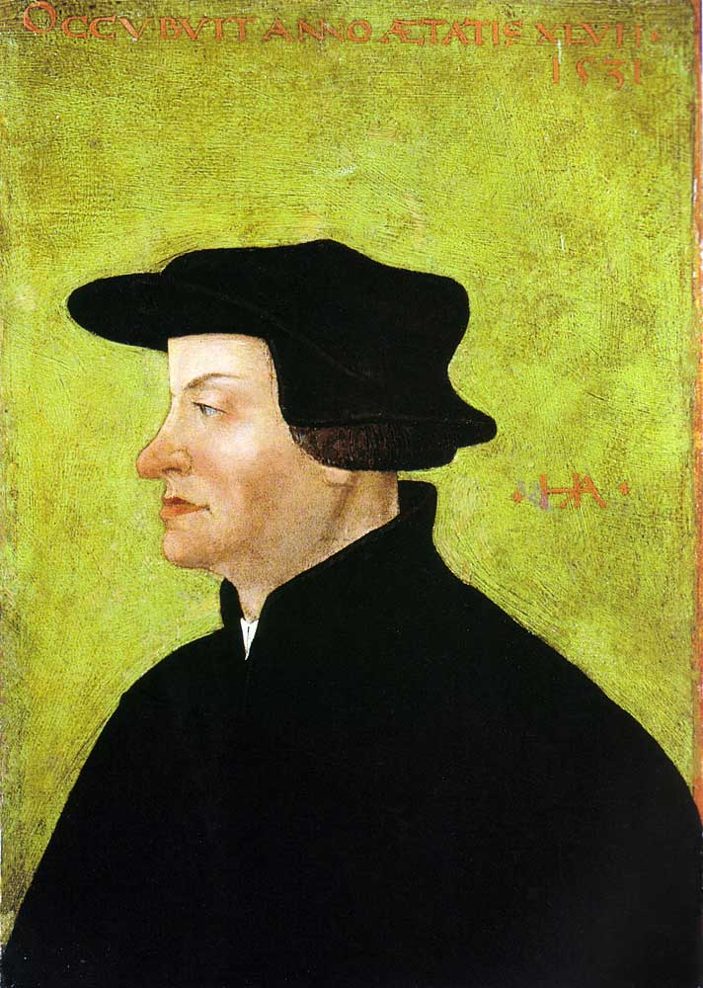
1531
Tyndale refuses Henry the VIII’s invitation to return to England
Ulrich Zwingli urges civil war in Switzerland to force remaining Catholic districts to accept Protestantism
Zwingli is killed in the 2nd Battle of Kappel
Ulrich Zwingli

Slide 72
The Church Across The Ages
of people, events
life and faith from
Glimpses
ZURICH REFORM UNDER ZWINGLI
“Catholic resistance in the rural cantons could not be overcome and eventually resulted in actual fighting. When war came, Zwingli joined the Zurich troops as an armed soldier against the Catholics in what is known as the 2nd Kappell War. The same Zwingli who had worked so hard to eliminate the mercenary service and had earlier even condemned war itself now took up arms, convinced it was necessary in the service of God and the Gospel. He was killed in battle on October 11, 1531, his body hacked to pieces and disgraced by his enemies.” (Protestant Reformer Martin Luther reportedly rejoiced at news of these events.)

Slide 74
THE THIRTY YEARS WAR Decades Of Horror: 1618-1648
The Reformation and Trent having settled the doctrinal issues decisively, nothing was left but to settle existence issues on the field of battle.
Christianity was not yet ready to let heresy and truth live side-by-side until the Day of Judgment.
The war was brought about in Germany by the supposed “Defenestration Of Prague,” which being interpreted meant that an unwelcome Roman Catholic official was thrown out a window in Protestant territory(Prague 1618).
* Source: Ligonier Ministries Church History Handouts

Slide 76
Looking For Trouble

Slide 77
FINDING IT

Slide 79
HERE THEY COME!

Slide 81
Paying The Price!

Slide 82
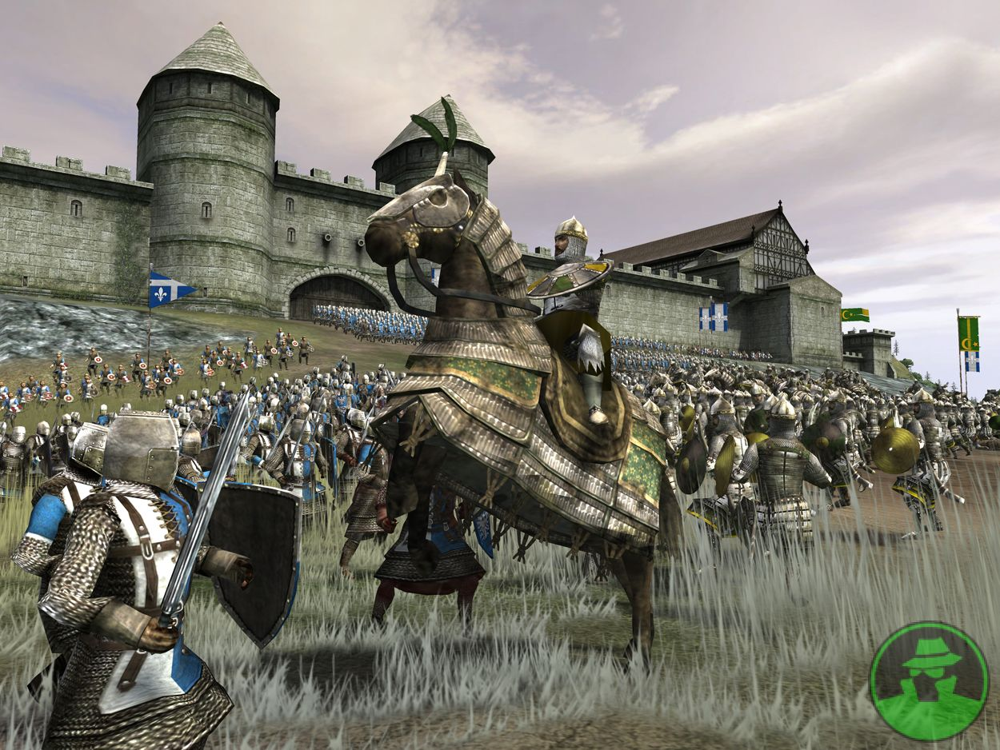
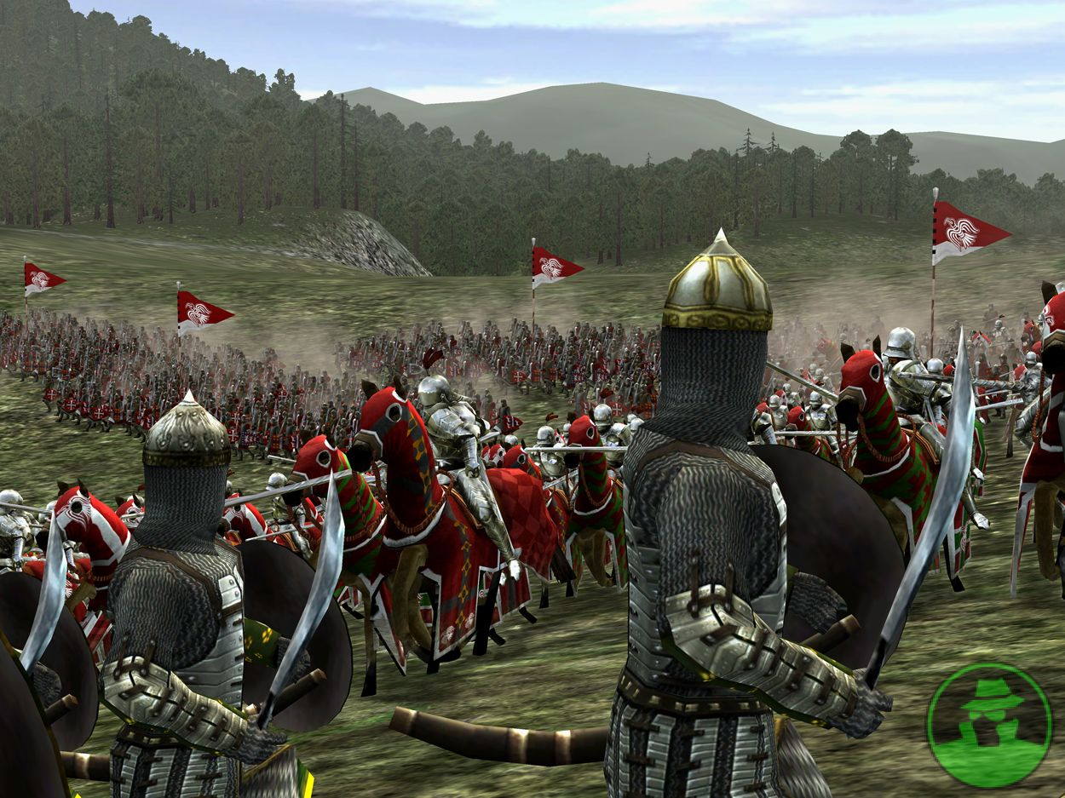
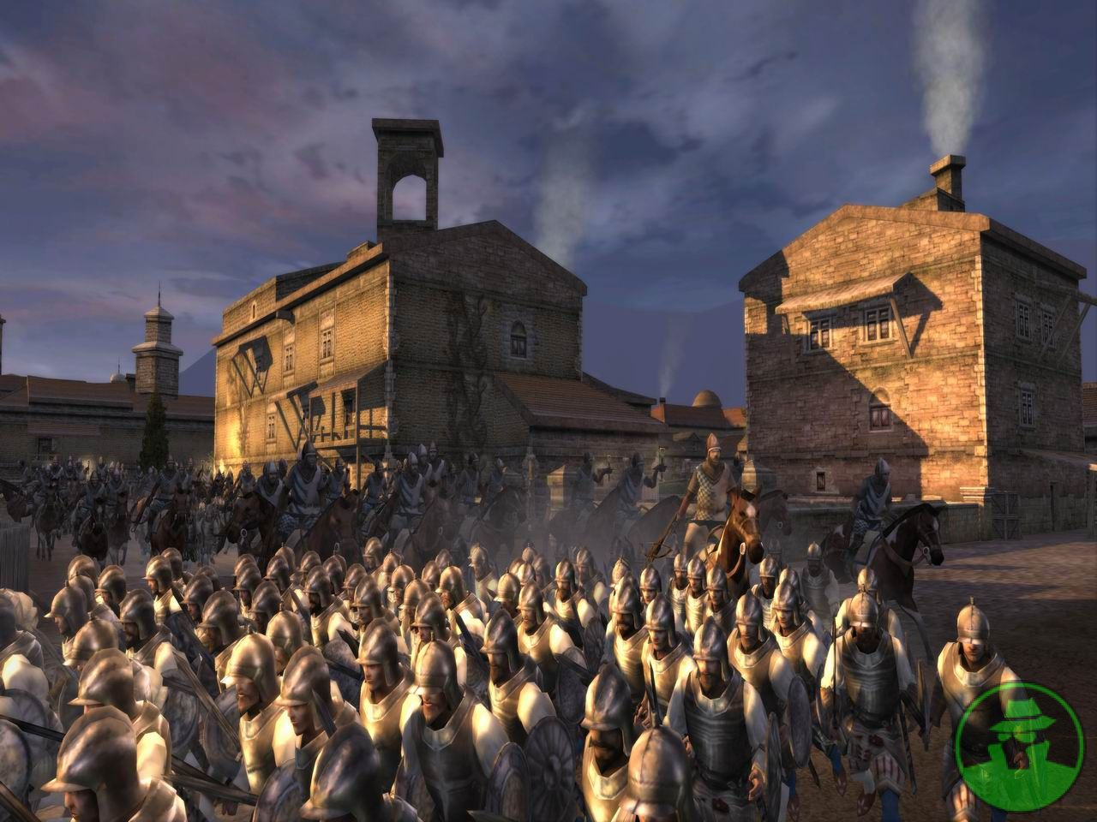
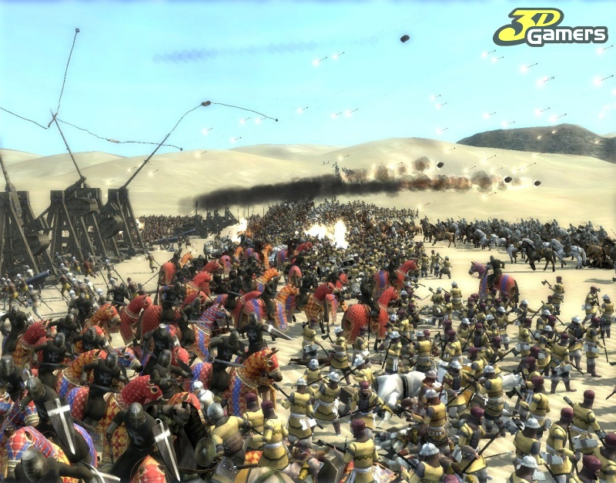
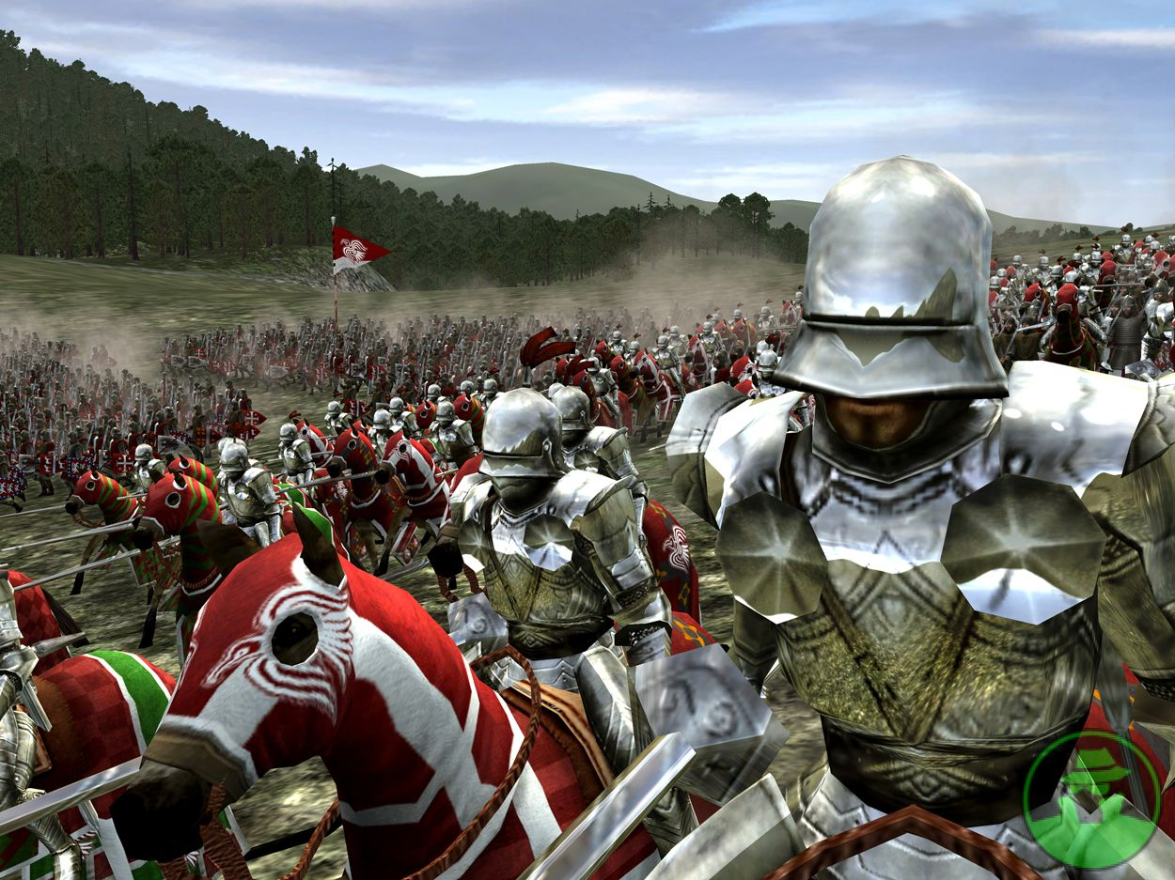
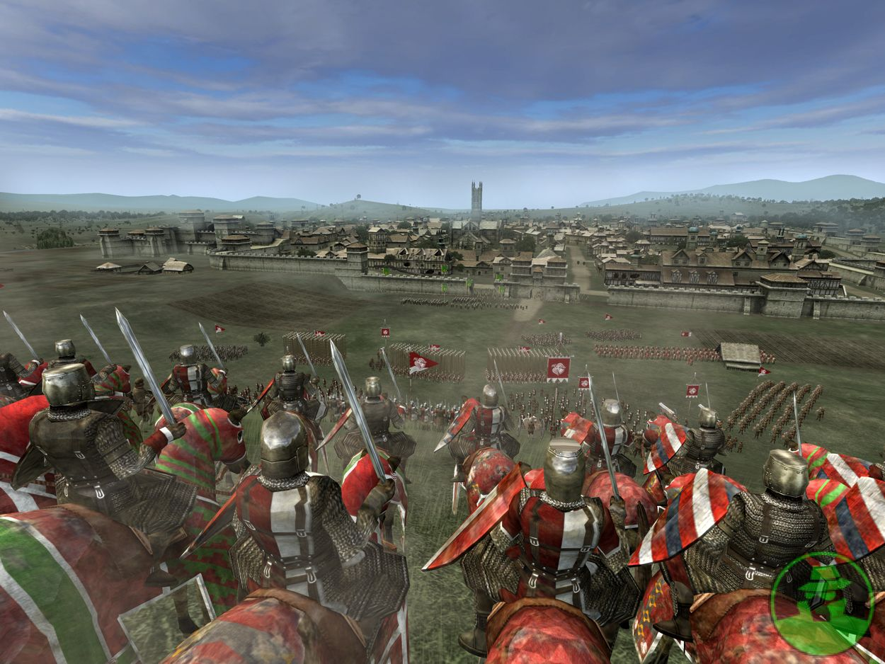

Slide 83
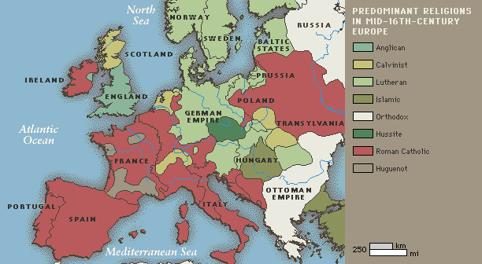
The
Thirty
Years
War

Slide 84
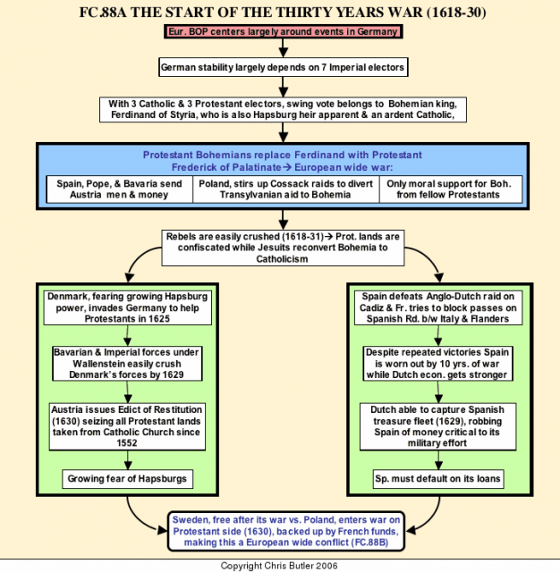

Slide 85
The Thirty Years War
THE BOHEMIAN PHASE
1618 - 1625

Slide 86
The Thirty Years War
THE DANISH PHASE
1625 - 1630

Slide 87
The Thirty Years War
THE SWEDISH PHASE
1631 - 1634

Slide 88
The Thirty Years War
THE FRENCH PHASE
1635 - 1648

Slide 89
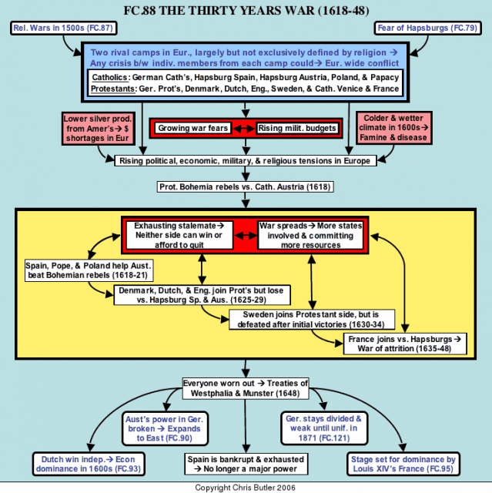

Slide 90
DENMARK:
In 1536 the Protestant party of nobles overthrew the Danish dynasty – an act of “civil disobedience” with accompanying strife. They then set up a new government and a new dynasty and established Lutheranism in the country.

Slide 92
NETHERLANDS:
Catholic Spain had isolated the non-Catholic population both politically and geographically. Thus the Protestants concentrated in what is now Holland which became the last holdout against the Spanish power. The leaders of the revolt established Protestantism as the dominant religious form of the country. The turning point was the battle for Leyden in 1574.

Slide 94
SWEDEN:
In 1527 the Vasa family broke away from Denmark as an act of rebellion and established Sweden as a Lutheran country. Later, in 1630, it was the Swedish King, Gustavus Adolphus, a sincere champion of Lutheranism, who marched his army out of Sweden and into Germany against the Emperor to protect Protestant Germany with his force of arms.

Slide 95
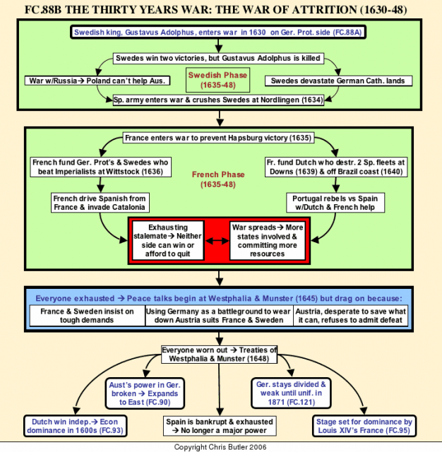

Slide 96
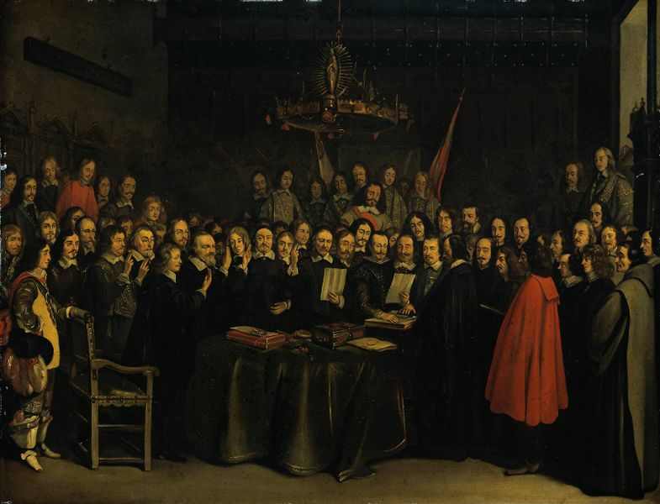
THE THIRTY YEARS WAR Decades Of Horror: 1618-1648
Rome declared war and Protestantism had to defend itself – which it did very poorly at first. The Roman General Wallenstein virtually romped across Europe.
The battle would have been soon over and even the Reformation almost erased were it not for Sweden’s Gustavus Adolphus. Almost an even century after the Reformation’s most basic creed, the Augsburg Confession, was drawn up in 1530, the Swedes – only partly for religious reasons – invaded Europe.
The King lost his life but won the battle for the North.
From the truce or “Peace of Westphalia” in 1648 to this day, Protestantism has dominated Northern Europe and Romanism, Southern Europe. Romanism has never been able to take the North nor Protestantism the South.
* Source: Ligonier Ministries Church History Handouts

Slide 97
1648
After the end of the Thirty Years’ War, Catholics and Protestants are given equal rights in most of the Holy Roman Empire

Slide 98
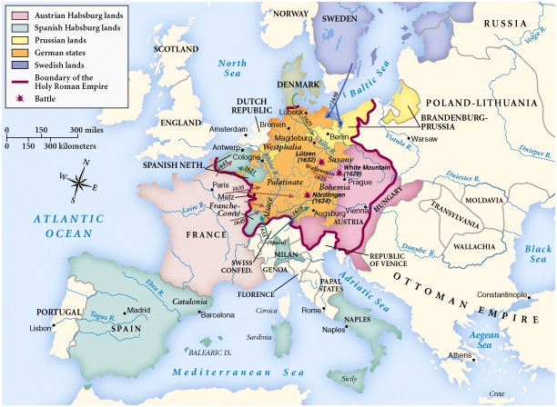

Slide 99
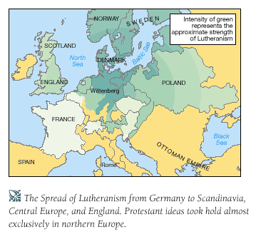

Slide 100
THE THIRTY YEARS WAR Decades Of Horror: 1618-1648
The cost of settlement was high. The population of Germany was cut by two thirds with the loss of several million lives. Property had been destroyed in the numerous battles and sackings of towns and villages. It took decades before Germany recovered from the devastation of property, the loss of life and the breakdown of morals incurred in the Thirty Years War.
* Source: Christianity Through The Centuries by Earle Cairns

Slide 101
1648
After the end of the Thirty Years’ War, Catholics and Protestants are given equal rights in most of the Holy Roman Empire
The emergence of Pietism from the devastation of the Thirty Year’s War.
1648~

Slide 102
1648
After the end of the Thirty Years’ War, Catholics and Protestants are given equal rights in most of the Holy Roman Empire
The emergence of Pietism from the devastation of the Thirty Year’s War.
By war’s end, countless villages, cities, and churches had been destroyed.
Torture, maiming, and murder of civilians had become commonplace; in some places even cannibalism.
Hungry & Diseased Displaced Populations
The cultural & spiritual damage often worse!
1648~

Slide 103
The emergence of Pietism from the devastation of the Thirty Year’s War:
Large numbers of the surviving population were left distrustful of all official religion.
Germany, which felt the brunt of the war, was left divided into over 300 territorial states controlled by regional princes to whom Luther and Melanchthon had turned for support.
In reaction to the war, two major alternatives to doctrinal disputation and religious conflict emerged. Many turned from theological disputes of revealed religion to Deism, preferring the seemingly rational objectivity of nature’s God, accessible to reason and science.
From the ashes of war also arose Pietism!
1648

Slide 104
The emergence of Pietism from the devastation of the Thirty Year’s War.
1648

Slide 105
1648~
The emergence of Pietism from the devastation of the Thirty Year’s War.
Positively – Pietism subordinated theology to the holy word. It involved laity in the spiritual disciplines and in scripture reading. It stressed heartfelt religion & charity.

Slide 106
1648~
The emergence of Pietism from the devastation of the Thirty Year’s War.
Negatively – Pietism deteriorated into subjectivism. It’s initial anti-authoritarian approach abounded into a broader anti-intellectualism.

Slide 107
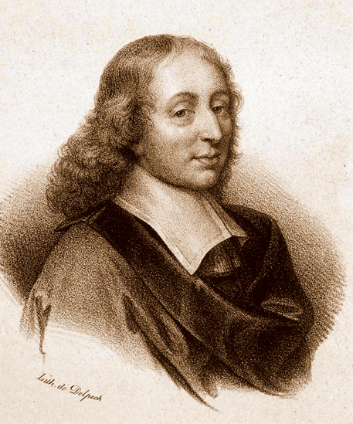
1648
In reaction to the war, two major alternatives to doctrinal disputation and religious conflict emerged. Many turned from theological disputes of revealed religion to Deism, preferring the seemingly rational objectivity of nature’s God, accessible to reason and science.
1654
Conversion of Blaise Pascal, French mathematician and theologian
Blaise Pascal

Slide 108
ENGLISH & EUROPEAN Reform Seeds Sow Restoration Christian Piety/(Re)AnaBaptist
David Lee Burris:
Pietist Saying – “I lift thee and thou lift me and we ascend to Heaven together.”
Christ’s Church: The Body Of His Converted Believers
Lived In Radical Community
Reject 2 City & 2 Kingdoms
Anti- Faith- Only Doctrine
Means To Persecute: Drown
Lived Love, Self-Denial, & Lowliness, Holiness, Peace {After Opposite Beginning}
Evangelistic & Missionary
Opposed Luther & Zwingli
Reaction to European War
Reaction To Doctrinal & Denominational Summas & Intellectual Orthodoxies
Protestant Type Thomism
Cruxiform Contemplatives
Life: Individual Faith, Personal Repentance, & Conversion Of Heart
Devotion-Ethics Emphasis
Moravian Slave Missions

