Slide 1
The SHEPHERD Watches The Sheep As The Wolf Watches The Watcher!
By David Lee Burris

Slide 2
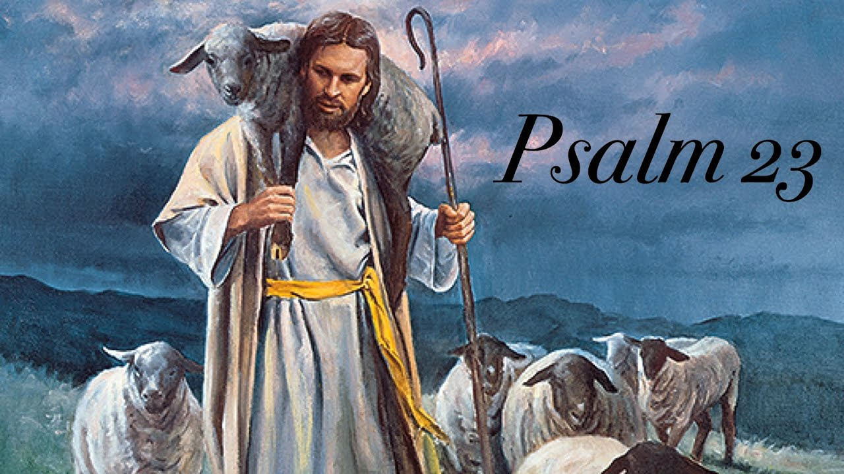

Slide 4
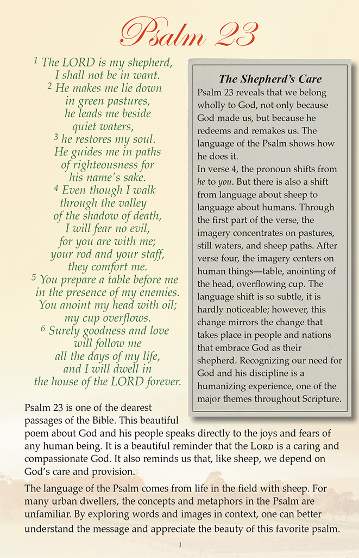

Slide 6
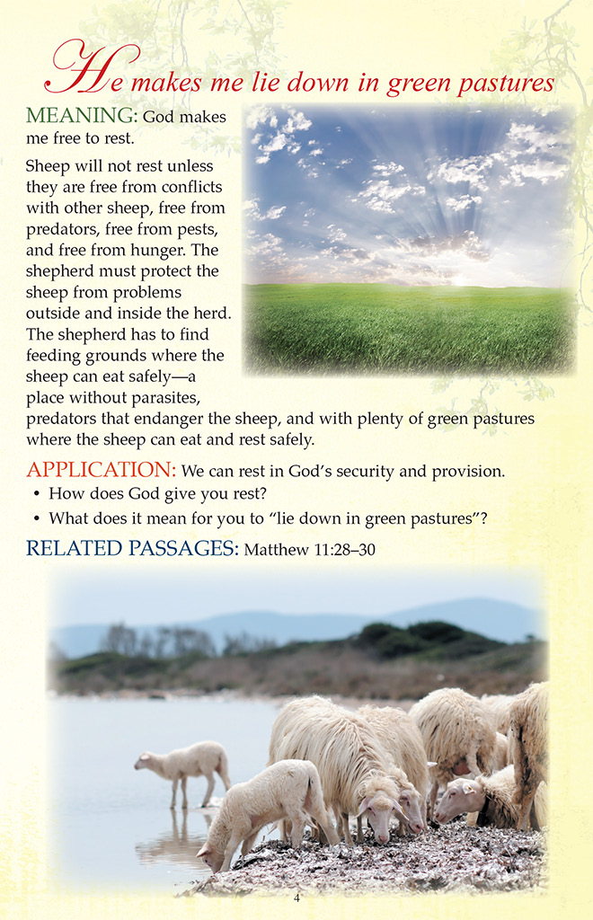

Slide 7
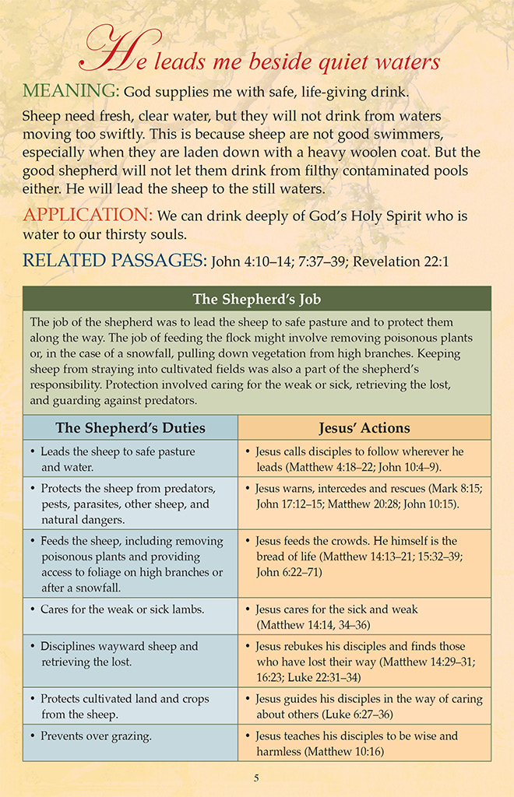

Slide 11
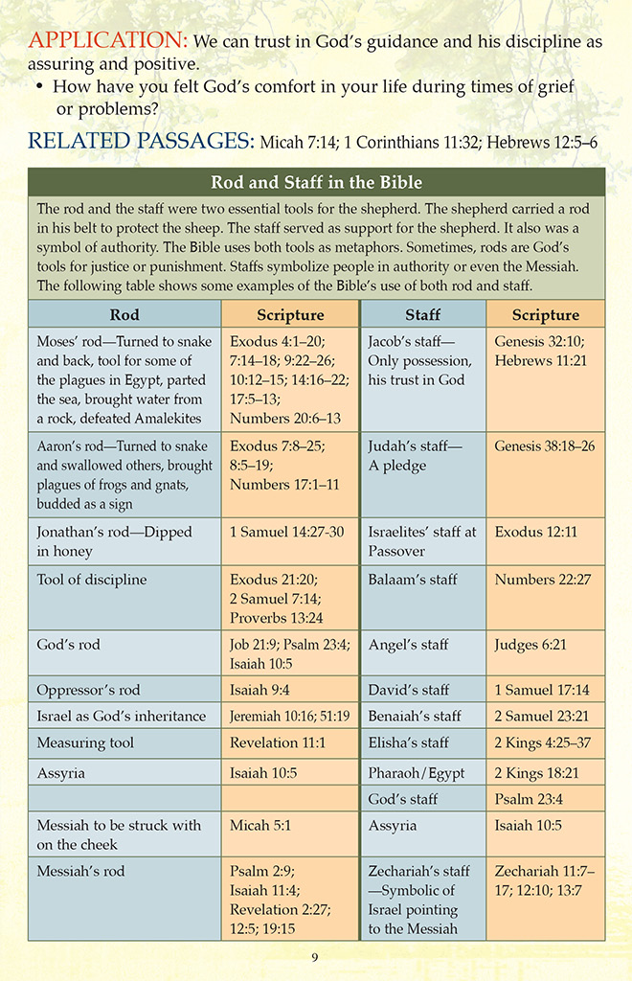

Slide 16
Ketcham, R. (1972). I Shall Not Want. Chicago, IL: Moody Publishers.
The New Testament presents the Lord Jesus as exercising a threefold shepherd ministry. In John 10:11 He calls Himself the “good shepherd” and declares that “the good shepherd giveth his life for the sheep.” In Hebrews 13:20 the inspired writer calls the Lord “that great shepherd of the sheep” and says that He became the great Shepherd through being “brought again from the dead.” In 1 Peter 5:4 the Lord Jesus is called “the chief shepherd” and Peter declares that He becomes the chief Shepherd in His second advent when He shall give to His own “a crown of glory that fadeth not away.”
Here, then, the Lord Jesus is placed before us as the good Shepherd, the great Shepherd, and the chief Shepherd. As the good Shepherd, He dies for the sheep. As the great Shepherd, He lives for the sheep. As the chief Shepherd, He comes for the sheep.
It is the relationship of the good Shepherd to the sheep rather than the relationship of the great Shepherd to the sheep that is referred to by many people when they quote verse 1 of Psalm 23. They are thinking of the ministry of the good Shepherd who died for them on Calvary’s cross, and who, for that matter, is also living in heaven and whom they are sure they will meet someday. The glorious truth that they should be meeting Him every day in green pastures and beside still waters has never dawned upon them, or at least has never become a blessed, daily experience in their Christian life. True it is that one cannot know Christ as Shepherd without knowing Him as Savior, but the tragedy is that born-again believers who know Him as Savior may never know Him in their daily experience as a blessed present Shepherd.
This threefold shepherd ministry of Christ is beautifully set forth in the triplet psalms, namely, Psalms 22, 23 and 24. Psalm 22 presents Him as the good Shepherd in death. Psalm 23 presents Him as the great Shepherd in life. Psalm 24 presents Him as the chief Shepherd in His sure return.
The opening sentence of Psalm 22 is the very dictation of Calvary’s cry of rejection—“My God, my God, why hast thou forsaken me?” These words are not primarily a quotation from Matthew 27:46, but Matthew 27:46 is the Lord Jesus Himself quoting from Psalm 22:1—quoting in awful, literal and terrible fulfillment all of the black and overwhelming portent of these words!
Psalm 22 is a literal word picture of the experiences of death by crucifixion; but more than that, the death of the Son of God by crucifixion. Even the details of garments parted, lots cast upon vesture, and pierced hands and feet, are here laid bare before us. Surely this is the good Shepherd giving His life for His sheep.

Slide 18
Tools & Tasks Of The Good Shepherd

Slide 19
SHEPHERD CARRIES FOUR THINGS

Slide 20
Sling Weapon For
The Distant Combat

Slide 22
Three Foot Long
Hard Wood Club
To Defend Flock
In Close Combat

Slide 23
Six Foot Long
Staff Or Crook
For Steep Climb
Pulling To Safety
Proding Together

Slide 25
The Good Shepherd
Prepares Beforehand
Contingency Provision

Slide 26
Anoint Heads From Elements

Slide 27
Shepherd’s Function Not Slaughter

Slide 28
JOHN 21: 15 & 16
1st Peter 5: 1 & 2

Slide 29
Bad Shepherds allow sheep to scatter!

Slide 30
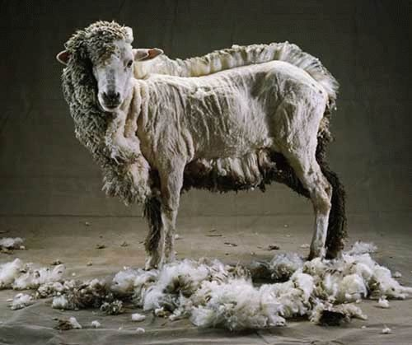
Ezekiel Chapter 34

Slide 33
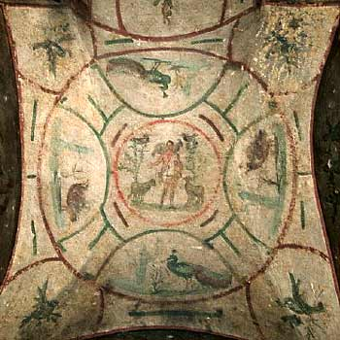
Catacombs
The Good Shepherd

Slide 34
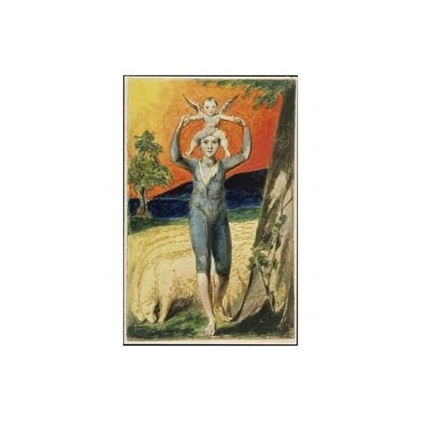
INNOCENCE

Slide 35
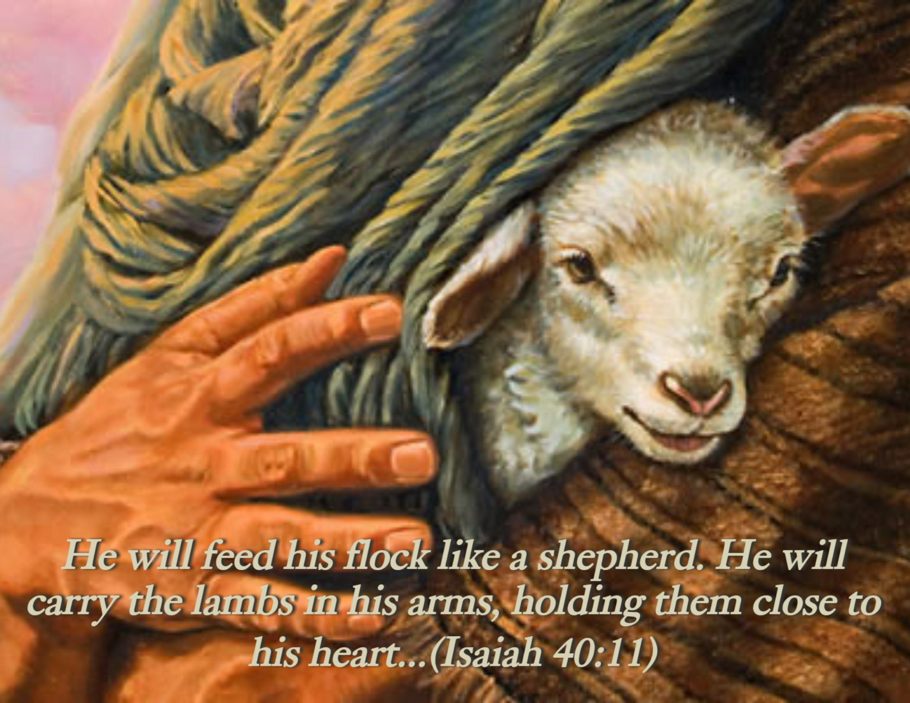

Slide 36
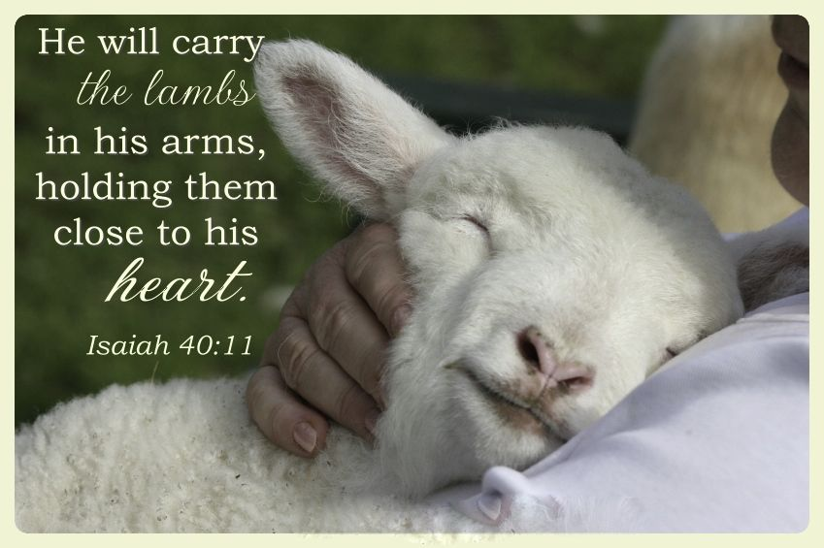

Slide 40
Ellicott's Commentary for English Readers
(12) But he that is an hireling.—The Greek word occurs again in the New Testament only in the next verse and in Mark 1:20. It implies a lower position than the household servant, and is more nearly what we should call the tramp-laborer. The thought follows from that of the good shepherd who in the time of danger will give his own life for the sheep. The hireling has no interest in the sheep, and cares for them only as far as to secure his own hire. This want of interest is strongly expressed in the double statement, “not the shepherd,” “whose own the sheep are not.” In the interpretation we are not to think of the hierarchy, who have been already, in John 10:8, designated as “thieves and robbers,” breaking into the fold, but of all persons who from any other motive than love for humanity, and by any other way than the door which is Christ, or by any other call than that of the Holy Spirit, take upon themselves the office of shepherds of the flock. The hour of danger will distinguish between the shepherd and the hireling. The one, loving the sheep, will give even his life for them. The other, caring only for the hire, in whatever form it comes, will flee and leave the sheep as a prey to the wolf. And the wolf catcheth them, and scattereth the sheep.—The words “the sheep” are not found in the majority of the better MSS., and their insertion makes the sentence awkward, because the pronoun “them” has been immediately before used for the same sheep. Adopting the better reading (see Note on next verse), we have, and the wolf catcheth them, and maketh havoc—i.e., seizeth individual sheep, and maketh havoc in the flock. Under the general image we are to understand all the spiritual foes which destroy individual souls and rend the Church of Christ. The wolf is the natural enemy of the sheep, and the fit emblem of all evil persons, who are the natural enemies of the sheep of Christ’s fold. He spake of “false prophets” as “ravening wolves” (Matthew 7:15). He sent forth the Twelve “as sheep in the midst of wolves” (Matthew 10:16), and the Seventy, whose mission, we shall see (comp. Note on John 10:22), was connected with the teaching of this chapter, “as lambs among wolves” (Luke 10:3). St. Paul foresaw that in the very city from which St. John wrote this Gospel, “after his departing, grievous wolves would enter in among them, not sparing the flock” (Acts 20:29). These are the only passages in the New Testament where the word occurs, and from them we may gather that while wolves represent all false teachers and foes to truth, “the wolf” represents him who is the source from whence they come. As all shepherds are related to the Good Shepherd, so are all wolves to the wolf whose work they do.

Slide 41
WOLves cause The sheep to Scatter!

Slide 42
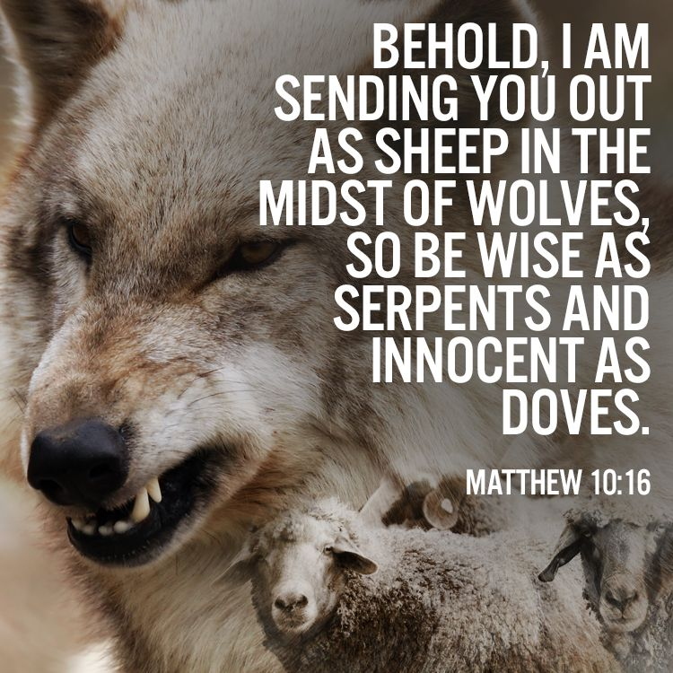

Slide 43
Matthew Poole's Commentary @Matthew 10:16
Our Lord having hitherto instructed his twelve apostles as to the places whither they were to go, the work they had to do, and the methods he would have them observe, now comes to arm them against their difficulties, and the temptations they were like to meet with. I send you forth (saith he) as sheep in the midst of wolves. It is most probable that our Savior speaks this with reference to what they were like to meet with when he should be taken from them, for we do not read of any great opposition which they at present met with. I send you, ( saith he), as sheep, which are feeble creatures in themselves, and without any natural armor to defend themselves, in the midst of wolves, which are rapacious creatures, and have a particular enmity to sheep: amongst enemies who will have as great an inclination from their malice to devour you, as wolves have from their nature to devour sheep. Be ye therefore wise as serpents. It is said of the serpent, Genesis 3:1, that he was more subtle than any beast of the field. Naturalists observe, yet, a great natural sagacity in the serpent, which they note in several particulars. It is hard to say that Christ aimed at this or that particular thing wherein the sagacity of serpents appeareth; he only proposes the serpent as a pattern of subtlety, and commendeth prudence to them so far as it consisteth with innocency, for it followeth, harmless as doves. Amongst the beasts of the field there is none more innocent than a sheep; amongst the birds of the air none more innocent than a dove; to both these our Lord compares his disciples. This text teacheth us: 1. That wisdom may dwell with prudence. 2. That all true prudence must be attended with innocency.

Slide 44
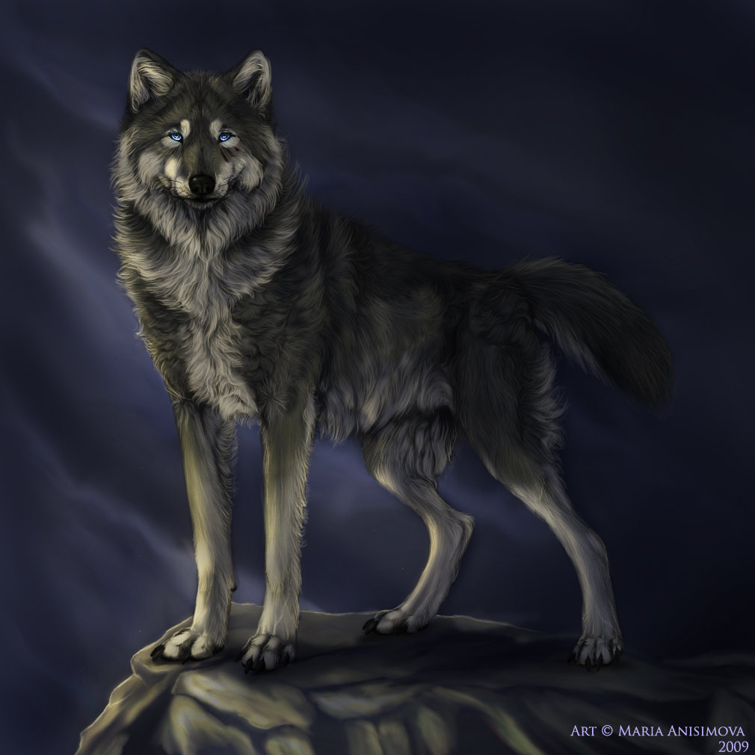
Wolves Effect On Sheep Herds:
Because of bunching together less forage consumption.
Lighter lambs coming off the range.
Reduced conception rates.

Slide 45
Wolves Effect On Sheep Herds:
Wolves do not kill for sport because carcass left half-eaten.
Wolves are opportunistic & programmed to kill easy prey.

Slide 46
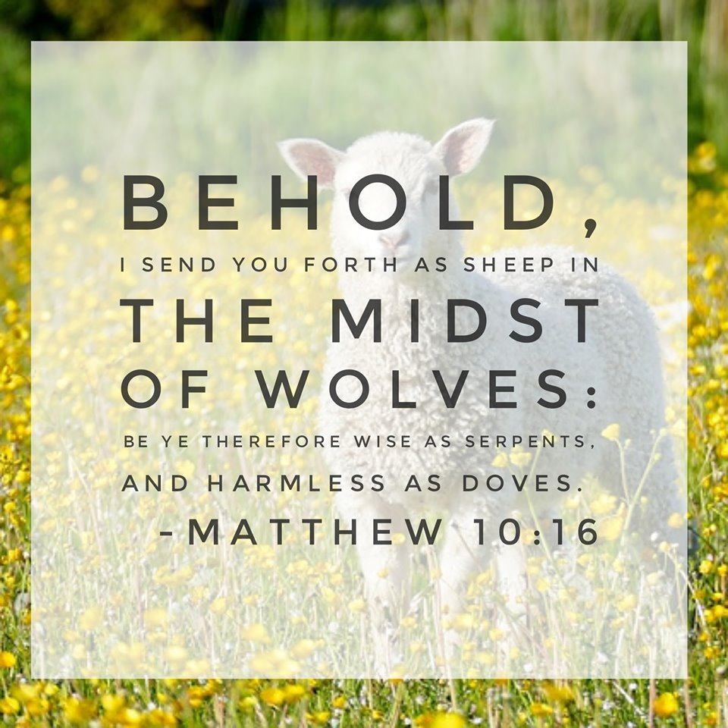
STILL GOOD ADVICE

Slide 48
Wolves Effect On Sheep Herds:
Wolves do not kill for sport because carcass left half-eaten.
Wolves are opportunistic & programmed to kill easy prey.

Slide 49
Sheep-Wolves Imagery To Travelers
“Apuleius says the lone traveler lived in terror when the roads took him through a wooded area. He recalls authorities warning travelers in central Greece against packs of enormous wolves that were attacking even houses. ‘We were told that the road we wished to take was strewn with half-eaten corpses, and clean-picked skeletons, and that we ought to proceed with all possible caution – the higher the sun the milder the wolves – and in a compact body with no stragglers.’ ” – The Veil Is Torn, pg. 105

Slide 50
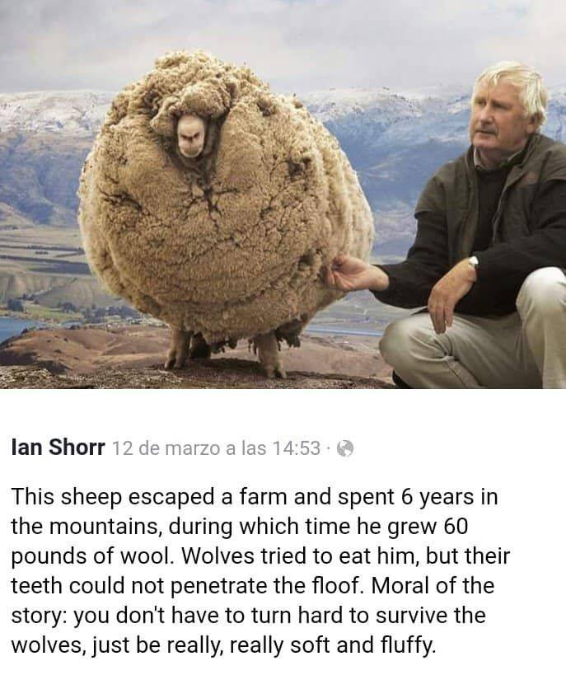

Slide 51
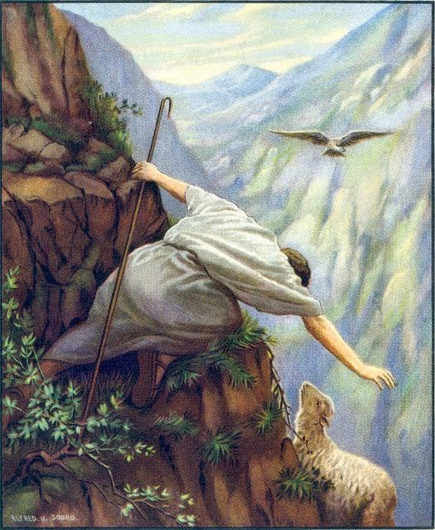

Slide 52
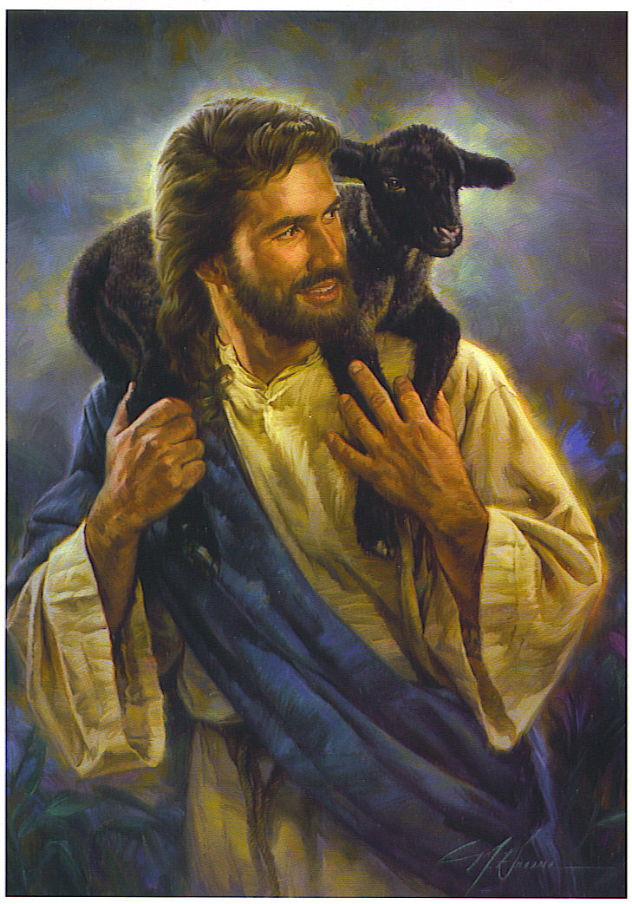

Slide 53
The Life and Times of Jesus the Messiah (Vol. 2, pp. 255). New York: Longmans, Green & Co.
The Lost Sheep is only one among a hundred: not a very great loss. Yet which among us would not, even from the common motives of ownership, leave the ninety-and-nine, and go after it, all the more that it has strayed into the wilderness? And, to take these Pharisees on their own ground, should not the Christ have done likewise to the straying and almost lost sheep of His own flock? Nay, quite generally and to all time, is this not the very work of the ‘Good Shepherd,’ and may we not, each of us, thus draw from it precious comfort? As we think of it, we remember that it is natural for the foolish sheep so to wander and stray. And we think not only of those sheep which Jewish pride and superciliousness had left to go astray, but of our own natural tendency to wander. And we recall the saying of Peter, which, no doubt, looked back upon this Parable: ‘Ye were as sheep going astray; but are now returned unto the Shepherd and Bishop of your souls.’ It is not difficult in imagination to follow the Parabolic picture: how in its folly and ignorance the sheep strayed further and further, and at last was lost in solitude and among stony places; how the shepherd followed and found it, weary and footsore; and then with tender care lifted it on his shoulder, and carried it home, gladsome that he had found the lost. And not only this, but when, after long absence, he returned home with his found sheep, that now nestled close to its Savior, he called together his friends, and bade them rejoice with him over the erst lost and now found treasure.
It needs not, and would only diminish the pathos of this exquisite Parable, were we to attempt interpreting its details. They apply wherever and to whatever they can be applied. Of these three things we think: of the lost sheep; of the Good Shepherd, seeking, finding, bearing, rejoicing; and of the sympathy of all who are truly friends—like-minded with Him. These, then, are the emblems of heavenly things. In heaven—oh, how different the feeling from that of Pharisaism! View ‘the flock’ as do the Pharisees, and divide them into those who need and who need not repentance, the ‘sinners’ and the ‘righteous,’ as regards man’s application of the Law—does not this Parable teach us that in heaven there shall be joy over the ‘sinner that repenteth’ more than over the ‘ninety-and-nine’ ‘righteous,’ which ‘have not need of repentance’? And to mark the terrible contrast between the teaching of Christ and that of the Pharisees; to mark also, how directly from heaven must have been the message of Jesus, and how poor sinners must have felt it such, we put down in all its nakedness the message which Pharisaism brought to the lost. Christ said to them: ‘There is joy in heaven over one sinner that repenteth.’ Pharisaism said—and we quote here literally—‘There is joy before God when those who provoke Him perish from the world.’

Slide 54
Bad Shepherds Metaphor for Bad Eldership

Slide 55
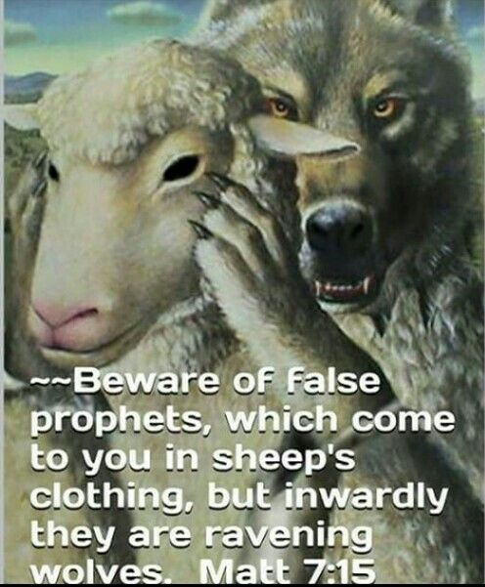

Slide 56
Gill's Exposition of the Entire Bible @Matthew 7: 15
Beware of false prophets,.... Or false teachers; for not such who pretended to foretell things to come, but such who set up themselves to be teachers of others, are here meant; see 2 Peter 2:1. It may be queried, whether our Lord has not respect to the Scribes and Pharisees, who sat in Moses's chair, and taught, for doctrines, the commandments of men? and of whose doctrines he elsewhere bids men beware: for whatever plausible pretenses for holiness and righteousness might appear in them, they were repugnant to the word of God, and destructive to the souls of men; such as their doctrines of justification by the works of the law, the traditions of the elders, &c. since it follows, which come to you in sheep's clothing, but inwardly are ravenous wolves; for these "loved to go in long clothing", Mark 12:38. in a garment which reached to the feet, and was made of the wool of sheep. The Babylonish garment Achan saw and stole, Rab says (r), was , a garment called "melotes": which is the very Greek word the author of the Epistle to the Hebrews uses for sheep skins, persecuted saints wandered about in, Hebrews 11:37 and the gloss upon the place, in the Talmud referred to, says, that this was , "a talith", or "garment of pure wool"; and Jarchi (s) says, that "it was the way of deceivers, and profane men, to cover themselves, "with their talith", or long garment, "as if they were righteous men", that persons might receive their lies.''

Slide 57
²⁸ Be on guard for yourselves and for all the flock, among which the Holy Spirit has made you overseers, to shepherd the church of God which He purchased with His own blood. ²⁹ I know that after my departure savage wolves will come in among you, not sparing the flock;
- Acts 20:28-29

Slide 58
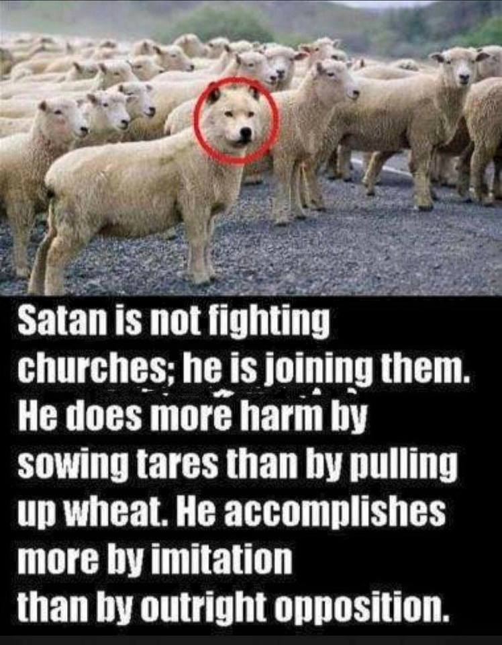

Slide 60
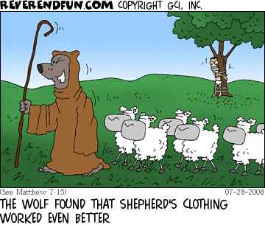

Slide 61
Coffman's Commentaries on the Bible
Verse 1
"This whole chapter (1 Timothy 4:1-16) constitutes a main division of 1Timothy; it deals with coming heresies and tells how Timothy is to be fortified and is to fortify the churches against them."[1] Lenski also denied the proposition that Paul was here merely writing instructions to the minister of a single congregation. "He is addressing his apostolic representative for the whole territory of which Ephesus is the center."[2] The first five verses (1 Timothy 4:1-5) deal with particular features of the great apostasy which all of the sacred writers revealed would develop during the historical progression of Christianity. Before beginning the study of this chapter, a glance at some of their prophecies is in order.
THE GREAT APOSTASY
Christ foretold that "wolves in sheep's clothing" would ravage the flock of God (Matthew 7:15ff), indicating that the church itself would be the theater of the apostasy.
Paul, right here in Ephesus, had warned that the "grievous wolves" would come from the eldership itself, "from among your own selves" (Acts 20:28-30).
The Corinthians were alerted to the fact that Satan would seduce them, and that their minds should "be corrupted from the simplicity and purity that is toward Christ"; and the contrast of the bride of Christ with that of Adam points to the church (2 Corinthians 11:3).
The apostasy shall occur, or be centered, in the very temple of God, in context a reference to the church, the spiritual body of Christ (2 Thessalonians 2:1-12). See under those verses above.
The falling (apostasy) "away from the faith" in this passage (1 Timothy 4:1-5) carries the presumption that the apostates were once in the true faith.
Another phase of the apostasy, namely, its amorality and lawlessness, is stressed in 2 Timothy 3:1-8; and the indifference of Christians to sound teaching and their desire for "teachers after their own lusts" are pinpointed in 2 Timothy 4:1-7.
Methods and character of the apostate teachers appear in 2 Peter 2:1-3, where is found remarkably supplementary material for what Paul mentioned in this chapter of Timothy, that the false teachers, greedy for money, teach what they know to be a falsehood.
Of course, chapters 17,18 of the Revelation set forth still other characteristics of the apostasy prophesied by the Lord and his apostles; and, in perfect consonance with everything else that was written about it, the heretical and persecuting power is a harlot church.
From the above, it is concluded, to begin with, that the fulfillment of Paul's words in 1 Timothy 4 must be looked for within the church itself, and not in some obscure ancient sect.

Slide 62
Coffman's Commentaries on the Bible
But the Spirit saith expressly, that in later times, some shall fall away from the faith, giving heed to seducing spirits and doctrines of demons, (1 Timothy 4:1)
The Spirit saith expressly ... "This means that there was neither doubt nor vagueness about it."[3] The connection of this section with the preceding chapter is seen in the contrast with the triumphant Christ depicted in the final six poetical lines of chapter 3. "Over against the future triumph of the church, assured by the finished work of Christ, we must set the opposition."[4]
That in later times ... This is not limited to any immediate period after Paul's letter. "From the time at which he was writing and forward in all periods of the church, men have apostatized from the faith."[5]
Some shall fall away from the faith ... Paul did not use the same word here for "fall away" which he used in 2 Thessalonians 2:3-11; but as Carl Spain said:
The APOSTASY of 2 Thessalonians 2:3 is the same as the DEPARTURE here in 1Tim. 4:1. Both words are from [@afistemi], meaning to abandon, to rebel, to desert. It is translated FORSAKE (Acts 21:21), and "fall away from" (Hebrews 3:12).[6]
The obvious connection with other New Testament references to the apostasy requires the deduction mentioned by Ward, "The `later times' foreshadow the gathering eschatological storm."[7] The Second Coming is also connected with the final and complete manifestation of this apostasy in 2 Thessalonians 2:1-12. Lenski made it "the whole time between the two Advents."[8]
From the faith ... simply means "the Christian faith," giving further emphasis to the Christian roots of the apostasy in view.
Giving heed to seducing spirits and doctrines of demons ... It is not taught here that evil spirits actually teach, but that they "through men" (mentioned a moment later) deceived multitudes and are, in fact, themselves instigators of the false teaching. In the Old Testament, the evil spirit who stood before the Lord said, "I will be a lying spirit in the mouth of all his prophets" (1 Kings 22:22); and the same evil power would be able also to corrupt Christian elders, change them into hardened hypocrites, speaking the most glaring falsehood, with no reproach whatever from their dead consciences. Of course, not elders alone, but ministers, church prelates, and the whole echelon of religious hierarchies are included in this.
Most scholars accept "doctrines of demons" in this passage subjectively, that is, doctrines taught by demons (through men); but there is a very possible interpretation which construes this as meaning "doctrines regarding demons"; and, as every Roman emperor upon his death became a demon to be prayed to, the historical church herself finally began offering prayers "to" its dead saints, which most certainly fulfills the definition of "doctrines of demons" understood objectively.

Slide 63
³⁰ and from among your own selves men will arise, speaking perverse things, to draw away the disciples after them. ³¹ Therefore be on the alert, remembering that night and day for a period of three years I did not cease to admonish each one with tears.
- Acts 20:30-31

Slide 64
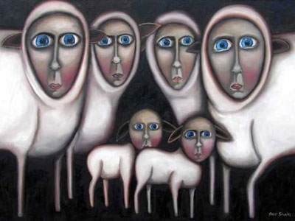
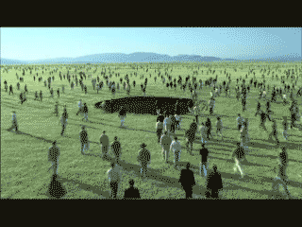
HERE IS THE CHURCH & HERE ARE THE SHEEPLE!

Slide 65
Prophecy fulfilled

Slide 66
Any Apostate Church Indicators?
David Lee Burris:
Predicted Departure From The Faith – Holy Spirit Predicted – From Truth Unto Fables Because They Could Not Endure Sound Doctrine – Speaking {Knowing} Lies In Hypocrisy – Their Consciences Over Time Become Without Feeling.
Vatican Built Upon Roman Racetrack & Circus & Next To Nero’s Gardens – Scenes Of Christian Persecution & Entertainment Execution!
To Proof Text Peter At Rome The Catholic Church Says 1st Peter 5: 13 Refers to Rome When Referencing Babylon & Clement Of Alexandria Makes The Same Application!
- - IMPROBABLE:
Fourth Kingdom of Daniel 2: 40, 41
Little Horn on Fourth Beast of Daniel 7: 8 – 25
Ten Horns on Dragon & Leopard of Revelation 12 & 13
Babylon – Mother & Daughters of Revelation 17 & 18
-- PROBABLE: Acts 20: 28 - 30: “grievous wolves among you”
Matthew 4: 1 – 3: “…in the latter times some will depart… giving heed to… doctrines of demons. … forbidding to marry and commanding to abstain from foods … created to be received with thanks

Slide 67
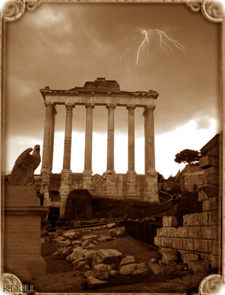
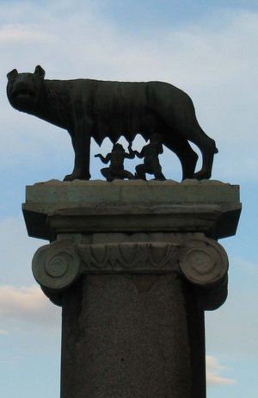
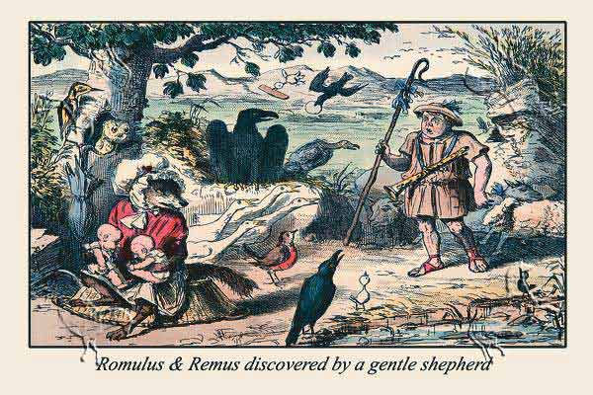
Any Apostate Church Indicators?
David Lee Burris:
Predicted Departure From The Faith – Holy Spirit Predicted – From Truth Unto Fables Because They Could Not Endure Sound Doctrine – Speaking {Knowing} Lies In Hypocrisy – Their Consciences Over Time Become Without Feeling.
Vatican Built Upon Roman Racetrack & Circus & Next To Nero’s Gardens – Scenes Of Christian Persecution & Entertainment Execution!
To Proof Text Peter At Rome The Catholic Church Says 1st Peter 5: 13 Refers to Rome When Referencing Babylon & Clement Of Alexandria Makes The Same Application!
- - IMPROBABLE:
Fourth Kingdom of Daniel 2: 40, 41
Little Horn on Fourth Beast of Daniel 7: 8 – 25
Ten Horns on Dragon & Leopard of Revelation 12 & 13
Babylon – Mother & Daughters of Revelation 17 & 18
Child Feral Abnormality
-- PROBABLE: Acts 20: 28 - 30: “grievous wolves among you”
Matthew 4: 1 – 3: “…in the latter times some will depart… giving heed to… doctrines of demons. … forbidding to marry and commanding to abstain from foods … created to be received with thanks

Slide 68
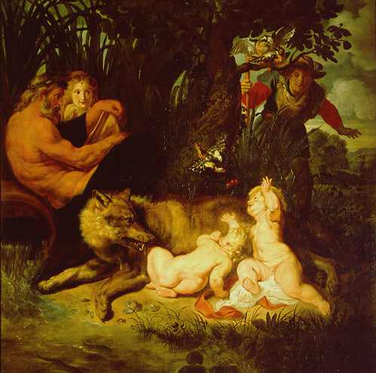
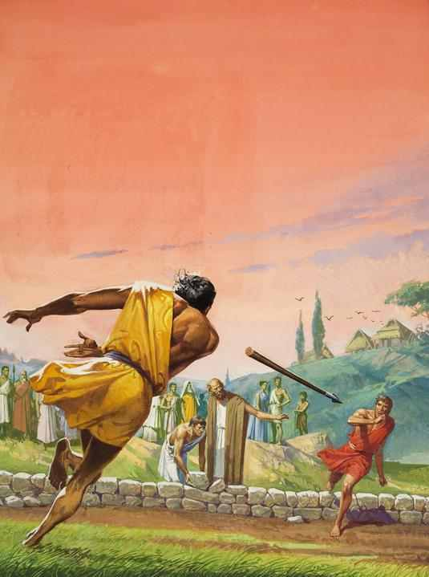
“so perish every one that shall leap over my wall!”

Slide 69
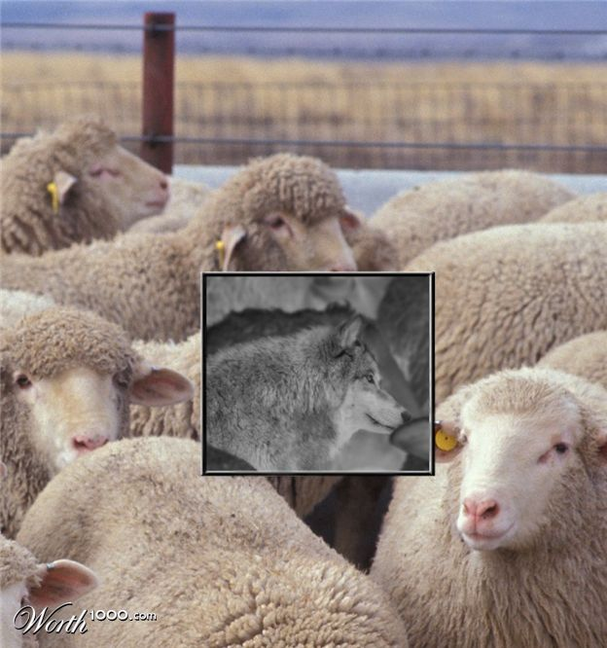
Pagan Rome Luperci Priesthood of the Wolf

Slide 70
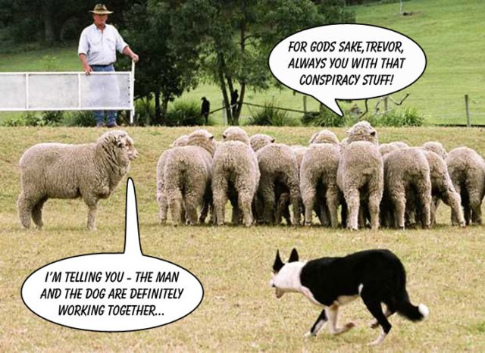

Slide 71
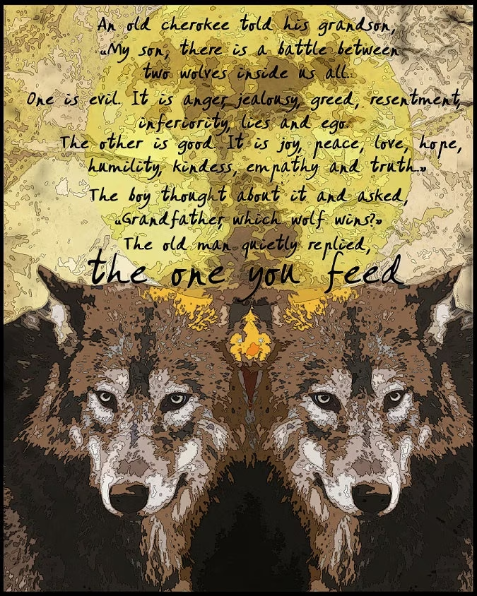

Slide 72
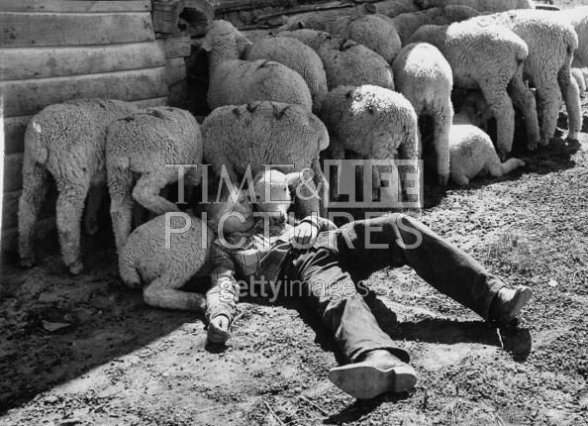
times THREE
ALSO: JOHN 10: 11 - 13
Sleeping Shepherds

Slide 73
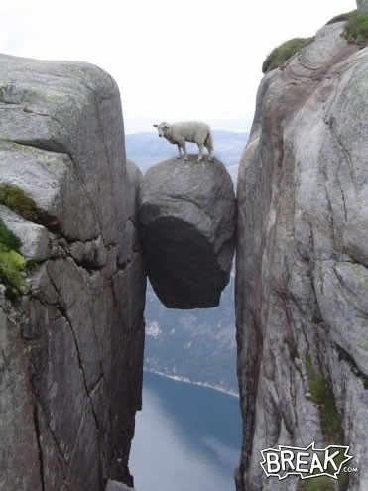
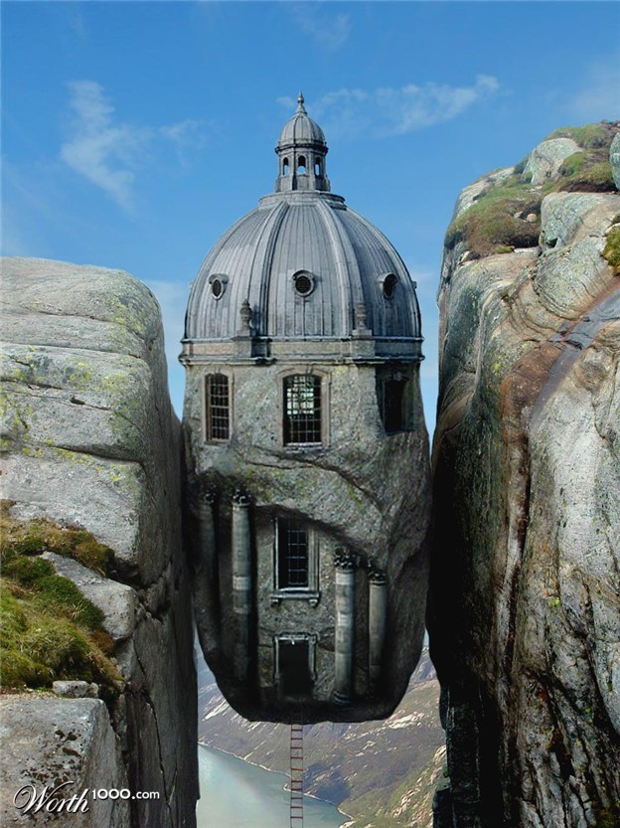

Slide 74
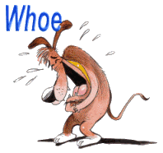
“…but the Brick Houses were not Built On Solid Ground.”
True Tales

Slide 75
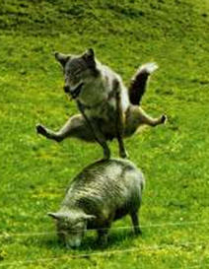
David Lee Burris:
Clipping The Wool From The Sheep’s Eyes – “This is a bad thing because a sheep with wool over his eyes doesn’t do good. He doesn’t see where he is going; he doesn’t find his food easily; he strays out from the rest and is more apt to be caught by a coyote.” - L. E. Lindsted

Slide 79
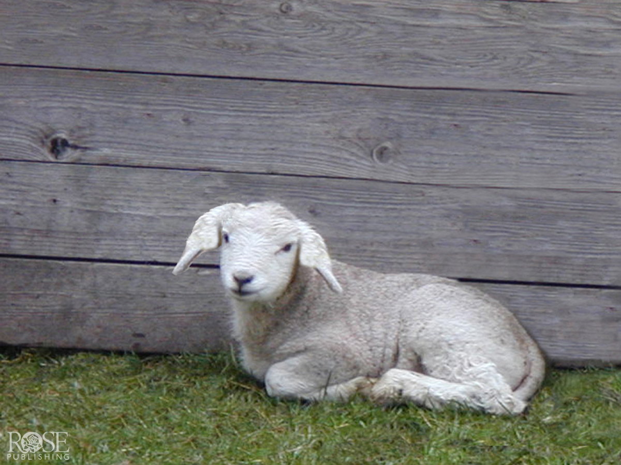

Slide 81
The next day John saw Jesus coming toward him and said, “Look, the Lamb of God, who takes away the sin of the world!”
—John 1:29

Slide 82
Jesus is our sacrifice.

Slide 83
Jesus is the fulfillment of the whole sacrificial system (Hebrews 7:26-29), especially as our Passover Lamb.
As the Lamb of God, Jesus’ sacrifice pays for our sins past, present, and future.

Slide 84
Offering (Hebrews 10:10)
Passover (1 Corinthians 5:7)
Propitiation (1 John 2:2)
Sacrifice (Ephesians 5:2)

Slide 85
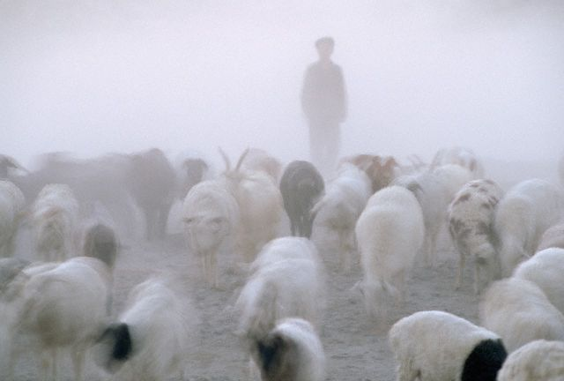

Slide 86
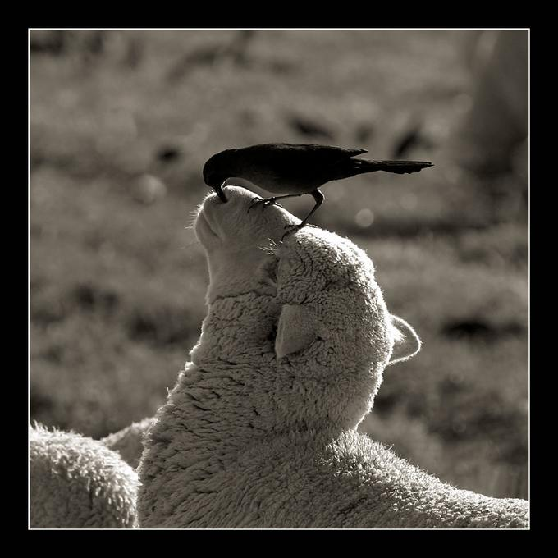

Slide 87
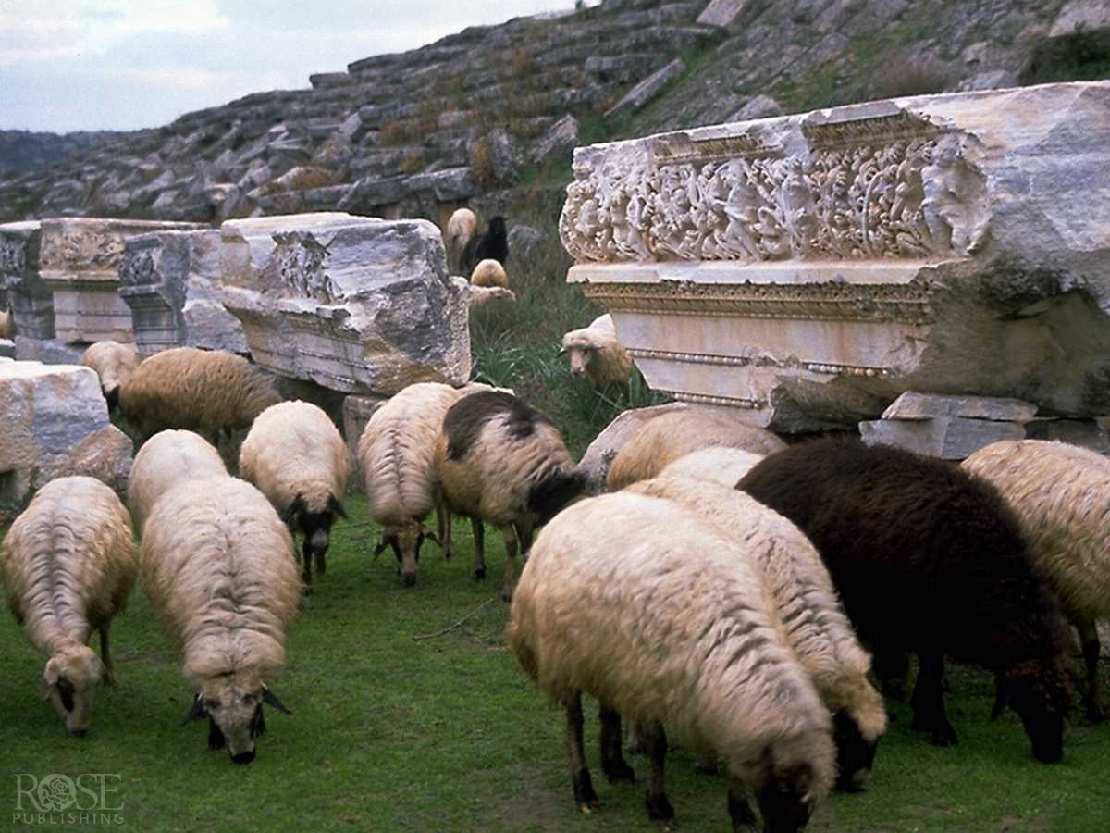

Slide 89
For you were like sheep going astray, but now you have returned to the Shepherd and Overseer of your souls.
—1 Peter 2:25

Slide 90
Jesus is the good shepherd.

Slide 91
Jesus came to care for and to lead lost sheep, lost men and women.
His sheep know His voice and no one can take them from His hands.

Slide 92
Door of the Sheepfold (John 10:7)
Good Shepherd (John 10:14)

