Slide 1


God Has Set Human Value
By David L. Burris

Slide 2
Perspectives on People
By What They Have Or Do
BY What They Are Or Who
By Who They Know!
Ransomed & Redeemed!
Adopted & carrying & honoring Family Name

Slide 3
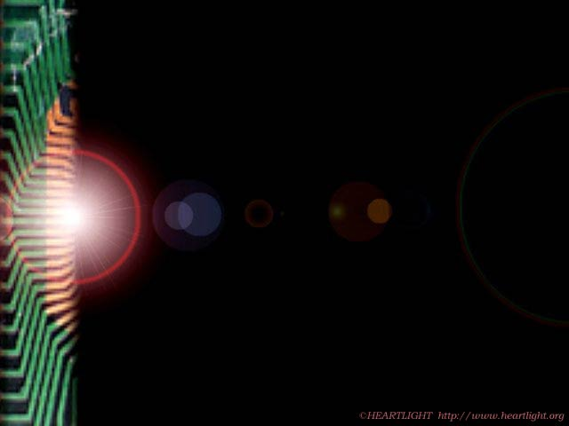

Men Are Valued:
By
What
They
Have

Slide 4
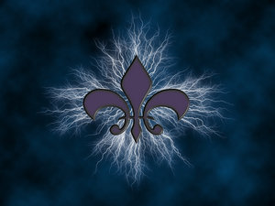
“We are shaped and fashioned by what we love.”
- Johann Wolfgang Von Goethe

Slide 5

Love Of
Possession

Slide 6
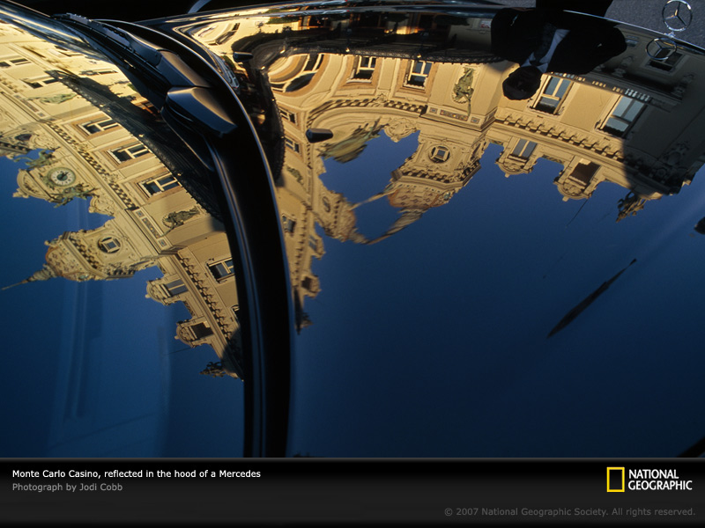

Slide 7
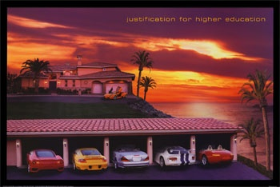

Slide 8
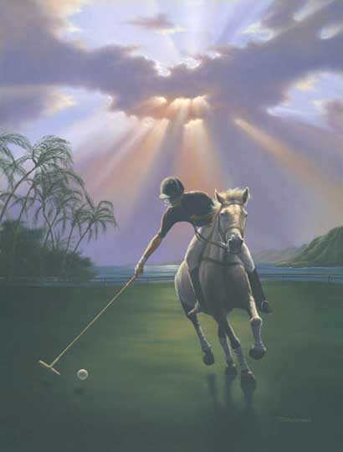

Slide 9

“THE REAL MEASURE OF WEALTH IS HOW MUCH YOU’D BE WORTH IF YOU LOST ALL YOUR MONEY!”
- Bernard Meltzer

Slide 10
ABOUT
MONEY

Slide 11
WITH MONEY YOU CAN
BUY A HOUSE,
BUT NOT A HOME.

Slide 12
WITH MONEY YOU CAN
BUY A CLOCK,
BUT NOT TIME.

Slide 13
WITH MONEY YOU CAN
BUY A BED,
BUT NOT SLEEP.

Slide 14
WITH MONEY YOU CAN
BUY A BOOK, BUT
NOT KNOWLEDGE.

Slide 15
WITH MONEY YOU CAN
SEE A DOCTOR,
BUT NOT GOOD HEALTH.

Slide 16
WITH MONEY YOU CAN
BUY A POSITION,
BUT NOT RESPECT.

Slide 17
WITH MONEY YOU CAN
BUY BLOOD,
BUT NOT LIFE.

Slide 18
WITH MONEY YOU CAN
BUY SEX,
BUT NOT LOVE.

Slide 19
“We are shaped and fashioned by what we love.”
- Johann Wolfgang Von Goethe

Slide 20
Men Are Valued:
By
What
They
Do

Slide 21
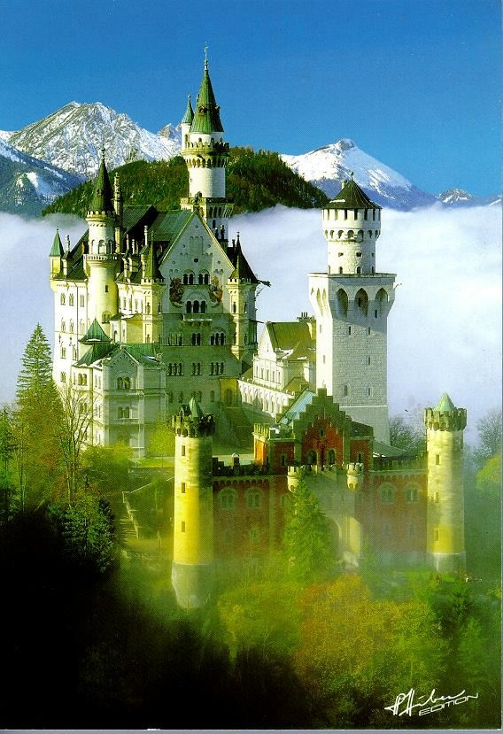

Slide 22
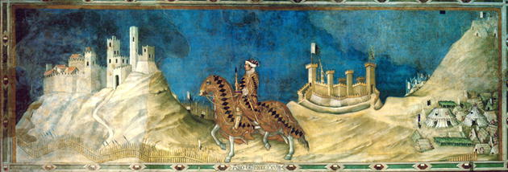

Slide 23
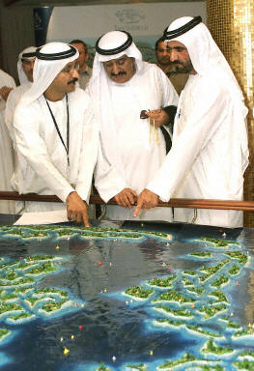
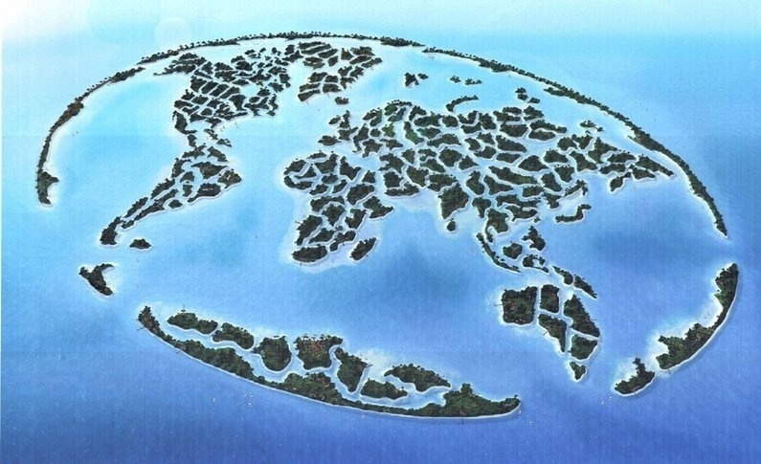

Slide 24
“We are shaped and fashioned by what we love.”
- Johann Wolfgang Von Goethe

Slide 25

position
LOVE OF

Slide 26

YES!

Slide 27
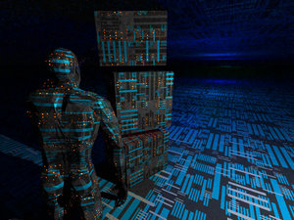
No
No
No
No
No
No
No
No
No
No
No
No
No
No
No
NO!

Slide 28
“We are shaped and fashioned by what we love.”
- Johann Wolfgang Von Goethe

Slide 29
Men Are Valued:
By
What
They
Are

Slide 30
Human Species: Made From Right Stuff?
Origins Of Man Debate: We Created Or Evolved
Nature Of Man Debate: Generally Good Or Evil
Position Debate: Above Animal Or Below Angel
Consciousness Debate: Continuous - Oblivious
In 50 B.C. It Was Stated Assuredly By Lucretius:
“Death is nothing to us – it concerns us not – since the nature of the mind is proved to be mortal.”
Hamlet’s Soliloquy By Playwright Shakespeare:
“To Die – To Sleep: Nothing More… & …To Die, To Sleep, Perhaps To Dream.”

Slide 31
Personage Materially Measured
Corporate Calculus From Famous Case; Gas Tank Placed To Add Golf Club Set; Future Income 180 Deaths = Utility $0.48 $11 Fire Extinguisher Not Cost Effective.
Humans For Sale Site Of Self Auction By Characteristics + Character Trait ~ $22.75
Body Chemical Total < One Blood Quart

Slide 32
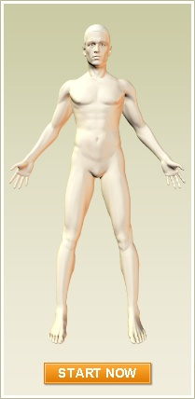
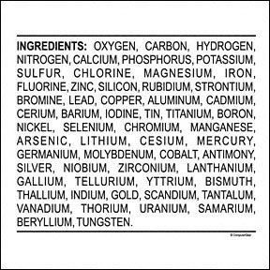


Slide 33
Kill Ratios & Carnage Costs
Wasting Lives & Wasting Money
Roman Caesars - Price Per Kill = $0.75
Napoleonic Age – Price Per Kill = $3,000
World War One – Price Per Kill = $21,000
World War Two – Price Per Kill = $200,000
War In Vietnam – Pay Per Hour = $1 Million

Slide 34
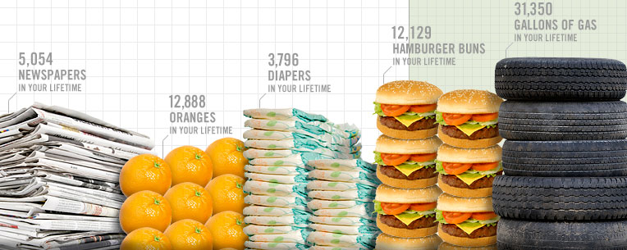
PERSONAL VALUE = PHYSICAL OR SPIRITUAL MEASURE?

Slide 35
Quantified Social Value Of Individuals
Statist Societies Have Made Doomed Dig Own Grave Prior To Execution.
Statist Societies Have Made Family Of Capital Offenders Incur Bullet Expense.
Statist Societies Have Sold Organs Of Criminals Executed On World Markets.

Slide 36
Cashing Out On Our Own Deaths
Insured Value
Litigation Value
Cadaver’s Value
Transplant Value

Slide 37
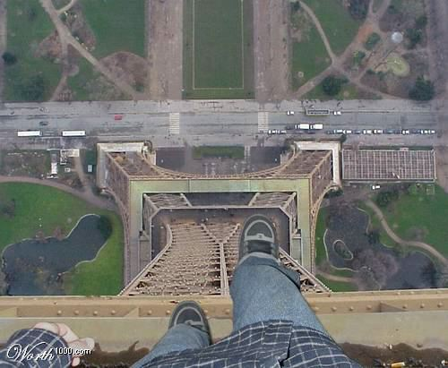

Slide 38
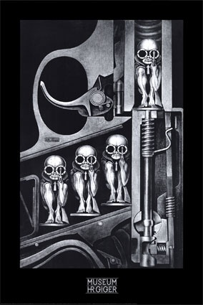
Time Charting Quality Of Life:
Mid-Scale Zero & Negative Entry?
Sharing Reasoning Of Those Suicidal.
Sharing Rationale Of The Mercy Killer.
Sharing Position Of Legal Euthanasia.

Slide 39
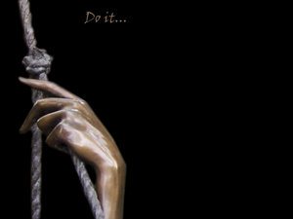

Slide 40
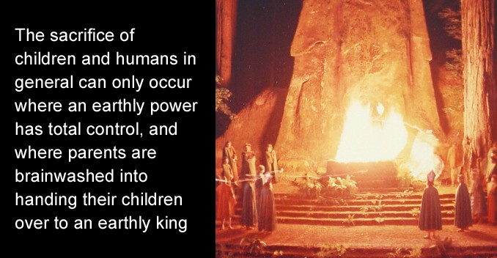
Time Charting Quality Of Life:
Mid-Scale Zero & Negative Entry?
Sharing Reasoning Of Those Suicidal.
Sharing Rationale Of The Mercy Killer.
Sharing Position Of Legal Euthanasia.
Sharing Platform With The Abortionist.
Child sacrifice

Slide 41

NO!

Slide 42
Quality Of Life Question:
Are We Worth More Dead Than Alive?
Replacing Value – You Are Unique!
Neighbor Value – You Are Needed!
Friendship Value – You Are Special!
Family Unit Value – You Are Crucial!
Intrinsical Value – Of Highest Order!
Priceless Value – Cannot Calibrate!

Slide 43

Synergistic
THE
SUM
GREATER
THAN
PARTS

Slide 44
Worth In Triage By Comparative Analogy
Only Way Works - Objective & Dispassionate.
Not Efficient Method When Knowing Personal.
Rationale For Emergency Not Utility Ideology.
Intervening To Save Years Rather Than Lives.
Compare Content Of Lives & Quality Of Years.
Decides Between Expenses: Price & Promise.
Extreme Example: The Lawful Over Criminal
Extreme Example: Taxpayer Over Tax Burden
Extreme Example: School Child Over Retiree

Slide 45
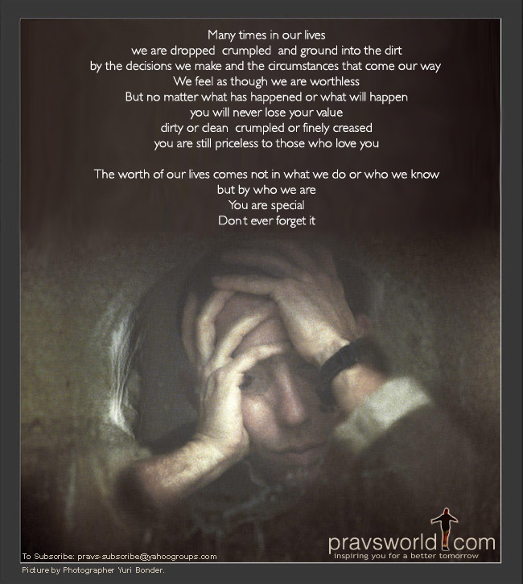

Slide 46
“We are shaped and fashioned by what we love.”
- Johann Wolfgang Von Goethe

Slide 47
Men Are Valued:
By
Who
They
Are

Slide 48



MANKIND MADE IN HIS IMAGE
Genesis Chapter One, Verse 26
“And God Said, Let Us Make Man In Our Image, After Our Likeness…”

Slide 49

God Cannot Triage!
He Values Us Equally:
Acts 10: 34
“Then Peter opened his mouth, and said, Of a truth I perceive that God is no respecter of persons…”

Slide 50
God Cannot Triage!
He Knows Us:
Jeremiah 1: 5
“Before I formed thee in the belly I knew thee; and before thou camest forth out of the womb I sanctified thee…”

Slide 51
God Cannot Triage!
He Loves Us:
John 3: 16
“For God so loved the world, that he gave his only begotten Son, that whosoever believeth in him should not perish, but have everlasting life.”

Slide 52
God Cannot Triage!
He Saves All:
John 3: 16
“For God so loved the world, that he gave his only begotten Son, that whosoever believeth in him should not perish, but have everlasting life.”

Slide 53
God Cannot Triage!
He Saves Lives:
John 3: 16
“For God so loved the world, that he gave his only begotten Son, that whosoever believeth in him should not perish, but have everlasting life.”

Slide 54

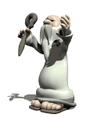
Chapter 7: 17
To The Heavens
David Lee Burris: God Without Game – Wants Man Without Guile
God’s Physics Not Chance & His Math Not Selfish. His Algebra Not Zero-Sum & His Geometry Has No Angle. He Does Not Focus On # 1 – His Love Indivisible – Redeems Financially Without Profit.
Job Cries Out:
“What is man, that thou shouldest magnify him?
& that thou shouldest set thine heart upon him?”

Slide 55
VALUE WORTH OF ONLY ONE: INFINITE
Best Clue Thing’s Worth Is Book Value.
Manufacturer Guide Features List Helps.
With Both Get Big Picture & Whole Story.
Holy Bible Is Our Own Owner’s Manual.
Learn Early We Do Not Own Ourselves.
Holy Bible Is Design Equip Price Guide.
We Learn Our Worth By What Was Paid.

Slide 56
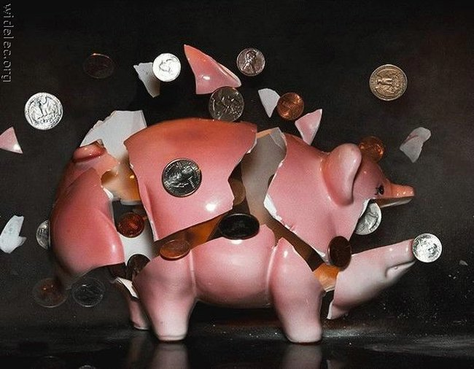

Slide 57


Slide 58

A Truism
I am not who I think I am…
I am not even who you think I am...
I am who God says I am!
You are not who you think you are…
You are not who I think you are…
You are who God says you are!

Slide 59
“We are shaped and fashioned by what we love.”
- Johann Wolfgang Von Goethe

Slide 60
Men Are Valued:
By
Who
They
Know

Slide 61
Ransom & Rescue

Slide 62
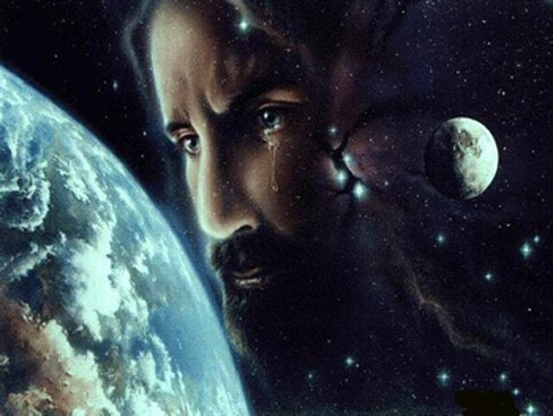

Slide 63
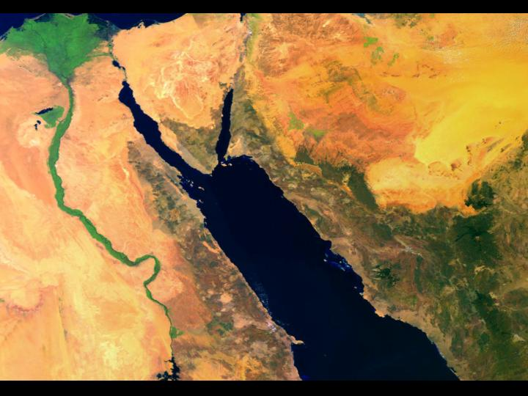

Slide 64
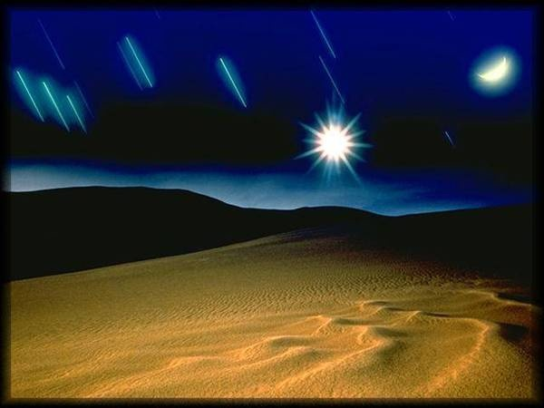

Slide 65
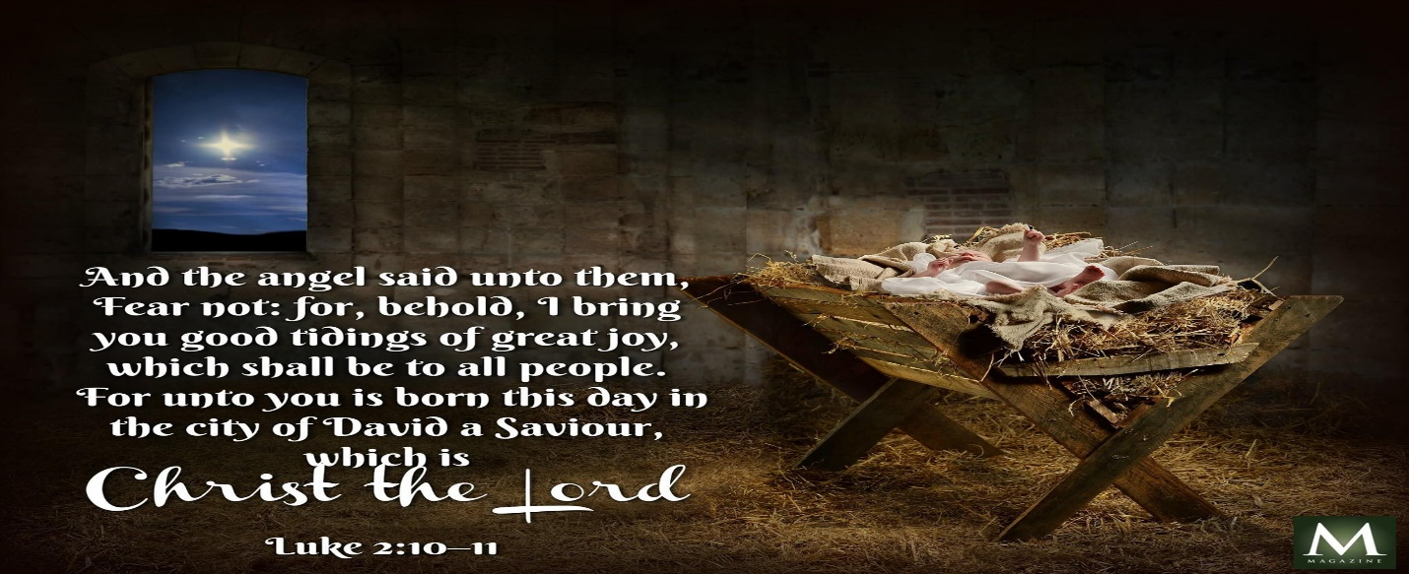

Slide 66
From the Dictionary of Paul & His Letters:
3.1. Ransom and Redemption. First Timothy 2:5–6 identifies Christ as the only mediator between God and human beings, declaring that he gave himself as a ransom for everyone. This statement may reflect the ransom saying in the Jesus *tradition (Mk 10:45), although it uses antilytron instead of lytron to express ransom, emphasizing the sense of exchange. By implication, human beings were held in captivity but were liberated by Jesus’ offering of himself on their behalf or (more likely) in their place. The ransom is Jesus himself, and the captor is not identified; however, 2 Timothy 2:25–26 states that nonbelievers are held captive by the devil.
Redemption (apolytrōsis) can refer to the eschatological “day of redemption” (Eph 4:30) when believers’ *bodies will be set free from decay in the general resurrection and believers will receive their inheritance (Rom 8:23; 1 Cor 15:50–57; Eph 1:14). Believers’ present experience of the Holy Spirit is the pledge of, or down payment on, that future inheritance (Eph 1:14).
However, redemption is also a metaphor for Christ’s completed work, which involves the justification of believers (Rom 3:24) and the forgiveness of their sins (Col 1:14). This redemption is accomplished by Christ’s death (Eph 1:7) and is embodied in Christ himself (Col 1:28). Gentiles are redeemed from their slavery to idols, while Jews are redeemed from their slavery under the law (Gal 4:8–9; 5:1–5, using exagorazō). Jesus’ faithful obedience unto death broke the cycle of law-sin-death for Jews and opened covenant membership to Gentiles. Believers are no longer slaves, because they have been bought (agorazō) with the price of Jesus’ death (1 Cor 6:20; 7:23). The Holy Spirit, who indwells them, is the stamp of Christ’s ownership (Eph 1:13). Because they now belong to Christ, they must not become slaves to immorality or to other people.

Slide 67
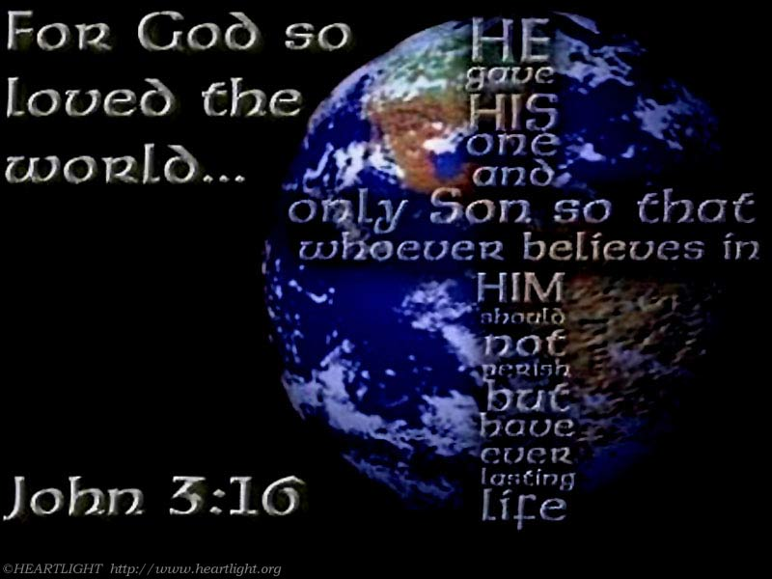
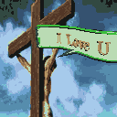

Slide 68
Right Value Of Self & Species Should Match Worth Creator Assigns Creation

Slide 69
MANKIND ACTED AS AN ENEMY
Romans Chapter Five, Verses 7 thru 10
“For scarcely for a righteous man will one die: yet peradventure for a good man some would even dare to die.
…But God commendeth his love toward us, in that, while we were yet sinners, Christ died for us. (8)
…Much more then, being now justified by his blood, we shall be saved from wrath through him. (9)
For if, when we were enemies, we were reconciled to God by the death of his Son, much more, being reconciled, we shall be saved by his life.”

Slide 70


Our Violent Grace
Christ’s Rejection
Jesus’ Humiliation
Son’s Desertion
His Ultimate Death

Slide 71
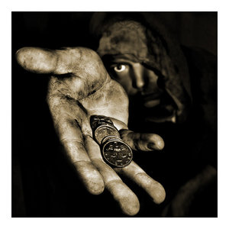

Slide 72
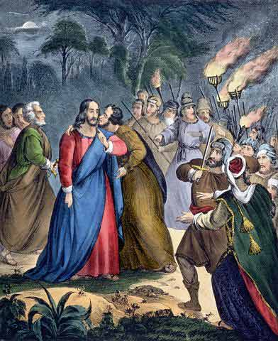

Slide 73
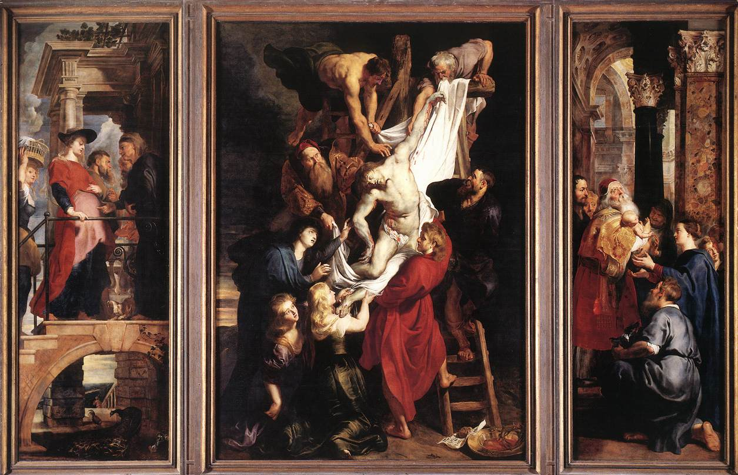

Slide 74
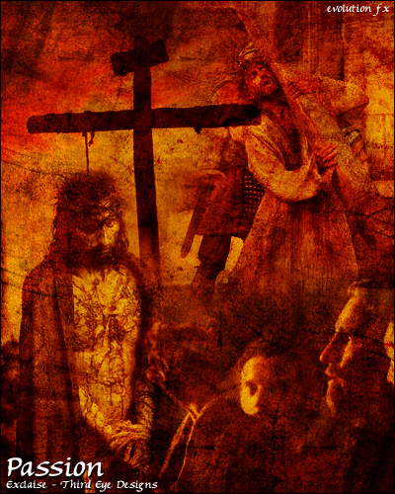

Slide 75



Slide 76
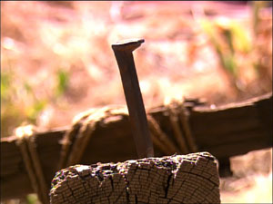

Slide 77
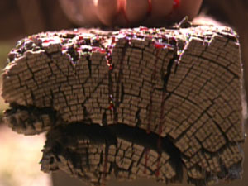

Slide 78
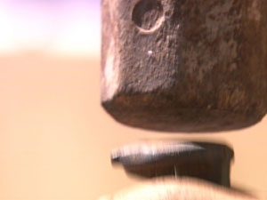

Slide 79


Slide 80
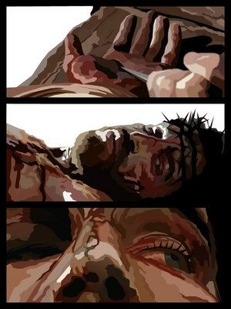

Slide 81
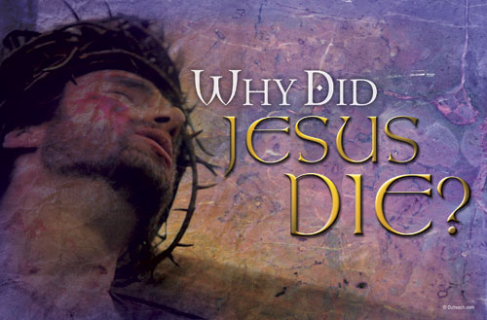

Slide 82
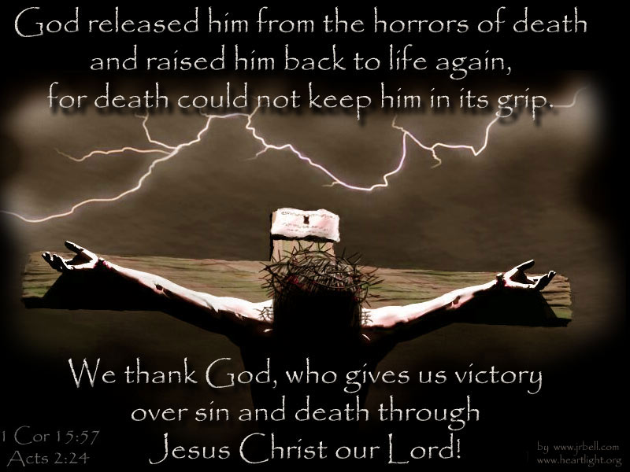

Slide 83
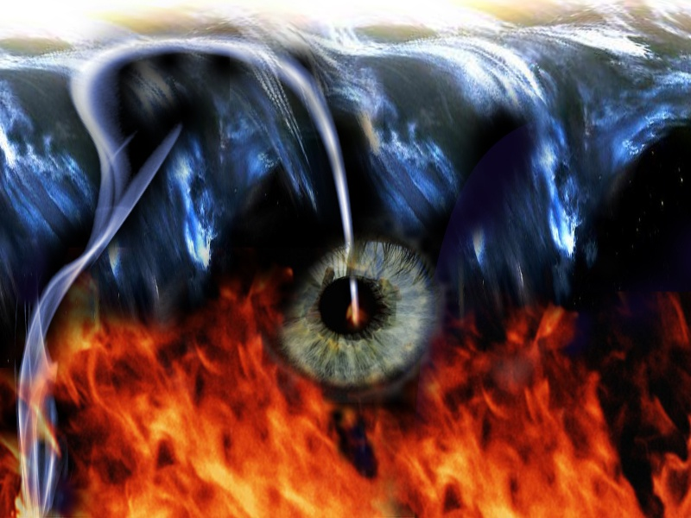
CHRIST ON THE CROSS WAS TO RETURN TO THE REALITY
HELL IS REAL!

Slide 84
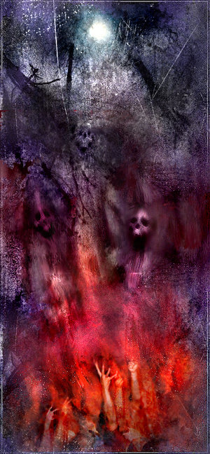


Slide 85
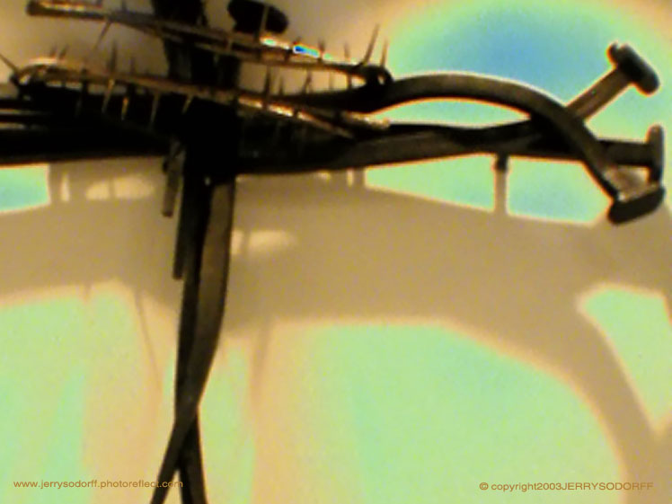

David Lee Burris:
Not Just Pleasant Fantasy!
THIS RESCUE WAS REAL!

Slide 86
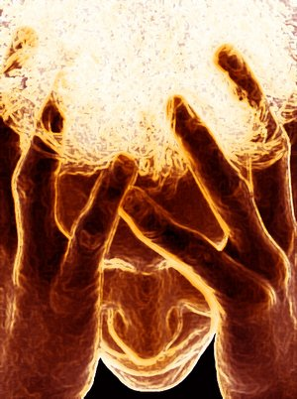
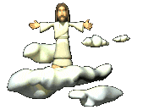

Slide 87
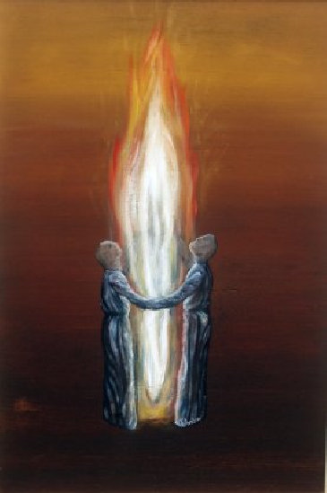

Slide 88
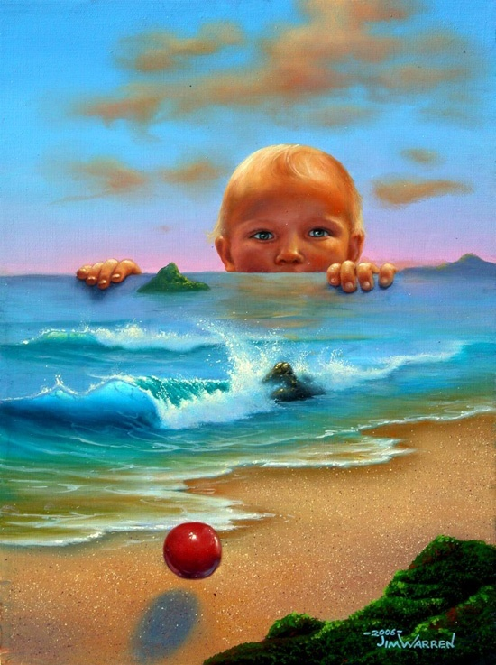


THE SON HAS RISEN

Slide 89
A Truism
I am not who I think I am…
I am not even who you think I am...
I am who God says I am!
You are not who you think you are…
You are not who I think you are…
You are who God says you are!

Slide 90
God’s Opinion of You
You were worth saving!
You are special in His eyes!
He does have a plan for you to give you a future and a hope
He calls you his child, an heir, a saint, his ambassador
He says you are the head not the tail, above and not beneath
He declares that you are more than a conqueror
He has promised that no good thing will he withhold from if you walk uprightly

Slide 91
we
Are
PRICELESS

Slide 92
Men Are Valued:
By
Who
They
Know!

Slide 93
“We are shaped and fashioned by what we love.”
- Johann Wolfgang Von Goethe

Slide 94


David Lee Burris:
“Close Your Eyes – Forget Your Name – Step Outside Yourself – Let Your Thoughts Stray – As You Go Insane.” - SLAYER

Slide 95
CHRISTIAN
David Lee Burris:
During The Time Of The Bible, A Person’s Name In Reflected Both On Who They Were & Who They Were To Become. Biblical Names Reflect On Both Individual Character & That Of God. Often In The Bible An Encounter & Challenge Required A New Name For A New Start. ;
SQUARE ROOTS LOOKING OUT FOR NUMBER ONE OR STRAIGHT ARROWS WATCHING FOR ONE ANOTHER – NEXTDOOR NEIGHBOR - HOMETOWN
THEY WERE CALLED CHRISTIANS FIRST BY OTHERS AT ANTIOCH!
LIVING UP TO THE BRAND NAME

Slide 96
A Great Truth
Tom Wolfe
There are only two reasons people do not become Christians
  They’ve never seen a Christian
  They have seen a Christian

Slide 97
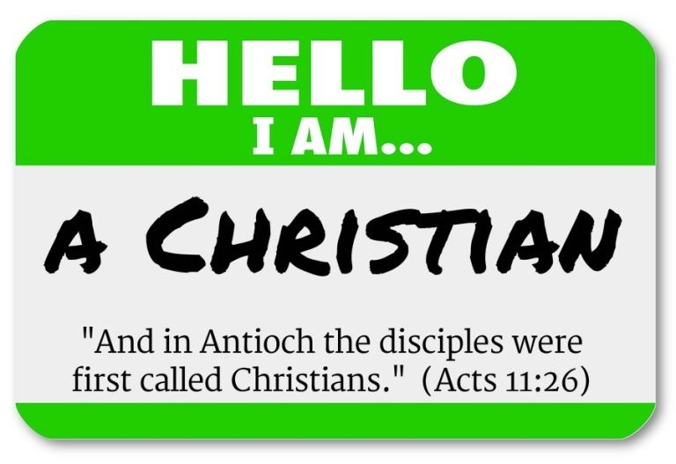

Slide 98

“It appears that CHRISTIANS was the first GENERAL appellative of the followers of our blessed Lord; and there is presumptive evidence that this appellative came by DIVINE APPOINTMENT. How very few of those who profess this religion are satisfied with this title.”
METHODIST ADAM CLARK:

Slide 99
“God never made Protestant Episcopalians, nor Presbyterians, nor Congregationalists, nor any other sectarian name. He made Christians, and they chose to call themselves by less lovely names.”
ANGLICAN BISHOP ANDERSON:

Slide 100
“I pray you leave my name alone, and call not yourselves Lutherans, but Christians. I have not been crucified for anyone. How then, does it befit me, a miserable bag of dust and ashes, to give my name to the children of God? Cease my dear friends, to cling to these party names and distinctions: away with all; and let us call ourselves only Christians.”
FIRST PROTESTANT & EARLY MARTIN LUTHER:

Slide 101
Adopted into God’s family

Slide 102
Christian Relationship: Not Title Or Brand Change But New Family Identification
"Whenever we read Bible stories we can't help but notice an important event that happens over and over again. People who have had a significant experience with God that transformed their life, more times than not they ended up with a name change. When Abram was called to leave his family & become the father of a great nation, his name was changed from Abram to Abraham. When Jacob wrestled with the angel & is blessed at the end of the battle, that blessing is signified in the change of his name from Jacob to Israel. When Simon confesses Christ on the mountain in Caesarea Philippi, his name is changed from Simon to Peter...
That is why it is significant that one of the first things that happens when Daniel and his friends are taken into exile in Babylon is that their names change. Each one of their original names has a significant connection to God. Daniel means "God judges." But when Daniel and his friends are renamed, all the references to God are lost.
It should be interesting for us as believers to pay attention to how the world would name you. To those who would see you as the end product of evolution, you are simply the next step in the process -- a conglomeration of proteins and water and carbon. To Madison Avenue we are consumers, targets to be separated from our money. To politicians we are voter groups who have significant key issues or points of interest, or agendas.
That is why it is so significant for us to remember who we are in Jesus Christ. We are indeed, rejected by the world but chosen by Jesus (1st Peter 2:4). We must understand who we are because what we do comes directly out of who we believe ourselves to be. If you believe your life is not worth anything, then you will make choices that reflect that lack of value. If you believe that you are created in the image of God and are called according to His purposes, then your behavior will reflect that basic belief.
Many of us complain about living in a world where we are called numbers. [Or a workplace nickname of physical or behavioral caricature.] It’s more than just a rude way to be addressed by corporations. It is a basic loss of humanity. The Gospel is good news because it restores our broken relationship to God, and in doing so restores our humanity. Today as you pray, confirm within you the name that He has given you, and that you will then live in the freedom of knowing who you are. Then you simply will not respond to a world that calls you by a wrong name." - Michael Duduit

Slide 103
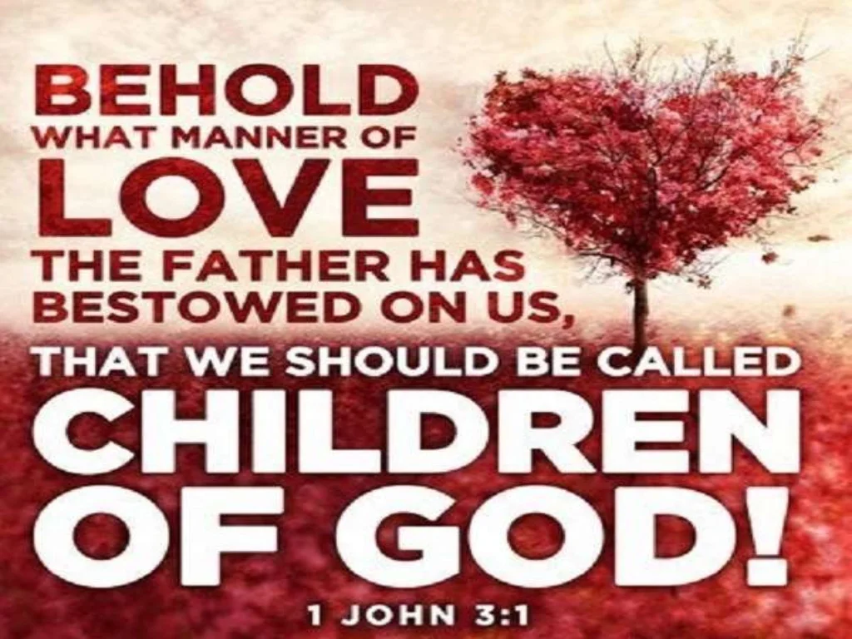

Slide 104
We’re Called Children. This increasing currency of the term brethren in the later apostolic age is intimately associated with the introduction of another name which came into use in the same period. Jesus frequently called the disciples his own brethren, and taught them, in praying to say, “Our Father, who art in heaven;” but the title, “children of God,” which grew out of the relation thus indicated, was not applied to them during this early period. It is not so applied in any of the gospels but John’s, and in this way only in two instances, where it is evident that he is using the phraseology of the time in which he writes rather than of the period of which he writes. This appellation, as a cotemporaneous and current title, is found only in the Epistles, being brought then into use after the disciples had obtained more exalted conceptions of the many blessed privileges & high honors which God had conferred upon them. It extorted an admiring comment from John, in his old age: “Behold, what manner of love the Father bestowed upon us, that we should be called the sons of God!” – J. W. McGarvey

Slide 105

ADOPTED?!
RANSOMED & RESCUED
REDEEMED BY THE CROSS

Slide 106
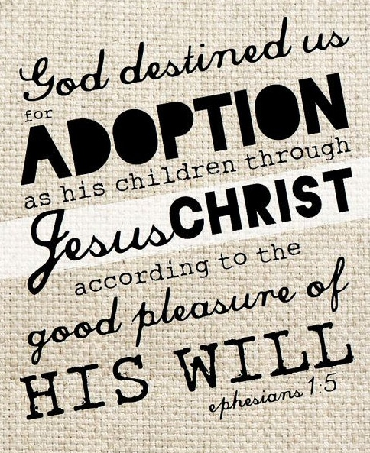

Slide 107
FROM TABLETALK MAGAZINE:
THE PAULINE VIEW OF ADOPTION: ROMANS 8:14–17
The grace of adoption was afforded to slaves of sin to make them co-heirs with Christ. For Paul to declare that those who were once slaves to sin were adopted was a very influential message. The slave metaphor was personal to many people. Furthermore, when a person was adopted, a change in commitment was expected. It was the norm to carry the name, estate & religious rites of the adoptive family. It was a new lineage. The notion that they had been brought into the household of God through adoption was transformative. They were not simply freed slaves who were often considered only slightly better than slaves who were still in bondage. Even a manumitted slave who amassed wealth still faced class restrictions. So, when Paul states that the Christians weren’t simply freed but adopted, they understood that they had received greater privileges.
What are some of the privileges of being adopted by God? Those who possess the Spirit of adoption have the Spirit of Christ and are no longer slaves to sin (Romans 8:9–14). Though slaves in the ancient world had much to fear, especially when they served a harsh master, believers could cry “Abba! Father!” (Romans 8:15–16). In Romans 8:17, Paul indicates that those adopted are “children” (Greek tekna). While believers are not shielded from present sufferings, those who suffer with Christ will also share in His glory (Romans 8:17). Hence, Paul speaks in Romans 8:23–25 about a future aspect of adoption, namely, the redemption of our bodies at the future resurrection.

Slide 108
1. The doctrine of adoption attributes the initiative for the relationship between God & fallen humanity to God
But to all who did receive him, who believed in his name, he gave the right to become children of God, who were born, not of blood nor of the will of the flesh nor of the will of man, but of God. (John 1:12–13)
As Russell Moore puts it, “adoption is a past tense verb,” and that is as true in spiritual adoption as it is in family adoption on earth; you were adopted, you are a son or a daughter of the Father, now and forever.
2. The doctrine of adoption acknowledges that we are part of a greater family
One body, and one Spirit, even as ye are called in one hope of your calling. (Ephesians 4:4 KJV)
Because all holy doctrine is connected, adoption connects us to the one, holy, timeless body of Christ. No longer can we think of ourselves in a private Christianity or ever believe again that our faith is just “a personal matter.” Rather, we are adopted into a true, organic family of God with all rights as fellow heirs with Christ. The terms “brothers,” “sisters,” “fathers,” and “mothers” in the faith are not just cute colloquial ways of addressing each other in the closing line of our letters. They are not some “clubby” insider terms of a closed society. Such filial terms are emotionally rich, unassailably real, and overflowing with deep theological, biblical, and even “blood-redeemed” meaning. [These terms] acknowledge our purchase from sin and our adoption in one common holy family.
The doctrine of adoption means that we, the Father’s children, have life together.
It is critical, therefore, to see in this passage that there is one body of Christ, not two or three, or more. There is one. There is one Spirit who baptizes us all into that body.
There is one hope of our calling, and that is the hope to eternal life through Jesus Christ our Lord.
The doctrine of adoption tells us that we are part of a family. We are not only part of a visible family, but also an invisible family that includes those family members in Christ who have gone before us. The church militant—those of us still moving on in Christ on earth—and the church triumphant—those who have gone from this life into the very presence of Christ—are all one family as well. We are truly a “communion of saints.” As A. A. Hodge wrote, “Adoption presents the new creature in his new relations.”
3. The holy doctrine of adoption attests to the biblical fact that there are two classes of mankind: those who have been adopted and those who have not
All of God’s children were adopted into His family. The world is filled with those who are His by adoption into His family and those who are not. There can be no in-between place. You are a child of God through faith in Christ or you are not a child of God. The doctrine of adoption clearly teaches that we cannot be Christians when we are born. God has no naturally born children. We must be born again, as our Lord taught Nicodemus in the third chapter of John’s gospel, in order to be a child of God.
Milton, M. A. (2012). What Is the Doctrine of Adoption?. (S. M. Lucas, Ed.) (pp. 5–39). Phillipsburg, NJ: P&R Publishing.

Slide 109
“We are shaped and fashioned by what we love.”
- Johann Wolfgang Von Goethe

Slide 110
CHURCH OF CHRIST
David Lee Burris: Needed Return To The Concept Of Family Honor!
Names Are The Way In Which We Identify Both People & Organizations. Name Recognition Can Illicit Humor, Horror, Or Honor. Our Group Names Reflect On Us & Us On The Group. BOTH INDIVIDUALLY & COLLECTIVELY GOD IS ENTRUSTING HIS REPUTATION WITH US.
WHEN OUR LIVES CEASE TO SPEAK OUR REPUTATIONS ONLY EXTERIOR FORMALITIES.
THEN WE BECOME INDISTINQUISHABLE AS THE PRISON CHAPLAIN CONVERTED TO THE CON AND THE MILITARY CHAPLAIN AVERSE OF THE FRONT AFRAID OF LOSING HIS LIFE
Living Up To The Family Name

Slide 111
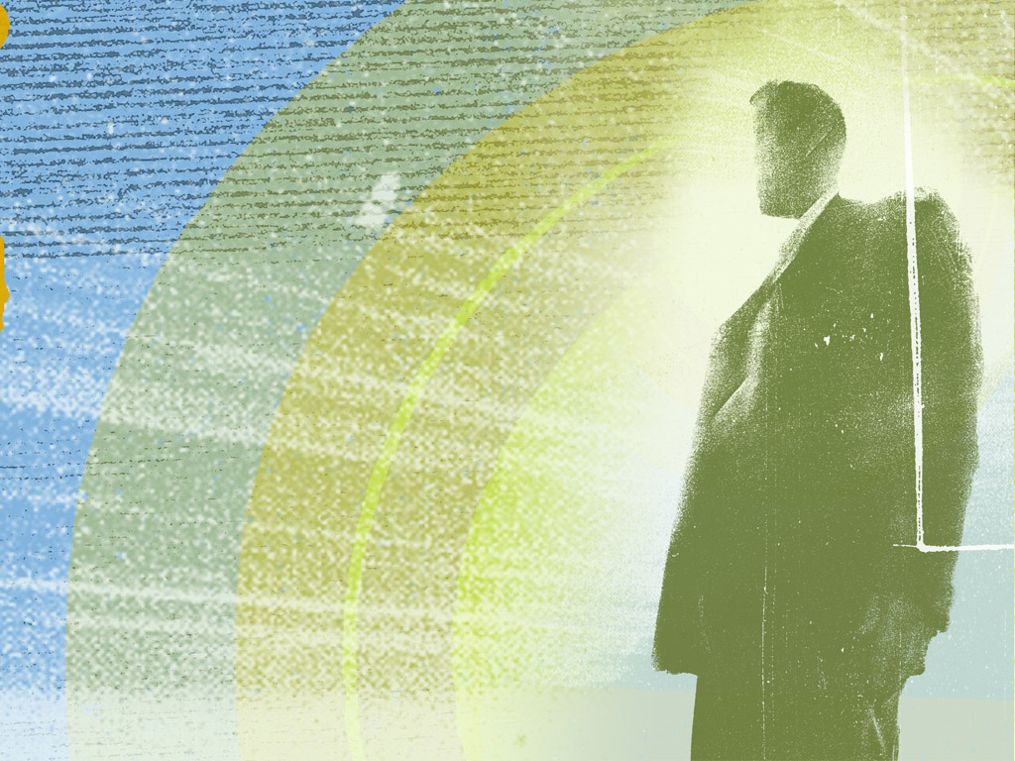
We ARE Jesus Presenters
We ARE Jesus Presenters and fortunately we are not alone.
✓ Our “association” is the church
✓ Power of God’s Word works thru us
✓ Holy Spirit comforts & assists
Notes:
We are Jesus Presenters.
Fortunately, we do not function alone or in isolation. Like Homer Sewell, we also have an “association,” an association of Jesus Presenters we call the church.
From this body we get guidance and encouragement and discipline and inspiration, plus the odd and enlightening experience of hanging around with a large group of people who are trying to project the same persona.
We certainly don’t all look the same, as is the case with a convention of 117 Abes in stovepipe hats, but we certainly can learn from one another, especially if we treat each other with kindness and mutual respect.
Even more importantly, we do our work knowing that the power of God is working through us. Jesus continues to be active in our lives, promising that he will do whatever we ask in his name, meaning that he will answer us when we ask for help in revealing the power and character of God.
We are asked to perform the works of Jesus, and through these works to reveal the power and character of God to the world.
If we accept this invitation, people will look at us and say, “Jesus.”
Source:
Schultz, Connie. “It’s not Christian to champion hate,” The Cleveland Plain Dealer, November 13, 2003.

Slide 112
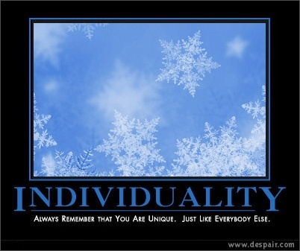

Slide 113
A Great Truth
Tom Wolfe
There are only two reasons people do not become Christians
  They’ve never seen a Christian
  They have seen a Christian

Slide 114
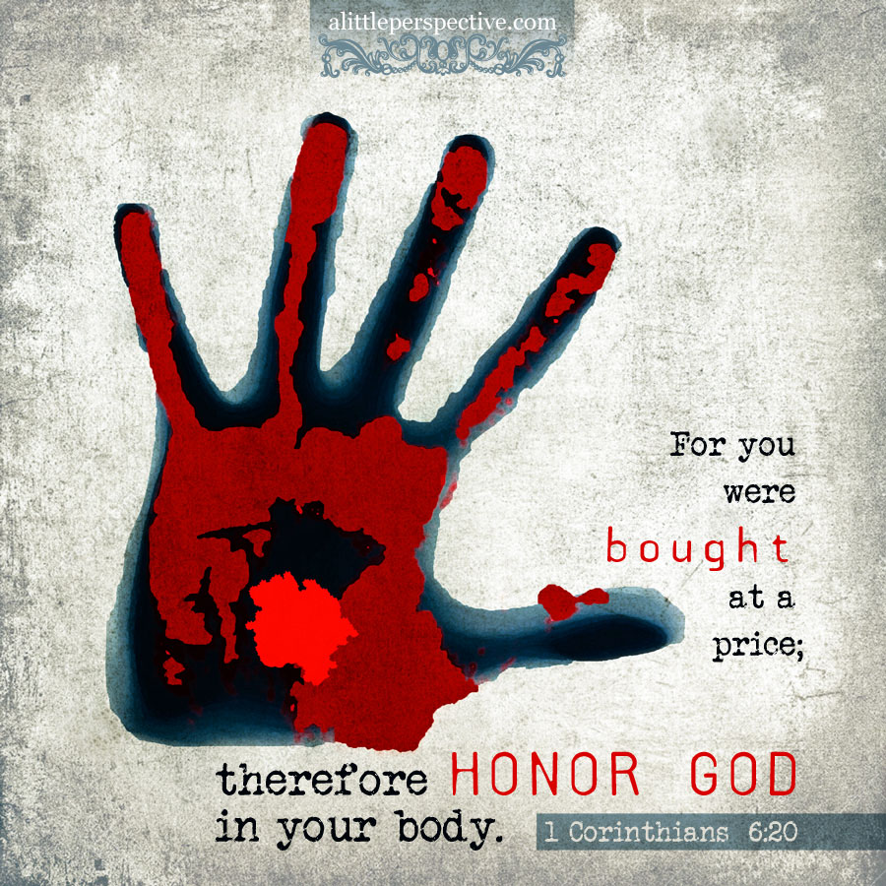

Slide 115
Adopted into God’s family & heavenly Heir

Slide 116
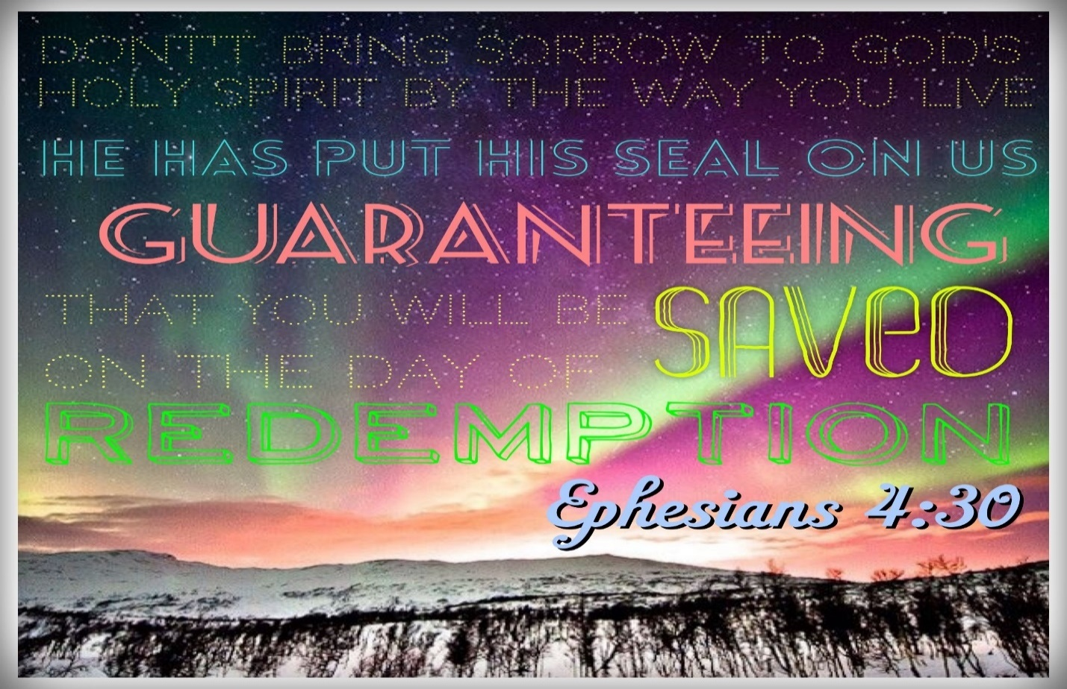

Slide 117
“We are shaped and fashioned by what we love.”
- Johann Wolfgang Von Goethe

