Slide 1
The Great Cane Ridge Revival
by David Lee Burris

Slide 2
THE PENDULUM EFFECT IN CHURCH HISTORY
Emphasis On Emotions
Emphasis On Intellect
SECOND CENTURY MONTANISM
 |  | SECOND CENTURY GNOSTICISM
THIRD CENTURY MONASTICISM
 |  | THE 11TH CENTURY SCHOLASTICS
THE 14TH CENTURY MYSTICISM
 |  | THE 16TH CENTURY REFORM CREED
THE 17TH CENTURY PIETISM
BIBLICAL CHRISTIANITY

Slide 4
"The chains of habit
are generally too small
to be felt until
they are too strong
to be broken."
- Samuel Johnson

Slide 5
May 19, 1780 Dark Day The dark day of May 19, 1780 was the most mysterious and as yet still unexplained phenomenon of its kind. It was a most unaccountable darkening of the whole visible heavens and atmosphere in New England. R. M. Devens, Our First Century, page 89. An eyewitness living in Massachusetts described the event as follows:
In the morning the sun rose clear, but was soon overcast. The clouds became lowery, and from them, black and ominous, as they soon appeared, lightning flashed, thunder rolled, and a little rain fell. Toward nine o'clock, the clouds became thinner, and assumed a brassy or coppery appearance, and earth, rocks, trees, buildings, water, and persons were changed by this strange, unearthly light. A few minutes later, a heavy black cloud spread over the entire sky except a narrow rim at the horizon, and it was as dark as it usually is at nine o'clock on a summer evening. . . . Fear, anxiety, and awe gradually filled the minds of the people. Women stood at the door, looking out upon the dark landscape; men returned from their labor in the fields; the carpenter left his tools, the blacksmith his forge, the tradesman his counter. Schools were dismissed, and tremblingly the children fled homeward. Travelers put up at the nearest farmhouse. 'What is coming?' queried every lip and heart. It seemed as if a hurricane was about to dash across the land, or as if it was the day of the consummation of all things. Candles were used; and hearth fires shone as brightly as on a moonless evening in autumn. . . . Fowls retired to their roosts and went to sleep, cattle gathered at the pasture bars and lowed, frogs peeped, birds sang their evening songs, and bats flew about. But the human knew that night had not come. . . .
Dr. Nathanael Whittaker, pastor of the Tabernacle church in Salem, held religious services in the meeting-house, and preached a sermon in which he maintained that the darkness was supernatural. Congregations came together in many other places. The texts for the extemporaneous sermons were invariably those that seemed to indicate that the darkness was consonant with Scriptural prophecy. . . . The darkness was most dense shortly after eleven o'clock." The Essex Antiquarian, April, 1899, Volume 3, Number 4, Pages 53, 54. In most parts of the country it was so great in the daytime, that the people could not tell the hour by either watch or clock, nor dine, nor manage their domestic business, without the light of candles. . . . The extent of this darkness was extraordinary. It was observed as far east as Falmouth. To the westward it reached to the farthest part of Connecticut, and to Albany. To the southward, it was observed along the seacoasts; and to the north as far as the American settlements extend."--William Gordon, History of the Rise, Progress, and Establishment of the Independence of the U.S.A., Volume 3, page 57. The intense darkness of the day was succeeded, an hour or two before evening, by a partially clear sky, and the sun appeared, though it was still obscured by the black, heavy mist.
After sundown, the clouds came again overhead, and it grew dark very fast. Nor was the darkness of the night less uncommon and terrifying than that of the day; notwithstanding there was almost a full moon, no object was discernible but by the help of some artificial light, which, when seen from the neighboring houses and other places at a distance, appeared through a kind of Egyptian darkness which seemed almost impervious to the rays. Isaiah Thomas, Massachusetts Spy; or, American Oracle of Liberty, Volume 10, Number 472 (May 25, 1780).
Said an eyewitness of the scene:
I could not help conceiving at the time, that if every luminous body in the universe had been shrouded in impenetrable shades, or struck out of existence, the darkness could not have been more complete. Letter by Dr. Samuel Tenney, of Exeter, New Hampshire, December, 1785 (in Massachusetts Historical Society Collections, 1792, 1st series, Volume 1, page. 97). Though at nine o'clock that night the moon rose to the full, it had not the least effect to dispel the deathlike shadows. After midnight the darkness disappeared, and the moon, when first visible, had the appearance of blood.
May 19, 1780, stands in history as "The Dark Day." Since the time of Moses no period of darkness of equal density, extent, and duration, has ever been recorded. The description of this event, as given by eyewitnesses, echoes the prophet Joel, twenty-five hundred years previous to their fulfillment: The sun shall be turned into darkness, and the moon into blood, before the great and terrible day of the Lord come. (Joel 2:31)

Slide 6
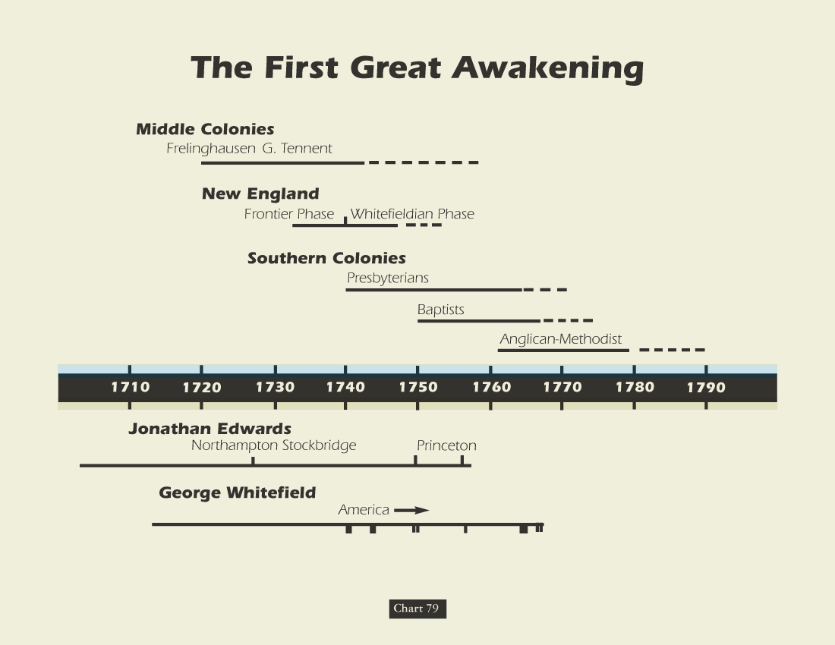
Jonathan Edwards Would Not Frontier Evangelize Because The Common People There “Smelled Like Bear Grease”

Slide 7
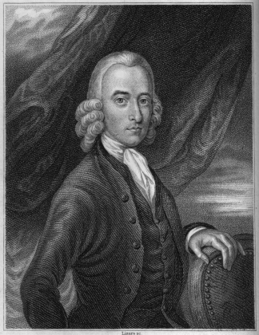
Robert Sandeman 1718-1771
American Influence
1760 – Letters On Theron And Aspasio Appear In Colonies
1763 – He Receives A Letter Urging A Visit To America
August 30, 1764 Sandeman Departs Scotland Arriving In Boston Harbor, Oct. 18, 1764
Glas/Sandemanian Churches Established In Connecticut, Rhode Island, Massachusetts, & Other New England States
Sandeman Died In Danbury, Connecticut, April 2, 1771 At 53 Years Of Age, Two Years Before Glas In Scotland

Slide 9
The Great Awakenings Compared
First Great Awakening | Second Great Awakening
Religious Revivals
Emotional, Fire & Brimstone Preaching
Calvinist Influence [Sinfulness Inherent] | Arminian Influence [Sinfulness a Choice]
Conversion Experience
Spread of Non-traditional Denominations
Promoted Democratic Ideals
American Revolution | Antebellum Reform

Slide 10
Family History From Family Bibles: Physical Births & Spiritual Rebirths
DENOMINATIONS = DEGREES OF REFORM
SACRAMENTAL/LITURGICAL TRADITIONIST
Reformation Regulative Principle Divide:
German Reformers - “Do any worship act not specifically forbidden.”
Swiss Reformers – “Only allow in service worship what specifically approved.”

Slide 11
First Awakening:
LEVELED CLERGY
Sacramental Religion
AD 1801
Charismatic Religion
Institutional Development FROM THE 2ND GREAT AMERICAN AWAKENING

Slide 12
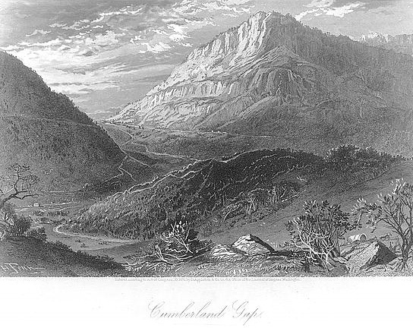
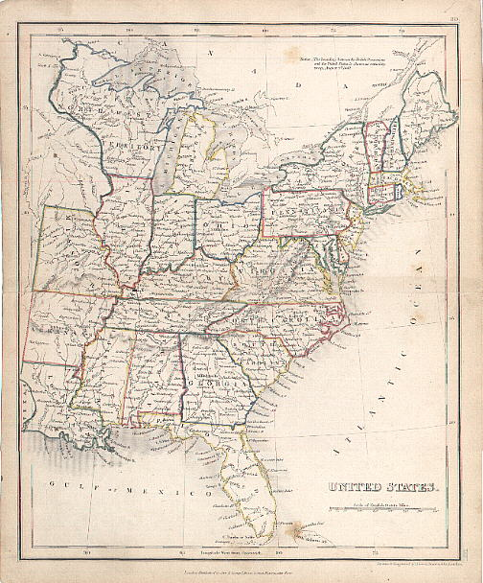
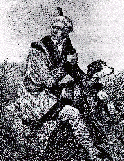
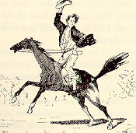
Early 19th Century America

Slide 13
According to the 1800 census, the United States contained 5,308,483 persons. In the same year the British Islands contained upwards of 15 millions; the French Republic, more than 27 millions. Nearly one fifth of the American people were negro slaves; the true political population consisted of 4.5 million free white or less than one million able-bodied males, on whose shoulders fell the burden of a continent. Even after two centuries of struggle the land was still untamed; forest covered every portion, except here & there a strip of cultivated soil; the minerals lay undisturbed in their rocky beds, and more than two thirds of the people clung to the seaboard within 50 miles of tide-water, where alone the wants of civilized life could be supplied. Center of population rested within 18 miles of Baltimore, north & east of Washington. Except in political arrangement, the interior was little more civilized than in 1750, and was not much easier to penetrate than when La Salle & Hennepin found their way to the Mississippi more than a century before.

Slide 14
Sweet’s Story of American Religion: Presbyterians
“Of all the American churches at the opening of the national era, the Presbyterian was the most strategically located for an immediate advance into the West. The Scotch-Irish constituted the last great wave of emigration previous to the Revolution and by 1760 Scotch-Irish Presbyterian churches were to be found scattered along from ‘the frontiers of New England to the frontiers of South Carolina.’”

Slide 15
The Church Across The Ages
of people, events
life and faith from
Glimpses
The Second Great Awakening
In August, 1801, Barton W. Stone led a revival in Cane Ridge, Kentucky that became the most famous camp meeting. The meeting lasted a week, and 23,000+ people came. The preaching was simple, lively, and persuasive, with preachers from different denominations sharing the platform. The strong emotional responses produced strange physical manifestations – some people fainted and fell to the ground or suffered uncontrollable shaking. There was dancing, running, and singing – all of which Stone said were manifestations of God’s presence. The noise of the meeting was so great some said “the noise was like the roar of Niagara.” Eastern revivalists were highly critical of the emotional excesses of the Cane Ridge camp meeting. One Presbyterian minister said the anarchy of the camp meetings must have had some connections with the French Revolution!

Slide 17
David Lee Burris:
One Year After Cane Ridge Stone Was Joined By Baptist Preacher John Mulkey Who Took ¾’s Of His Church Out With Him. He Went On To Scripturally Baptize Over 10,000 people; Barton Stone Spoke Fluent Cherokee & Evangelized The Cherokee Nation
Stone Movement Sent First Christians To Texas With Davey Crockett In 1835
Campbell Presbyterian Intermediate Affiliation With Baptists
Presbyterian
AD 1801
In 1801, Barton Stone held his Cane Ridge Revival in Kentucky.
This marked the root beginning of American Churches of Christ.
Churches of Christ

Slide 18
Family History From Family Bibles: Physical Births & Spiritual Rebirths
DENOMINATIONS = DEGREES OF REFORM
SACRAMENTAL/LITURGICAL TRADITIONALIST
ANTI-TRADITIONAL REVIVALISTS MOVEMENT
RATIONALISM + NATURALISM
PRE-RESTORATION SCOTLAND
PRE-RESTORATION AMERICA
THE FIRST GREAT AWAKENING
THE SECOND GREAT AWAKENING
BARTON STONE

Slide 19
B. W. Stone Movement
David Lee Burris:
His Cousin Was A Signer Of The Declaration Of Independence & His Older Brothers Fought In The War;
Rice Haggard Worked With Stone & Was Link With O’Kelly Movement Not Accepting American Bishop;
Black Freemen At Cane Ridge Building Segregated To The Upstairs Gallery
OTHER PREACHERS AT CANE RIDGE LEFT TO EMBRACE SHAKERISM
Barton Stone Witnessed The American Revolution
Second Part “Great Awakening” Was After War
War Partisan Denominations Demoralized Most
Official Church Membership Was Down By 90%
Sent Schooling To The David Caldwell Academy
McGready’s Message Convicted But W/O Hope
Hodge’s Positive Message Converted With Heart
Gave Qualified Presbyterian Confession Of Faith
Cane Ridge 25,000 Camp Meet Was Non-Creedal
Challenged Churches Of That Time In Their Legalism, Authoritarianism, & Exclusivism
Charged W/ Arminian Heresy Formed Association
Signed Satirical “Last Will” As Simply Christians
Notes:
At Age Seven He Could Hear The Guns Of General Green & Cornwallis At The Battle Of Guilford Courthouse.
As A Youth He Sunk Himself In Sports Because Of Bickering Between Baptists & Methodists; He Felt That Religion Was Mere Occasion For Narrow Minded People To Quarrel.
“The doctrines of the Bible, we believe, have never divided Christians, but human opinions of these doctrines, without charity, have already done the mischief…For thirty years of my ministry I have kept in view the unity of Christians as my polar star…
Stone Fathered 19 Children Of His Own From Two Wives.
Increasingly Calvin’s God Became Stone’s Devil!
He Began To Preach Regularly That The Gospel Was For All, Not Just The Elect!
Cane Ridge Building Had Gallery For Slave Seating.
25,000 Plus People Camped Nearby In Woods For Seven Day Meeting.
Presbyterian Church Did Not Want Their Educated Ministers Participating With Uneducated Methodists & Baptists.
Of This First Five Against Religious Party Spirit - Who Signed Last Will & Testament Of Springfield Presbytery – Two Went Into Shakerism – Two Returned To Presbyterianism – Barton Stone Was Left Alone For Eight Years Before The Campbells Were Ever Baptized

Slide 20
David Caldwell 1725-1821
Born In Lancaster County, Pennsylvania, March 22nd, 1725
Graduated from Princeton in 1761
Licensed To Preach By The Presbytery Of New Brunswick, June 8th, 1763
1765 While Doing Mission Work In North Carolina, He Started A Log Cabin School In Guilford County
1766 Married Rachel Craighead, Daughter of Presbyterian Minister, Alexander Craighead
1768, He Was Installed As Minister Of The Two Presbyterian Churches In Buffalo and Alamance Settlements
1769 Began His Academy At Greensboro, N.C.
During Revolutionary War, Gen. Cornwallis offered a £200 Reward For His Capture For Speaking Out Against The Crown – Home Destroyed By Fire, Including Library By British
1776, Member Of The Convention That Formed The Constitution Of The State Of North Carolina
1789 When University of N.C. Was Chartered Caldwell Was Offered The Presidency

Slide 21
David Caldwell 1725-1821
His School Sent Out Over 50 Preachers, 5 Governors, Congressmen, Physicians, Lawyers & Judges
1790 – 65 Years Of Age When B.W. Stone Became Student
Continued To Preach In His Two Churches Till The Year 1820
Preached Often At Hawfields Church Where B.W. Stone Was Later Ordained Into Orange Presbytery
He died August 28th, 1824

Slide 22
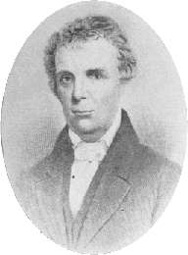
Barton Warren Stone
Born In 1772 – Port Tobacco, Maryland
Feb 1, 1790, Age 18, Attends Doctor David Caldwell’s Guilford Academy, Greensboro, North Carolina

Slide 23
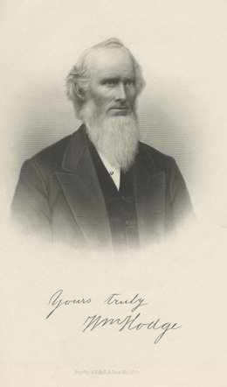
Barton Warren Stone
Studied The Languages – Believed That The Hebrew & Greek Languages Were The Choices Of God To Deliver His Message To Man, Therefore His Honor To Study
Got Religion
Upon Arrival, Not Interested In Religion, Just Wanted To Study Law
Just Before Arriving Most Of Student Body Had Been Converted To Presbyterianism At The Preaching Of William Hodge
1791, February — Heard James McGready, Who Left Him Cold And Religiously Detached
In The Spring, Got Religion At The Milder Preaching Of William Hodge, (Graduate of Caldwell’s School) At Hawfields Presbyterian Church - Sprinkled
William Hodge

Slide 24
Barton Warren Stone
After Graduation, Though Leaning To The Ministry, He Rejected It Initially Choosing To Visit His Brother In Washington, Georgia
Offered Teaching Position At Succoth Academy, In Washington, Georgia For One Year
Influenced By Principal, Hope Hull, A Methodist Influenced By O’Kelley In 1795
Was Professor Of Languages
His Notoriety As A Linguist Nearly Caused Him To Turn Away From Religion
1796 Return To N.C. Stone Was Licensed In The Orange Presbytery At Hawfields Church, To Preach
At Ordination William Hodge Took The Bible In Hand And Said Their Greatest Obligation Was To It
Stone Noted That Such Focus Was Not On The Confession Of Faith, But The Bible

Slide 25
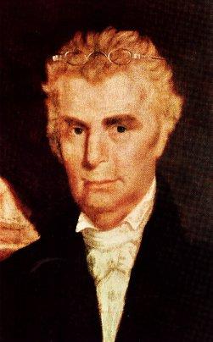
Family Life Of Barton W. Stone
Barton & Eliza Had One Son And Four Daughters Together – The Son Died Early
Eliza Campbell Stone Died In 1810
Stone Married Celia Bowen Of Gallatin, Tennessee in 1811
Moved To Gallatin In Hopes To Take Over Bowen Home And Plantation
1812 He Returns To Kentucky To Teach And Preach

Slide 26
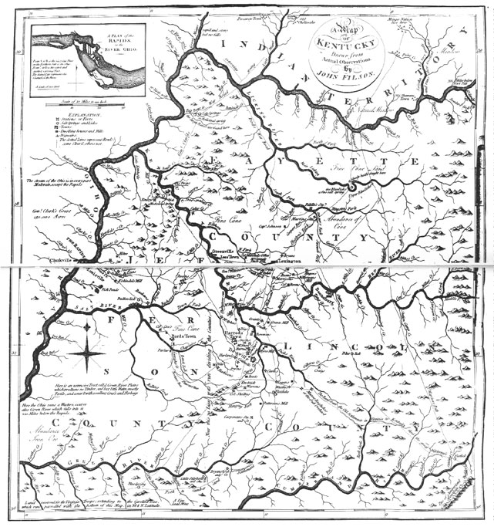
Barton Warren Stone
Stone Goes West To Kentucky

Slide 27
Barton Warren Stone
Moved To Cane Ridge, Kentucky In 1797 Where He Accepted Positions Of Pastor For Concord & Cane Ridge Churches
Concerning His Ordination Into The Transylvania Presbytery, He Was To Swear Allegiance To The Westminster Confession Of Faith
Stone Said, “I Do In As Far As It Agrees With The Bible”
Heard Of And Visited The McGready Revival In Logan County, Fall, 1800
Returned To Cane Ridge And Preached A Lesson On John 3:16
July 2, 1801 – Married Elizabeth Campbell At Greenville, Ky.

Slide 28
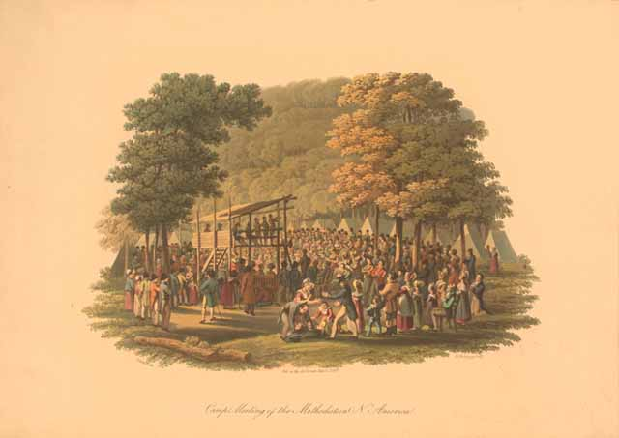
Getting Religion: Calvinism’s Influence On Late 18th & Early 19th Century Religion

Slide 29
B.W. Stone Battle With Calvinism
Does God Really Love The Whole World as is said in John 3:16?
Continued On Next Slide

Slide 30
B.W. Stone Battle With Calvinism
Continued On Next Slide

Slide 31
B.W. Stone Battle With Calvinism

Slide 32
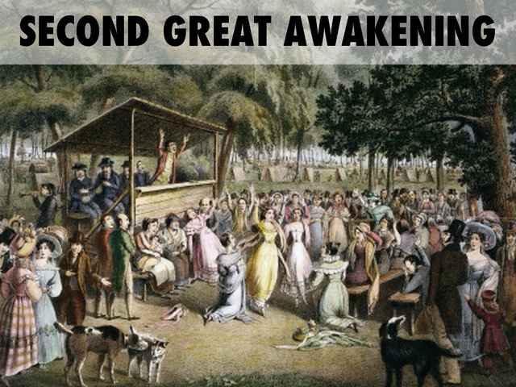

Slide 33
Background To The Kentucky Revival
In 1796, 97 Many Denominational Preachers Questioned Their Backgrounds
One Preacher Wrote That His Sin Was Greatest Among Sinners Deserving God’s Wrath
Another Wrote, “If People Are Spotted With Sin, I’m Spotted All Over.”
One Preacher Thought The World Was Doomed Waiting On The Wrath Of God To Be Revealed
Others Thought Themselves Unworthy Of Any Blessing From God
Everyone Was Doomed And There Was Nothing That Could Be Done About It
These Were The Result Of Calvinism In Presbyterian Teaching In Kentucky In Late 18th Century

Slide 34
Background To The Kentucky Revival
Spiritual Conditions Prior to the Cane Ridge Revival
William Dorchester said that it was… “the darkest period spiritually and morally in the history of the United States.”
Letter To Richard McNemar

Slide 35
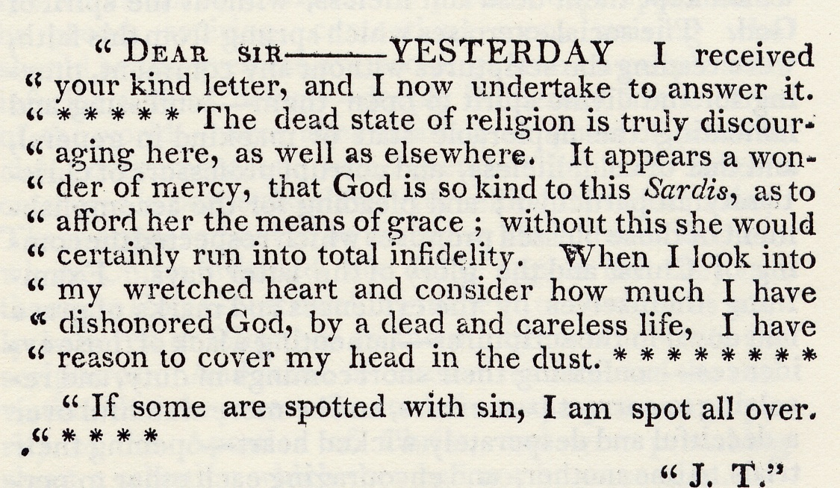
Background To The Kentucky Revival
“The Kentucky Revival” Richard McNemar, Chapter 1

Slide 36
Red River Meetinghouse Logan County, Kentucky Birthplace Of The Kentucky Revival

Slide 37
Kentucky Revival & James McGready (1760-1817)
A Different Kind Of Presbyterian Minister
Born In Pennsylvania, Moved To Guilford County, N.C. After Revolutionary War
Attended David Caldwell’s School
Very Dramatic In His Preaching
Moved To Logan County, Kentucky, 1796
At Meetinghouses On Gasper & Red Rivers
Peter Cartwright, A Methodist Minister Called It “The Devil’s Den”
Outcasts From Society Moved There For Its Location – Good Hiding Places, Escape Law In Tennessee
His Preaching
Repentance, Not Baptism For Remission Of Sins
If All Can Repent, Then Calvinism’s Predestination Fails
People Responded!!!!!
Mainline Presbyterians Rejected Him
Fall Of 1800 – Revival Brought Many Onlookers – One A Young Presbyterian Minister Named Barton W. Stone.

Slide 38
“All this we must grasp if we hope to understand Barton Stone’s relation to the great Cane Ridge Revival. For these were the things he saw and heard on the eve of that revival, and these were the ideas that transformed his preaching from Calvinist gloom and doom to what he often now described as ‘gospel-liberty.’ ‘Like Fire in Dry Stubble’ Having left Logan County, Stone returned to his own congregation at Cane Ridge where he preached the following Lord’s Day. And he took for his text that Sunday Mark 16:15–16: ‘Go ye into all the world and preach the gospel to every creature. He that believeth and is baptized shall be saved, and he that believeth not shall be damned.’ Here was a text that turned Calvinism upside down. For Stone found in this text substantial evidence that the gospel call was for every human being, not just for the elect.” – Leonard Allen, Answered by Fire

Slide 39
The Work And Influence Of Barton W. Stone In Kentucky

Slide 40
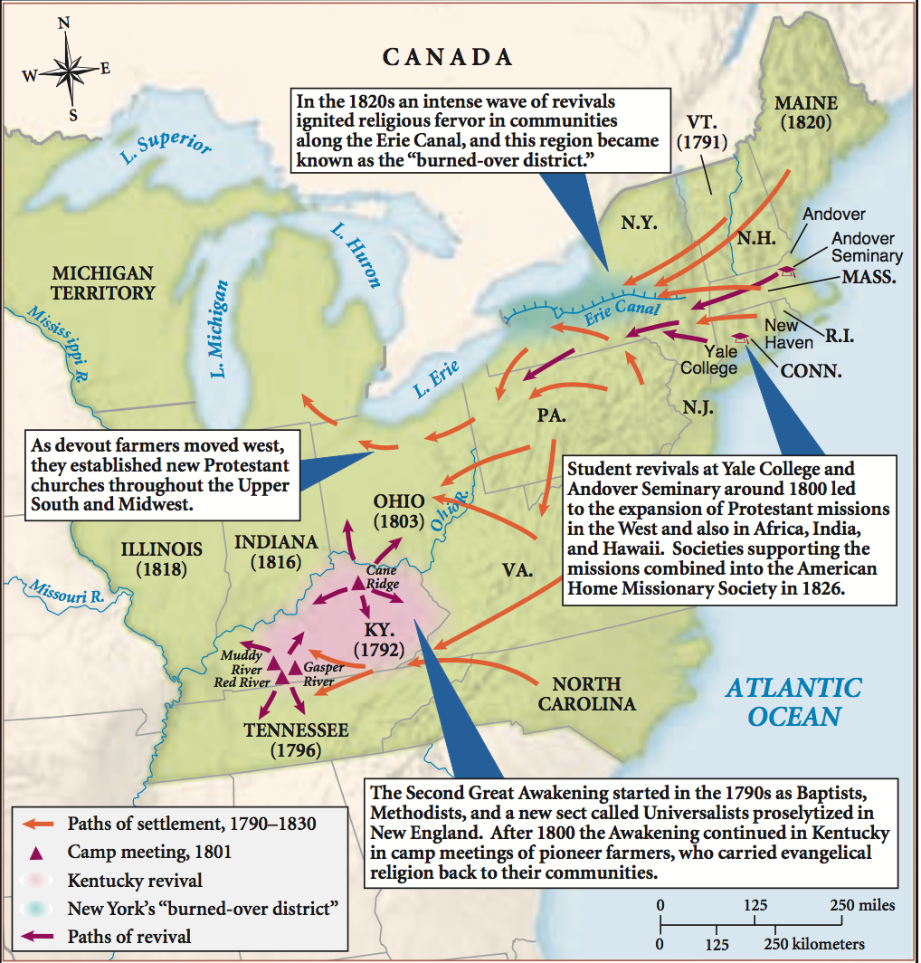

Slide 41
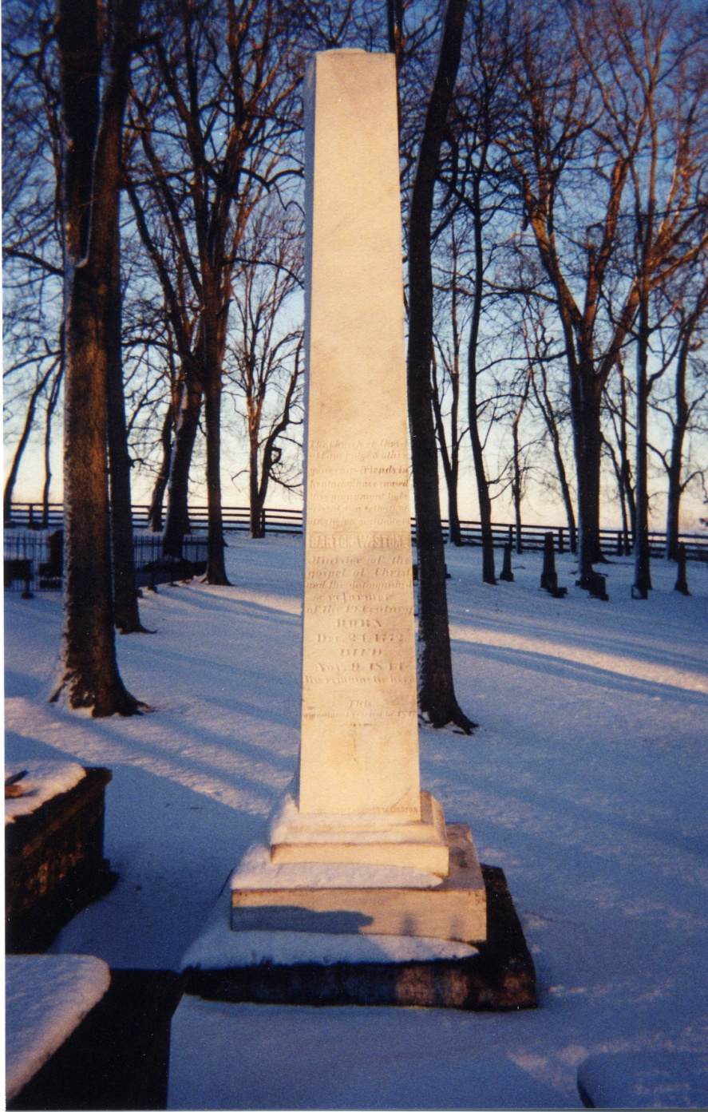
Around Cane Ridge

Slide 42
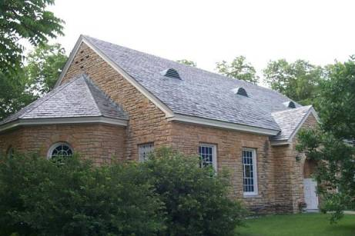
Around Cane Ridge

Slide 43
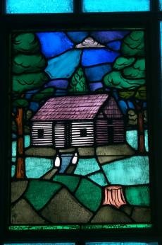
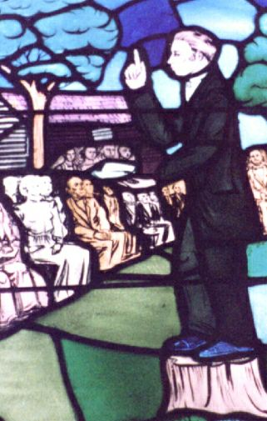
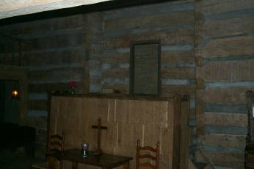
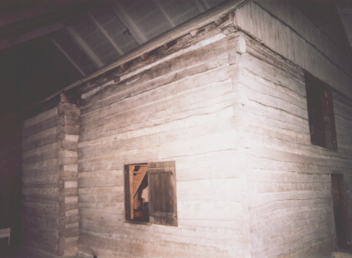
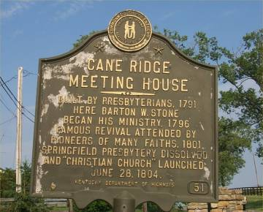
Cane Ridge Meetinghouse

Slide 44
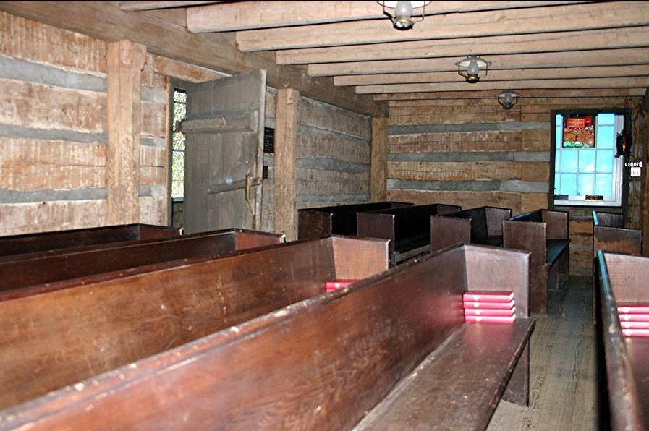

Slide 45
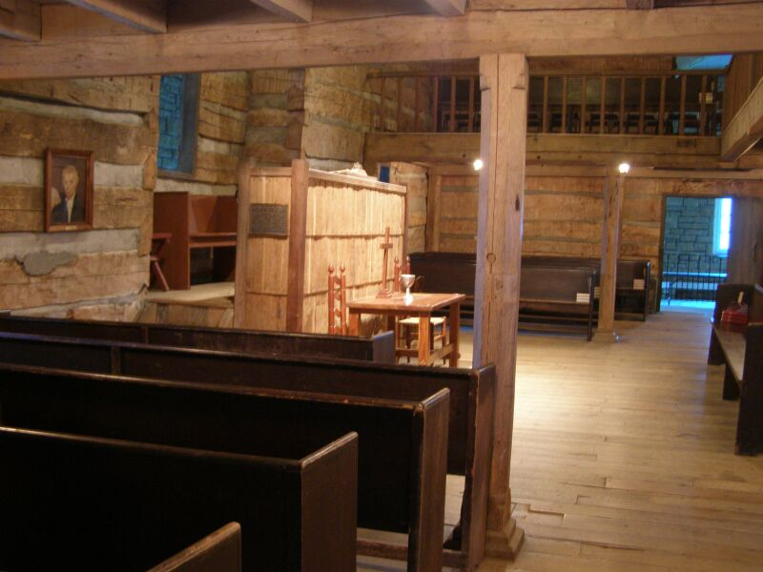

Slide 46
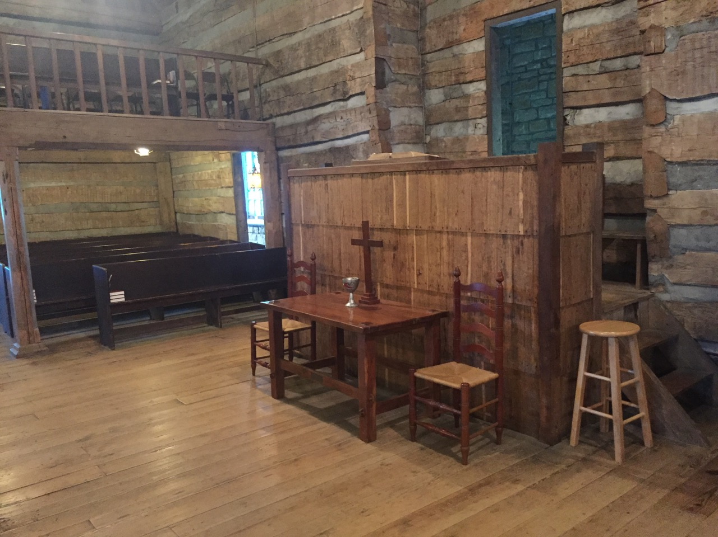

Slide 48
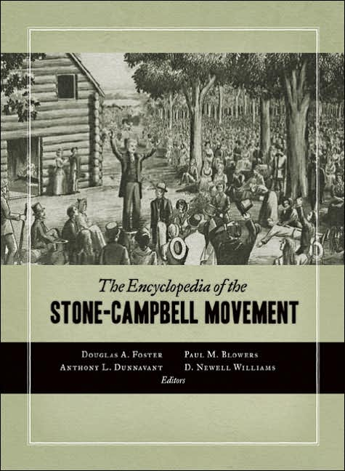
B. W. Stone Movement
David Lee Burris:
His Cousin Was A Signer Of The Declaration Of Independence & His Older Brothers Fought In The War;
Rice Haggard Worked With Stone & Was Link With O’Kelly Movement Not Accepting American Bishop;
Black Freemen At Cane Ridge Building Segregated To The Upstairs Gallery
OTHER PREACHERS AT CANE RIDGE LEFT TO EMBRACE SHAKERISM
CANE RIDGE MEETING
Barton Stone Witnessed The American Revolution
Second Part “Great Awakening” Was After War
War Partisan Denominations Demoralized Most
Official Church Membership Was Down By 90%
Sent Schooling To The David Caldwell Academy
McGready’s Message Convicted But W/O Hope
Hodge’s Positive Message Converted With Heart
Gave Qualified Presbyterian Confession Of Faith
Cane Ridge 25,000 Camp Meet Was Non-Creedal
Challenged Churches Of That Time In Their Legalism, Authoritarianism, & Exclusivism
Charged W/ Arminian Heresy Formed Association
Signed Satirical “Last Will” As Simply Christians
Notes:
At Age Seven He Could Hear The Guns Of General Green & Cornwallis At The Battle Of Guilford Courthouse.
As A Youth He Sunk Himself In Sports Because Of Bickering Between Baptists & Methodists; He Felt That Religion Was Mere Occasion For Narrow Minded People To Quarrel.
“The doctrines of the Bible, we believe, have never divided Christians, but human opinions of these doctrines, without charity, have already done the mischief…For thirty years of my ministry I have kept in view the unity of Christians as my polar star…
Stone Fathered 19 Children Of His Own From Two Wives.
Increasingly Calvin’s God Became Stone’s Devil!
He Began To Preach Regularly That The Gospel Was For All, Not Just The Elect!
Cane Ridge Building Had Gallery For Slave Seating.
25,000 Plus People Camped Nearby In Woods For Seven Day Meeting.
Presbyterian Church Did Not Want Their Educated Ministers Participating With Uneducated Methodists & Baptists.
Of This First Five Against Religious Party Spirit - Who Signed Last Will & Testament Of Springfield Presbytery – Two Went Into Shakerism – Two Returned To Presbyterianism – Barton Stone Was Left Alone For Eight Years Before The Campbells Were Ever Baptized

Slide 49
A new world Pentecost?

Slide 50
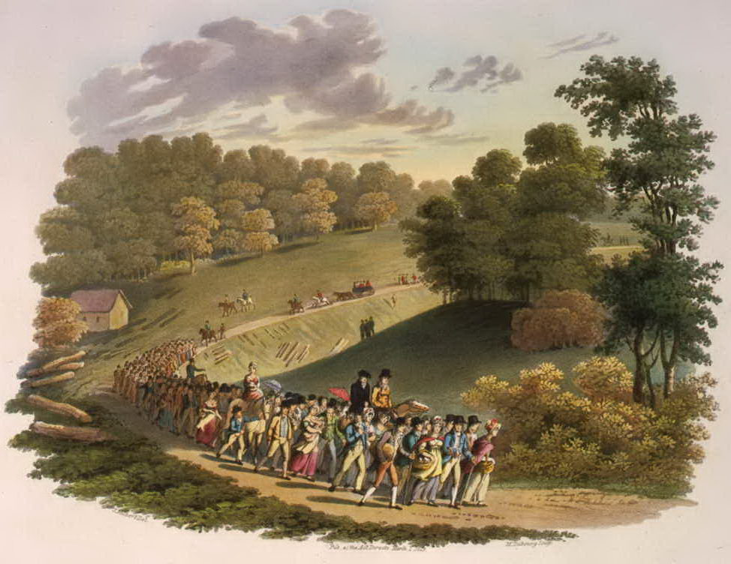

Slide 51
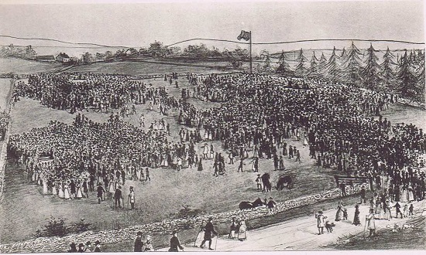

Slide 52
Testimony of James Finley, who later became a circuit rider:
A Presbyterian minister preached from a stage erected in the clearing one hundred yards from the meetinghouse. At the same time a Methodist spoke from a stand one hundred yards east of the building, while an assembly of colored people met about one hundred and fifty yards away. James B. Finley "counted seven ministers, all preaching at one time, some on stumps, others in wagons, and one, the Rev. William Burke (Methodist) was standing on a tree which had, in falling, lodged against another . . .
The noise was like the roar of Niagara. The vast sea of human beings seemed to be agitated as if by a storm. I counted seven ministers, all preaching at one time, some on stumps, others in wagons and one standing on a tree which had lodged against another.
I stepped up on a log where I could have a better view of the surging sea of humanity. The scene that then presented itself to my mind was indescribable. At one time I saw at least five hundred swept down in a moment as if a battery of a thousand guns had been opened upon them, and immediately followed shrieks and shouts that rent the heavens. Men of the most depraved hearts and vicious habits were made new creatures, and that their conversion was confirmed by a life of virtue.

Slide 53
David Lee Burris:
Other Early Restoration Associates All Went With The Shakers – Stone Was Alone In His Message For Many Years!
STONES MOVEMENT
Time Coincident With
SHAKER SIMPLICITY

Slide 54
A FRONTIER AWAKENING
SHAKERISM EXERCISES
SCOTTISH COMMUNION

Slide 55
What Happened at Cane Ridge
►Around the turn of the century a mass migration was taking place of nearly one million people. Pioneers were heading to the western frontiers of Kentucky, Tennessee, Ohio, and Indiana, many of whom were illiterate—never having read a Bible or heard a sermon
►Communications were sent out concerning the planned camp meeting that was to start on August 6, 1801. These camp meetings followed the Scottish communion pattern of being held on a Friday through Monday (Holy Fair), like what was conducted during the Cambuslang, Scotland, Revival of 1742.
►When the date arrived, reports from various sources estimated the numbers assembled to have reached between 12,500 to 30,000 people. People arrived in wagons from Kentucky, Ohio, and Tennessee. (Lexington, the largest town in Kentucky at the time, had a population under 1,800, and was located 28 miles to the west of Cane Ridge.)
►Denominations having been arranged in different sections of the camp, the Presbyterian, Methodist, and Baptist preachers and circuit riders formed preaching teams, speaking simultaneously in different parts of the camp grounds, all aiming for the conversion of sinners.

Slide 56
Historian Sidney Ahlstrom describes the scene:
“The milling crowds of hardened frontier farmers, tobacco chewing, tough spoken, notoriously profane, famous for their alcoholic thirst; their scarcely demure wives and large broods of children; the rough clearing, the rows of wagons and crude improvised tents with horses staked out behind; the gesticulating speaker on a rude platform, or perhaps simply a preacher holding forth from a fallen tree. At night, when the forest’s edge was limned by the flickering light of many campfires, the effect of apparent miracles would be heightened. For men and women accustomed to retiring and rising with the birds, these turbulent nights must have been especially awe-inspiring. And underlying every other conditioning circumstance was the immense loneliness of the frontier farmer’s normal life and the exhilaration of participating in so large a social occasion.”[1]

Slide 57
Christian History Magazine: The Second Awakening
CANE RIDGE KENTUCKY REVIVAL
Yet the full force of the movement was yet to be experienced, and it came about through the activity of Barton W. Stone (1772–1844), Presbyterian pastor of the Cane Ridge and Concord churches, northeast of Lexington, Kentucky. Stone traveled to Logan County to observe McGready’s work, and returned home to plan a similar meeting for August 1801 at Cane Ridge.
Being better publicized than the meetings in Logan County, Cane Ridge attracted an amazing multitude. The numbers arriving, coming from as far as Ohio and Tennessee, were estimated between 10,000 and 25,000. (Lexington, then the largest town in Kentucky, had fewer than 1,800 citizens!) Stone looked on as “the roads were crowded with wagons, carriages, horses, and footmen moving to the solemn camp.”
While Stone and his colleagues had not expected these numbers, preparations had been made so that the crowds could be divided into separate congregations. Invitations had been sent by the Presbyterians to Methodist and Baptist preachers from far and near, and Stone was delighted that “all appeared cordially united in it. They were of one mind and soul: the salvation of sinners was the one object. We all engaged in singing the same songs, all united in prayer, all preached the same things.”
Moses Hoge described the Cane Ridge camp meeting, in an account that could stand for similar meetings of that period:
The careless fall down, cry out, tremble, and not infrequently are affected with convulsive twitchings.…
Nothing that imagination can paint, can make a stronger impression upon the mind, than one of those scenes. Sinners dropping down on every hand, shrieking, groaning, crying for mercy, convulsed; professors praying, agonizing, fainting, falling down in distress, for sinners or in raptures of joy!.…
As to the work in general there can be no question but it is of God. The subjects of it, for the most part are deeply wounded for their sins, and can give a clear and rational account of their conversion.…
The Return of the Spirit—The Second Great Awakening. (1989). Christian History Magazine-Issue 23: Spiritual Awakenings in North America.

Slide 58
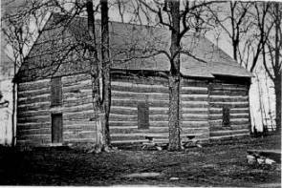
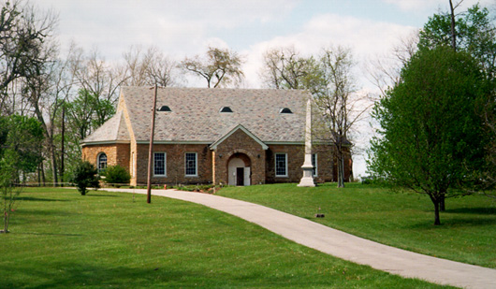
Cane Ridge Revival August 14-19, 1801
Area Settled In The Mid 1700s By Daniel Boone And Group From North Carolina
1791 – Built Largest One–Room Log Cabin In America
Between 15 & 25,000 People Gathered From All Denominations
Many Got Religion, Repented Of Sin And Confessed The Lord
Different Preachers Would Get Up On The Back Of Wagons And Speak To Groups In Their Area
People Left When Food Ran Out At The End Of Six Days

Slide 59
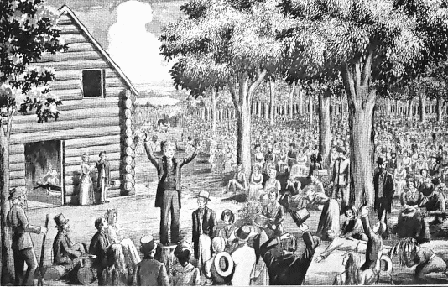
The Cane Ridge Revival

Slide 60
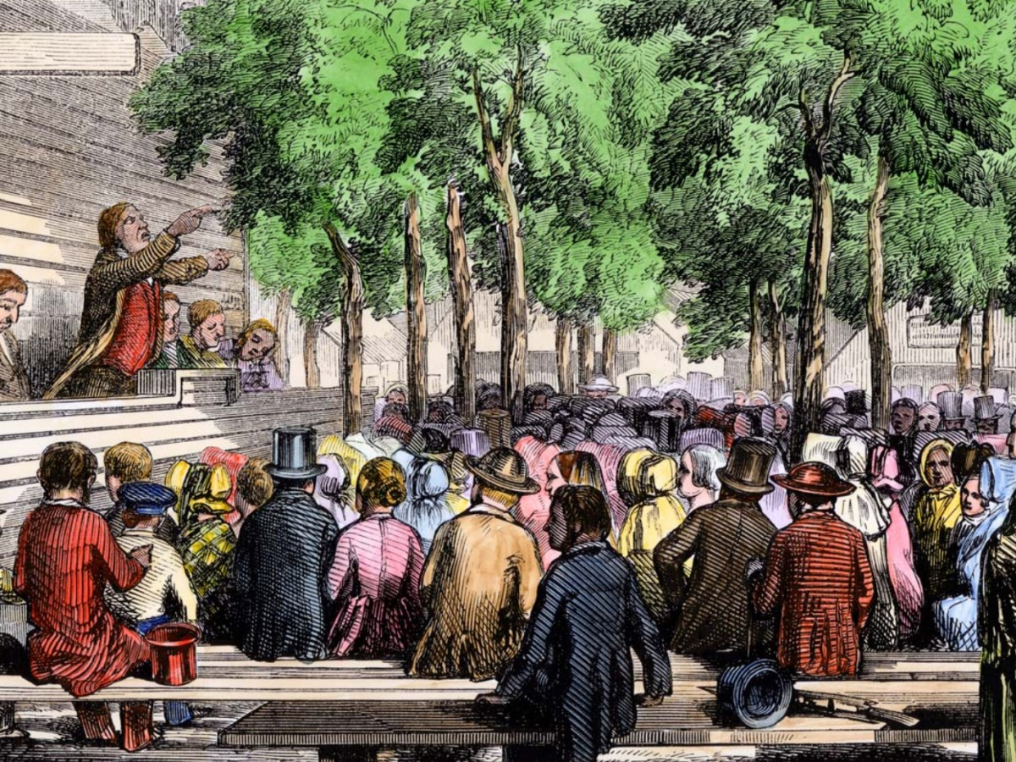

Slide 61
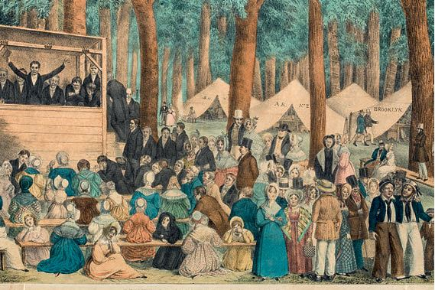

Slide 62
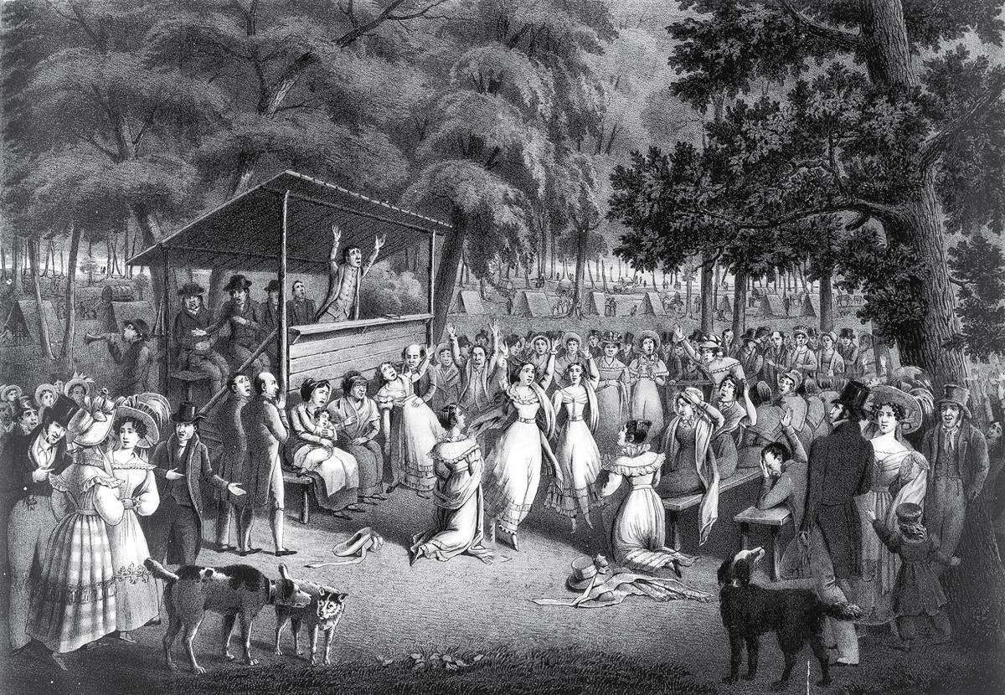

Slide 63
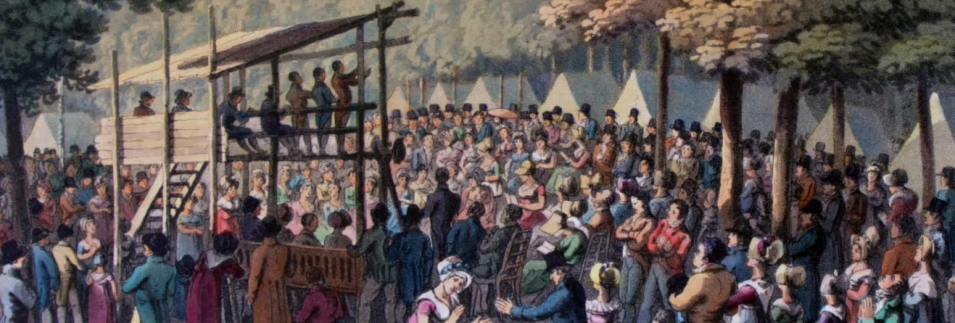

Slide 65
Christian History Magazine: The Second Awakening
CANE RIDGE KENTUCKY REVIVAL
Emotional Awakenings
Cane Ridge became famous not only for its numbers, but also for its excesses of enthusiasm. Hysterical laughter, trances, and more bizarre forms of behavior were seen occasionally. This wildness was of course grossly exaggerated and often used to discredit the camp meetings by their enemies. Nonetheless, it could not be denied that audiences at frontier awakenings often became highly emotional.
Most clergymen opposed this, but often it was beyond their power to control, and in some ways it was inevitable. The roughness of frontier life, its absence of social controls, and the scarcity of social contacts for those living in isolated cabins, made such people susceptible to uncontrolled displays when they found themselves in the company of large numbers. And under the intensity of much powerful preaching within just a few days, emotions boiled over.
However, though camp meetings were sometimes the scenes of excesses, they were much more the scenes of great spiritual awakening. The rough, violent, irreligious frontier, which many felt threatened to undo the morals of the new nation, was being tamed by the Lamb of God.
The Return of the Spirit—The Second Great Awakening. (1989). Christian History Magazine-Issue 23: Spiritual Awakenings in North America.

Slide 66
Testimony of Richard McNemar:
The scene was awful beyond description; the falling, crying out, praying, exhorting, singing, shouting, etc. exhibited such new and striking evidences of a supernatural power, that few, if any could escape without being affected. Such as tried to run from it [the power and presence of God], were frequently struck on the way, or impelled by some alarming signal to return: and so powerful was the evidence on all sides, that no place was found for the obstinate sinner to shelter himself…
These public testimonies against the work, particularly by ministers, were a means of stirring up and encouraging those who were openly wicked, to come forth and mock, oppose, and persecute; but even such, were often unable to withstand the power, and sometimes in the very act of persecuting and afflicting, were struck down like men in battle; and so alarming was the sight, that others on foot or on horseback, would try to make their escape and flee away like those who are closely pursued by an enemy in time of war, and be overtaken by the invisible power, under which they would be struck down and constrained to cry out in anguish, and confess their wickedness in persecuting the work of God, and warn others not to oppose it.

Slide 67
“Conversion was detached from baptism, the communion table, and, indeed, from church membership. . . The new revival techniques became a new kind of liturgy—new modes of singing and ecstatic forms of worship, lay testimony and exhortation, special places at the front of worship spaces for sinners under conviction, and camp meetings (which soon replaced the communion festival).” Internet

Slide 68
The Focus Of The Revival
Some Falsely Claim That The Focus Of The Cane Ridge Revival Was To Achieve A Religious Experience. See Stone’s Purpose In The Revival From His Autobiography
Bodily Functions Among Some In Attendance, Called “Exercises” Included Uncontrollable Dancing, Jerking, Running, Barking, Laughing, Etc.,
Stone Found Them Strange And Unexplainable. He Gave God The Praise And Pressed Forward With His Anti-Calvinistic Mission Of Preaching & Teaching The Gospel That Must Be Responded To In Order To Receive Its Blessings

Slide 69
B. W. Stone Movement
David Lee Burris:
His Cousin Was A Signer Of The Declaration Of Independence & His Older Brothers Fought In The War;
Rice Haggard Worked With Stone & Was Link With O’Kelly Movement Not Accepting American Bishop;
Black Freemen At Cane Ridge Building Segregated To The Upstairs Gallery
OTHER PREACHERS AT CANE RIDGE LEFT TO EMBRACE SHAKERISM
Barton Stone Witnessed The American Revolution
Second Part “Great Awakening” Was After War
War Partisan Denominations Demoralized Most
Official Church Membership Was Down By 90%
Sent Schooling To The David Caldwell Academy
McGready’s Message Convicted But W/O Hope
Hodge’s Positive Message Converted With Heart
Gave Qualified Presbyterian Confession Of Faith
Cane Ridge 25,000 Camp Meet Was Non-Creedal
Challenged Churches Of That Time In Their Legalism, Authoritarianism, & Exclusivism
Charged W/ Arminian Heresy Formed Association
Signed Satirical “Last Will” As Simply Christians
They Didn't Accept The Trinity
Barton Stone Taught Oneness
He Was Accused Of Arianism
Notes:
At Age Seven He Could Hear The Guns Of General Green & Cornwallis At The Battle Of Guilford Courthouse.
As A Youth He Sunk Himself In Sports Because Of Bickering Between Baptists & Methodists; He Felt That Religion Was Mere Occasion For Narrow Minded People To Quarrel.
“The doctrines of the Bible, we believe, have never divided Christians, but human opinions of these doctrines, without charity, have already done the mischief…For thirty years of my ministry I have kept in view the unity of Christians as my polar star…
Stone Fathered 19 Children Of His Own From Two Wives.
Increasingly Calvin’s God Became Stone’s Devil!
He Began To Preach Regularly That The Gospel Was For All, Not Just The Elect!
Cane Ridge Building Had Gallery For Slave Seating.
25,000 Plus People Camped Nearby In Woods For Seven Day Meeting.
Presbyterian Church Did Not Want Their Educated Ministers Participating With Uneducated Methodists & Baptists.
Of This First Five Against Religious Party Spirit - Who Signed Last Will & Testament Of Springfield Presbytery – Two Went Into Shakerism – Two Returned To Presbyterianism – Barton Stone Was Left Alone For Eight Years Before The Campbells Were Ever Baptized

Slide 70
the
OneGod
THE FALLING EXERCISE
THE JERKING EXERCISE
THE DANCING EXERCISE
THE BARKING EXERCISE
The laughing exercise
THE RUNNING EXERCISE
THE SINGING EXERCISE

Slide 71
The Cane Ridge Meetinghouse: Compiled with the Autobiography of Barton W. Stone, (pp. 99-101). Cobb Publishing. Kindle Edition.
BARTON STONE @CANE RIDGE “ECCENTRICITIES”
“The falling exercise was very common among all classes, the saints and sinners of every age and of every grade, from the philosopher to the clown. The subject of this exercise would, generally, with a piercing scream, fall like a log on the floor, earth, or mud, and appear as dead. Of thousands of similar cases, I will mention one. At a meeting, two gay young ladies, sisters, were standing together attending to the exercises and preaching at the time. Instantly they both fell, with a shriek of distress, and lay for more than an hour apparently in a lifeless state. Their mother, a pious Baptist, was in great distress, fearing they would not revive. At length they began to exhibit symptoms of life, by crying fervently for mercy, and then relapsed into the same death-like state, with an awful gloom on their countenances. After a while, the gloom on the face of one was succeeded by a heavenly smile, and she cried out, “Precious Jesus,” and rose up and spoke of the love of God, the preciousness of Jesus, and of the glory of the gospel, to the surrounding crowd, in language almost superhuman, and pathetically exhorted all to repentance. In a little while after, the other sister was similarly exercised. From that time, they became remarkably pious members of the church. I have seen very many pious persons fall in the same way, from a sense of the danger of their unconverted children, brothers, or sisters—from a sense of the danger of their neighbors, and of the sinful world. I have heard them agonizing in tears and strong crying for mercy to be shown to sinners, and speaking like angels to all around.”

Slide 73
The Cane Ridge Meetinghouse: Compiled with the Autobiography of Barton W. Stone, (pp. 99-101). Cobb Publishing. Kindle Edition.
BARTON STONE @CANE RIDGE “ECCENTRICITIES”
The jerks cannot be so easily described. Sometimes the subject of the jerks would be affected in some one member of the body, and sometimes in the whole system. When the head alone was affected, it would be jerked backward and forward, or from side to side, so quickly that the features of the face could not be distinguished. When the whole system was affected, I have seen the person stand in one place, and jerk backward and forward in quick succession, their head nearly touching the floor behind and before. All classes, saints and sinners, the strong as well as the weak, were thus affected.
I have inquired of those thus affected. They could not account for it; but some have told me that those were among the happiest seasons of their lives. I have seen some wicked persons thus affected, and all the time cursing the jerks, while they were thrown to the earth with violence. Though so awful to behold, I do not remember that any one of the thousands I have seen ever sustained an injury in body. This was as strange as the exercise itself.

Slide 74
The Cane Ridge Meetinghouse: Compiled with the Autobiography of Barton W. Stone, (pp. 99-101). Cobb Publishing. Kindle Edition.
BARTON STONE @CANE RIDGE “ECCENTRICITIES”
The dancing exercise. This generally began with the jerks, and was peculiar to professors of religion. The subject, after jerking awhile, began to dance, and then the jerks would cease. Such dancing was indeed heavenly to the spectators; there was nothing in it like levity, nor calculated to excite levity in the beholders. The smile of heaven shone on the countenance of the subject, and assimilated to angels appeared the whole person. Sometimes the motion was quick and sometimes slow. Thus they continued to move forward and backward in the same track or alley till nature seemed exhausted, and they would fall prostrate on the floor or earth, unless caught by those standing by. While thus exercised, I have heard their solemn praises and prayers ascending to God.

Slide 75
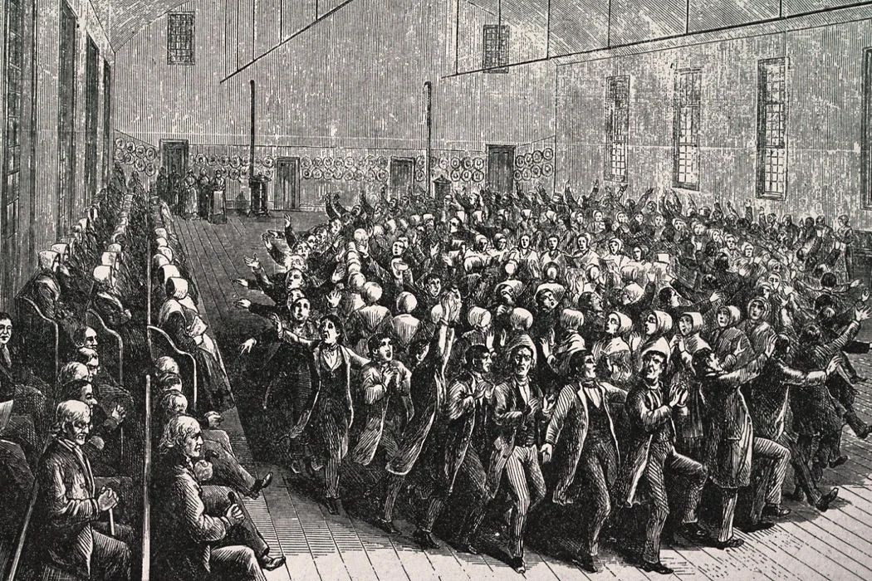
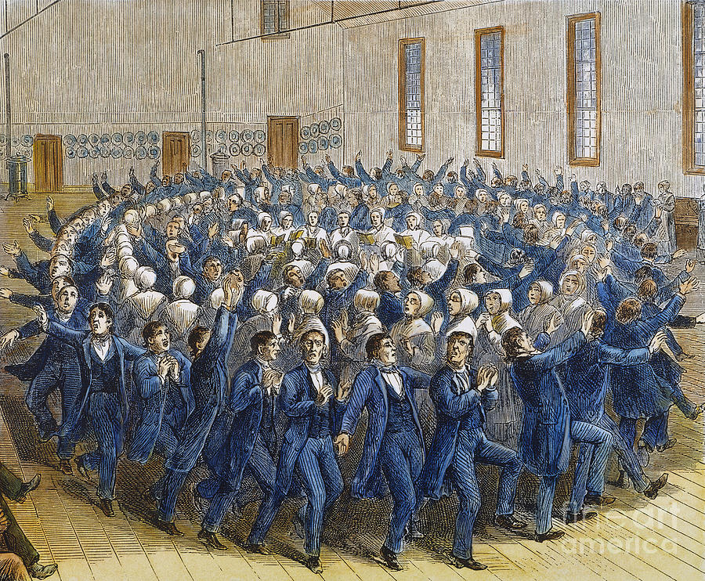
Shaker Dancing

Slide 76
The Cane Ridge Meetinghouse: Compiled with the Autobiography of Barton W. Stone, (pp. 99-101). Cobb Publishing. Kindle Edition.
BARTON STONE @CANE RIDGE “ECCENTRICITIES”
The barking exercise, (as opposers contemptuously called it,) was nothing but the jerks. A person affected with the jerks, especially in his head, would often make a grunt, or bark, if you please, from the suddenness of the jerk. This name of barking seems to have had its origin from an old Presbyterian preacher of East Tennessee. He had gone into the nearby woods for private devotion, and was seized with the jerks. Standing near a sapling, he caught hold of it, to prevent his falling, and as his head jerked back, he uttered a grunt or kind of noise similar to a bark, his face being turned upwards. Some wag discovered him in this position, and reported that he found him barking up a tree.

Slide 77
The Cane Ridge Meetinghouse: Compiled with the Autobiography of Barton W. Stone, (pp. 99-101). Cobb Publishing. Kindle Edition.
BARTON STONE @CANE RIDGE “ECCENTRICITIES”
The laughing exercise was frequent, confined solely with the religious. It was a loud, hearty laughter, but one sui generis; it excited laughter in none else. The subject appeared rapturously solemn, and his laughter excited solemnity in saints and sinners. It is truly indescribable.

Slide 79
The Cane Ridge Meetinghouse: Compiled with the Autobiography of Barton W. Stone, (pp. 99-101). Cobb Publishing. Kindle Edition.
BARTON STONE @CANE RIDGE “ECCENTRICITIES”
The running exercise was nothing more than, that persons feeling something of these bodily agitations, through fear, attempted to run away, and thus escape from them; but it commonly happened that they ran not far, before they fell, or became so greatly agitated that they could proceed no farther. I knew a young physician of a very celebrated family, who came some distance to a big meeting to see the strange things he had heard of. He and a young lady had agreed to watch over, and take care of each other, if either should fall. At length the physician felt something very uncommon, and started from the congregation to run into the woods; he was discovered running as for life, but did not proceed far till he fell down, and there lay till he submitted to the Lord, and afterwards became a zealous member of the church. Such cases were common.

Slide 81
The Cane Ridge Meetinghouse: Compiled with the Autobiography of Barton W. Stone, (pp. 99-101). Cobb Publishing. Kindle Edition.
BARTON STONE @CANE RIDGE “ECCENTRICITIES”
I shall close this chapter with the singing exercise. This is more unaccountable than anything else I ever saw. The subject in a very happy state of mind would sing most melodiously, not from the mouth or nose, but entirely in the breast, the sounds issuing thence. Such music silenced everything, and attracted the attention of all. It was most heavenly. None could ever be tired of hearing it. Doctor J.P. Campbell and myself were together at a meeting, and were attending to a pious lady thus exercised, and concluded it to be something surpassing anything we had known in nature.
I have given a brief account of the wonderful things that appeared in the great excitement in the beginning of this [nineteenth] century. That there were many eccentricities, and much fanaticism in this excitement, was acknowledged by its warmest advocates; indeed it would have been a wonder, if such things had not appeared, in the circumstances of that time. Yet the good effects were seen and acknowledged in every neighborhood, and among all the different sects it silenced contention, and promoted unity for a while; and these blessed effects would have continued, had not men put forth their unhallowed hands to hold up their tottering ark, mistaking it for the ark of God.

Slide 82
Testimony of Peter Cartwright, who later became a circuit rider:
Somewhere between 1800 and 1801, in the upper part of Kentucky, at a memorable place called “Cane Ridge,” there was appointed a sacramental meeting by some of the Presbyterian ministers, at which meeting, seemingly unexpected by ministers and people, the mighty power of God was displayed in a very extraordinary manner: many were moved to tears, and bitter and loud crying for mercy. The meeting was protracted for weeks. Ministers from almost all denominations flocked in from far and near. The meeting was kept up by night and day. Thousands heard of the mighty work, and came on foot, on horseback, in carriages and wagons. It was supposed that there were in attendance at times during the meeting from twelve to twenty-five thousand people. Hundreds fell prostrate under the might power of God, as men slain in battle. Stands were erected in the woods from which preachers of different Churches proclaimed repentance toward God and faith in our Lord Jesus Christ, and it was supposed, by eye and ear witnesses, that between one and two thousand souls were happily and powerfully converted to God during the meeting. It was not unusual for one, two, three, and four to seven preachers to be addressing the listening thousands at the same time from the different stands erected for the purpose.
The heavenly fire spread in almost every direction. It was said, by truthful witness, that at times more than one thousand persons broke into loud shouting all at once, and that the shouts could be heard for miles around. From this camp-meeting, for so it ought to be called, the news spread through all the Churches, and through all the land, and it excited great wonder and surprise; but it kindled a religious flame that spread all over Kentucky and through many other states. And I may here be permitted to say, that this was the first camp-meeting ever held in the United States, and here our camp-meetings took their rise. As Presbyterian, Methodist, Baptist ministers all united in the blessed work of the meeting, when they returned home to the different congregations, and carried news of this mighty work, the revival spread rapidly through the land; but many of the ministers and members of the synod of Kentucky thought it all disorder, and tried to stop the work. They called their preachers who were engaged in the revival to account, and censured and silenced them. These ministers then rose up and unitedly renounced the jurisdiction of the Presbyterian Church, organized a Church of their own, and dubbed it with the name of Christian.

Slide 83
The historians used "loaded language" to describe the revival with superlatives and emotive terms that colored their facts. They called the Cane Ridge Revival the "most hysterical" revival held in early America, an orgy reminding one of "ancient rites Dionysiac like,” a "frenzy," a "monster meeting," a place where "one prayer felled three thousand,“ one of the "roaring revivals" or "religious fairs," a place reminiscent of the "circus," where people drank in "hell-fire gospel," and exhibited "pathological symptoms in unison." it was "intoxication wine to the ignorant masses; a stumbling block to the orderly Presbyterians; foolishness to the upper Kentucky strata; hysteria to contemporary and present day rationalists.” – Wayne Shaw

Slide 84
A new world Pentecost?
There Is No Pattern!
ABSOLUTELY NOT!

Slide 86
Aftermath Of The Revival
10000 Expected; Over 25000 in Actual Attendance
3000 People “Got Religion” At The Revival
Preachers From The Methodist, Presbyterian, and Baptist All Spoke At Cane Ridge
This Brought Old Calvinistic Religion To A Crisis
The Baptists Divided Into Free-Will And Calvinists
The Presbyterians Divided Into New Lights and Old Lights
The Cumberland Presbyterian Church Began In 1810 As A New Light Congregation
This Was What Brought Barton Stone To A Crossroad In His Own Religion, And Caused Him To Begin Searching For New Testament Christianity

Slide 87
Did the conversions last? For his part, Stone came to believe that various aspects of Presbyterian doctrine, derived from the teachings of John Calvin, were in fact not biblically based. Stone questioned the notion of predestination, the requirement of an educated clergy, the idea that human will had no role in salvation, and the requirement for any Church governance beyond the congregation, for example by a Synod or council of churches, as in the Presbyterian Church. Eventually, Barton Stone broke from the Presbyterians and started what he considered a strictly Biblical church movement whose members referred to themselves simply as “Christians.” Later merging with a similar movement started by the father and son team of Thomas (1763-1854) and Alexander (1788-1866) Campbell, also Scots-Irish Presbyterians, the followers of Stone became known as the Disciples of Christ.
It is worth noting that the Cane Ridge revival occurred five months after Thomas Jefferson’s inauguration. We can only imagine what he might have thought if he had observed his fellow countrymen writhing in ecstatic communion with their God. Somehow, however, Jeffersonian rationalists [i.e. Alexender Campbell] and Christian revivalists both managed to survive and prosper in their new country.

Slide 88
“Stone, who gave up his slaves as a result of the revival, felt that the exercises were sent because the state of religion was so low that ‘nothing common could have arrested the attention of the world.’ He reacted favorably to the revival because he was convinced that it helped the religious situation, but he did not approve of everything that went on: ‘Much did I then see, and much have I since seen, that I considered to be fanaticism; but this should not condemn the work.’ He rejoiced in the ‘spirit of love and union’ among the preachers who took part in the revival, and he caught a vision of what they could accomplish when they worked in harmony. The Cane Ridge Revival caused Stone to feel that Christian unity was possible.” – Wayne Shaw

Slide 89
Rejection & Restructuring
Rejection
By 1803 Revival Had Died Down Some
Presbyterian Church Put Pressure On Stone To Quit What He Was Preaching
Other Preachers He Influenced: John Dunlavy; David Purviance; John Marshall; Richard McNemar; Malcolm Worley; John Thompson
Either He Was To Preach Presbyterian Doctrine Or Be Excommunicated
Restructuring
These Men Resigned Both Orange And Washington Presbyteries
They Formed The Springfield Presbytery
They Vowed To Preach The Bible Only
In 1804 They Disbanded The Springfield Presbytery

Slide 90
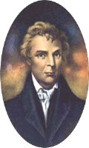
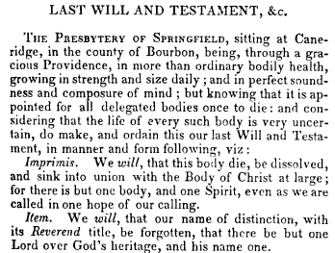
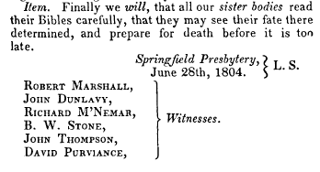
The Last Will & Testament Of The Springfield Presbytery, June 28, 1804

Slide 91
Resolutions from The Last Will Of The Springfield Presbytery
A Call To Take The Bible As The Only Sure Guide to Heaven
A Call To Reject The Westminster Confession Of Faith And All Document Designed By Man
That The church of Christ Resume Her native Right Of Internal Government
That The Title Of “Reverend” Be Forgotten, And Designated Only For The Lord.
At The Insistence Of Rice Haggard, The Name “Christian” Only Be Used
Notes:
The Last Will And Testimony Of The Springfield Presbytery
"THE PRESBYTERY OF SPRINGFIELD, sitting at Cane Ridge, in the county of Bourbon. Being, through a gracious providence, in more than ordinary bodily health, growing in strength and size daily; and in perfect soundness and composure of mind; but knowing that it is appointed for all delegated bodies once to die: and considering that the life of every such body is very uncertain, do make, and ordain this our last Will and Testament, in manner and following, viz:
Imprimis. We will, that this body die, be dissolved, and sink into union with the body of Christ at large, for there is but one body, and one spirit, even as we are called in one hope of our calling.
Item. We will, that our name of distinction, with its Reverend title, be forgotten, that there is but one Lord over God’s heritage and His name one.
Item. We will, that our power of making laws for the government of the church and executing them by delegated authority forever cease; that the people may have free course to the Bible, and adopt the law of the spirit of life in Christ Jesus.
Item. We will, that candidates for the Gospel ministry henceforth study the Holy Scriptures with fervent prayer, and obtain license from God to preach the simple Gospel, with the Holy Ghost sent down from Heaven, without any mixture of Philosophy, vein deceit, traditions of men or rudiments of the world- and let none henceforth take this honor to himself but he that is called of God, as was Aaron.
Item. We will, that the church of Christ resume her native right of internal government—try her candidates for the ministry as to the soundness of their faith, acquaintance with experimental religion, gravity, and aptness to teach; and admit no other proof of their authority but Christ speaking in them- We will, that the church of Christ lock to the Lord of the harvest to send forth laborers into His harvest; and she resume her primitive right of trying those who say they are apostles and are not.
Item. We will, that cacti particular church, ass body, actuated by the same spirit, choose their own preacher, and support him with a free will offering without a written call or subscription--admit members—remove offenses; and never henceforth delegate her right of government to any man or set of men whatsoever.
Item. We will, that people henceforth take the Bible as the only sure guide to Heaven; and as many as are offended with other books, which stand in competition with I, may cast them into the fire if they choose: for it is better to enter into Life having one Book, than having many to be cast into hell
Item. We will, that preachers and people, cultivate a spirit of mutual forbearance; pray more and dispute less; and while they behold the signs of the times, look up and confidently expect that redemption draweth nigh.
Item. We will, that our weak brethren, who may have been wishing to make the Presbytery of Springfield their king, and wot not what is now become of it. betake themselves to the Rock of Ages, and follow Jesus for the future.
Item. We will, that the Synod of Kentucky, examine each member, who may be suspected of having departed from the Confession of Faith, and suspend every such suspected heretic immediately, in order that the oppressed may go free, and taste the sweets of Gospel I body
Item. We will, that J --—, the author of two letters lately published in Lexington, be encouraged in his zeal to destroy partyism. We will, moreover, that our past conduct be examined into by all who have correct information; but let foreigners beware of speaking evil of things that they know not.
Item. Finally, we will, that all our sister bodies read their Bibles carefully, that they may see their fate there determined, and prepare for death before it is too late,
Springfield Presbytery, L. S., June 28, 1804
Witnesses:
Robert Marshall, John Dunlavy, Richard McNemar, B. W. Stone, John Thompson, David Purviance.
Writing in the Christian Messenger, Stone tells us about the forming of the Springfield arid its demise,
Under the name of Springfield Presbytery we went forward preaching, arid constituting churches: but we had not worn our name more than one year, before we saw that it savored of a party spirit With the man-made creeds we threw it overboard, and took the name CHRISTIAN—the name given to the disciples by divine appointment first at Antioch We published a pamphlet on this name, written by Elder Rice Haggard, who had just lately united with us. Having divested ourselves of all party creeds. And party names, and trusting alone in God; and in the Word of His grace. we became a by-word and Laughing stock to the sects around; all prophesying our speedy annihilation. Yet from this period I date the commencement of that reformation, which has progressed to this day.

Slide 92
Restoration
June 28, 1804 – The Signing Of The Last Will & Testament Of The Springfield Presbytery
A Call To Preach The Bible Only
A Call To Reject The Westminster Confession Of Faith And All Document Designed By Man
At The Insistence Of Rice Haggard, The Name “Christian” Only Be Used To Designate What They Would Be Called.

Slide 93
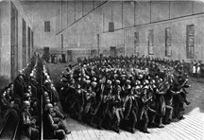
Growth Of A Movement
1805 Trouble With The Shakers Movement, McNemar & Dunlavy Defect
Thompson & Marshall Return To Presbyterianism
His 1st wife, Eliza Passes Away
Even With Setbacks, The Movement Grows Rapidly
The Shakers In Kentucky

Slide 94
Allen, Leonard. Answered by Fire: Cane Ridge Reconsidered (pp. 91-93). Abilene Christian University Press. Kindle Edition.
STONE & CAMPBELL IN SEARCH OF THE ANCIENT ORDER
Stone always looked favorably on revivalism and, as late as 1832, was willing to retain the mourner’s bench, which was a symbol and tool of camp-meeting-type conversions. Cane Ridge also left Stone with a passion for the unity of Christians and for freedom in the Spirit. The intense and practical spirit of unity he experienced in the revival Stone tied to the outpouring of the Spirit. The conversions, the exercises, and the stunning display of unity were all tied together. They could only be explained by the Spirit’s fire. We can also say that the Spirit’s fire lit in Stone a passion for freedom from the theological intricacies of human creeds and the constriction of human traditions, and a passion for restoration of simple New Testament Christianity. This was the aura of Cane Ridge that pervaded the Stoneite churches as they steadily spread throughout the Cumberland region, mostly in the backwoods. But in 1823 a new voice appeared in Kentucky.
Alexander Campbell came to Kentucky to debate the Presbyterian W. L. McCalla on the topic of baptism. Campbell’s argument about the role of baptism for remission—and the new pattern of conversion (ordo salutis) it anchored—quickly resonated with thousands of Stoneite Christians in the region. Campbell’s precise “ancient gospel” provided theological structure, rational certainty, and blessed assurance for many whose experiential conversions had left them unsure of where they stood with God. And his simple outline of the “ancient order of things” gave primitive Christianity a clarity and structure. The Stoneite “Christians” gradually adopted Campbell’s new theology of conversion and church order. As this change happened, the movement underwent an unforeseen transformation. As the “Christian” movement converged with Campbell’s “current reformation” (in the 1830s and beyond), the aura of Cane Ridge receded. Indeed, it was mostly eclipsed by Campbell’s Old Light sensibilities, his new ordo salutis, and his Baconian rationalism. When Campbell’s “Disciples” and Stone’s “Christians” formally united in January 1832, the handwriting was already on the wall: the theology and practices of Cane Ridge and the Great Revival would be quickly eclipsed and left behind in the new “Stone-Campbell movement.”

Slide 95
ANTINOMIANISM CHARGES IN CHURCH HISTORY
Emphasis On Liberty
Emphasis On Legalism
FIRST CENTURY NICOLAITANS
 |  | FIRST CENTURY JUDAIZERS
REFORMATION PERIOD MELANCHTHON
 |  | REFORMATION PERIOD ARICOLIANS
REFORMATION PERIOD LUTHERANS
 |  | REFORMATION PERIOD CALVINISTS
RESTORATION PERIOD CAMPBELLITES
BIBLICAL CHRISTIANITY

Slide 96
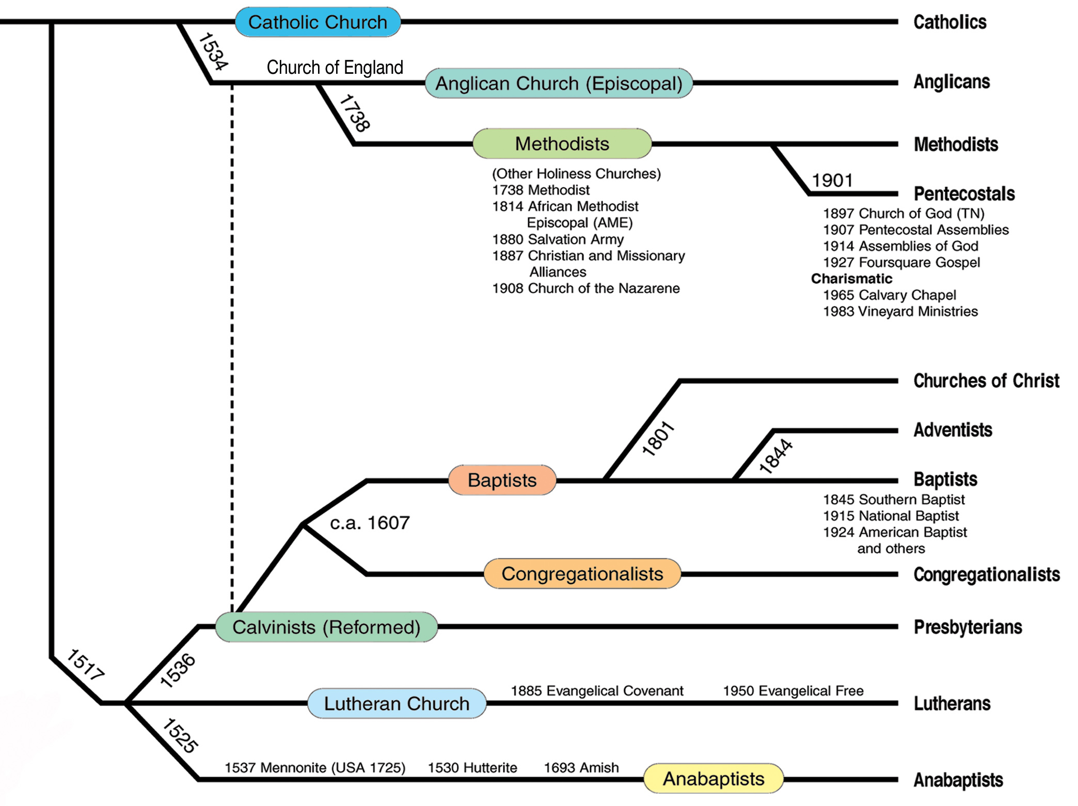

Slide 97
Presbyterian Seceders Intermediate Affliation
Baptists
AD 1830
Mahoning Association Expels Thomas & Alexander Campbell.
This was one of two historical marks that began the American Churches of Christ.
Churches of Christ

Slide 98
After Famous 1832 Handshake Revivalism Meets Rationalism Similarities & Differences
Sola Scriptura Seen As Accepted Authority
Sectarianism Seen As Being Anti-Christian
Calvin Wrong On Pre-destination/Atonement
Refused Unscriptural Names & Titles
Rejected Denominational Organization & Structure
Name: Disciples (Stone) Christians (Campbell)
Baptism: Non-Essential (Stone) Essential (Campbell)
Lord’s Supper: Occasionally (Stone) Weekly (Campbell)
Faith Outwork: Emotion (Stone) Reason (Campbell)
Notes:
“Campbell and Stone differed in their methods of presenting the gospel. Stone was the evangelist, while Campbell was the teacher. Stone appealed to the head, while Campbell appealed to the heart. Campbell provided the light of information, while Stone was the man of exhortation.”

Slide 99
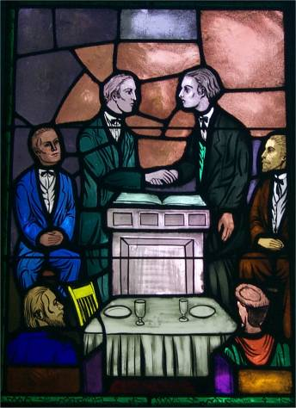

Slide 100
After Famous 1832 Handshake Revivalism Meets Rationalism Stone Reacts To Unity Address
“Controversies in the church sufficiently prove that Christians can never be one in their speculations upon these mysterious & sublime subjects, which, while they interest the Christian philosopher, can’t edify the church. After we have given up all creeds and taken the Bible, and the Bible alone, as our rule of faith and practice, we met with so much opposition that I was led to deliver some speculative discourses upon these subjects. But I never preached a sermon of that kind that really feasted my heart; I always felt a barrenness of soul afterwards. I perfectly accord with Brother Smith that these speculations should never be taken into the pulpit; and when compelled to speak of them at all, we should do so in the words of inspiration!”
Notes:
“Campbell and Stone differed in their methods of presenting the gospel. Stone was the evangelist, while Campbell was the teacher. Stone appealed to the head, while Campbell appealed to the heart. Campbell provided the light of information, while Stone was the man of exhortation.”

Slide 101
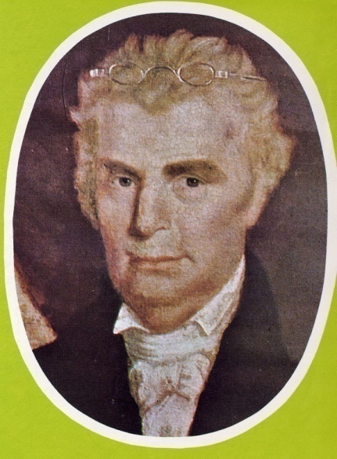
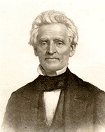
Coming Together Of A Movement
Meeting Of Stone’s Christians & Campbell’s Disciples At Hill Street Church In Lexington, Last Week In 1831
January 1, 1832 Joined Forces With A. Campbell’s Disciples Movement
“Let us, then my brethren, be no longer Campbellites or Stoneites, New Lights or Old Lights, or any other kind of lights, but let us come to the Bible, and to the Bible alone, as the only book in the world that can give us all the light we need.” — John Smith
Hill Street Church, Lexington, Kentucky
“Raccoon” John Smith

Slide 102
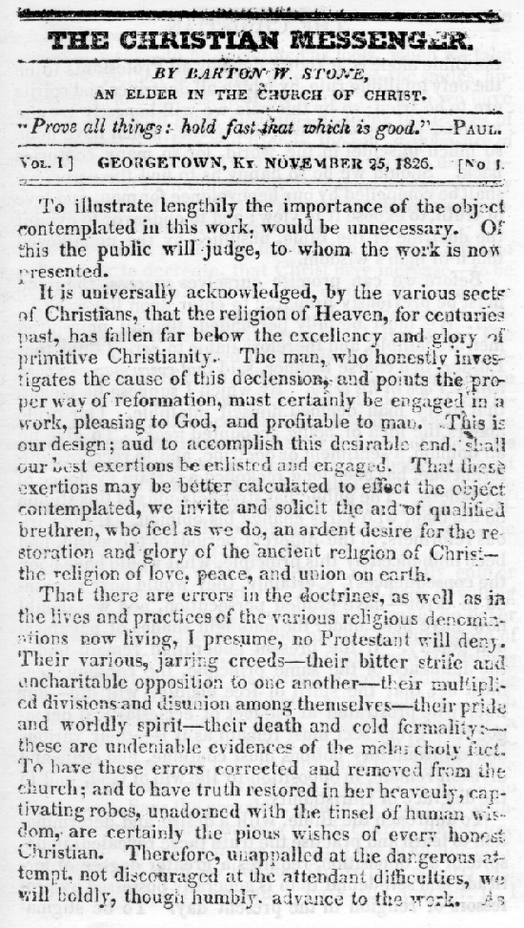

Slide 103
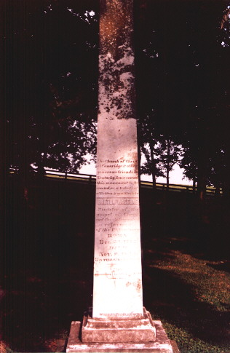
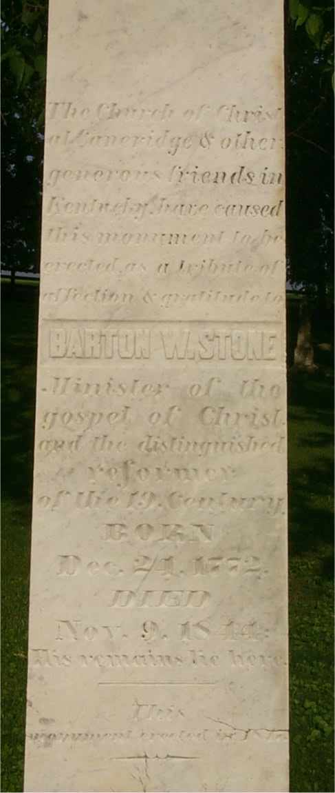
Cane Ridge Cemetery
The Church of Christ
at Caneridge & other
generous friends in Kentucky
have caused this monument
to be erected as a tribute of
affection & gratitude to
BARTON W. STONE
Minister of the gospel of
Christ and the distinguished
reformer of the 19 Century.
BORN Dec. 21, 1772
DIED Nov. 9, 1844
His remains lie here.
This monument was erected in 1847

Slide 104
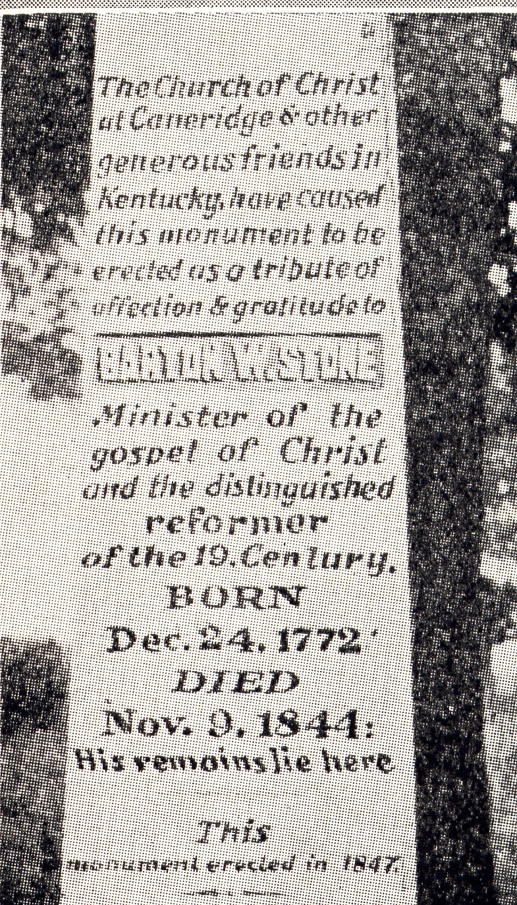
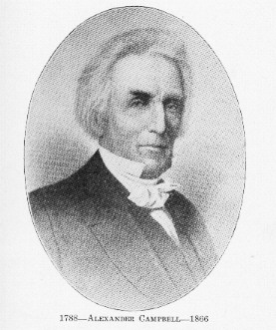
Campbell’s Visit
Campbell’s Reaction Upon His Visit To The Grave Of Barton W. Stone

Slide 105
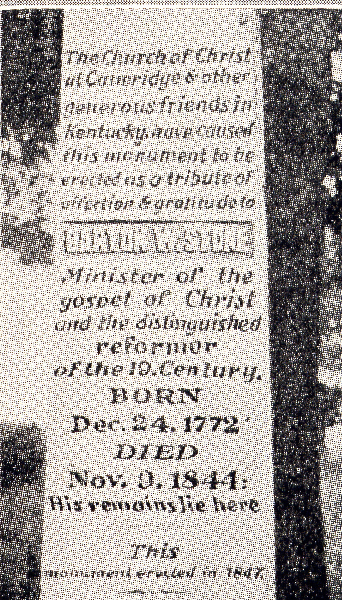
Campbell’s Visit
When The Inscription Was Being Considered As To What Was Appropriate For Stone’s Memorial, Letters Were Written To Many Requesting Suggestions, With No Response. John Rogers Wrote The Words That Appear On The Monument. When A. Campbell Visited The Grave Of His Old Friend, He Suggested That The Words “the distinguished reformer” Should More Properly Be Written As “A distinguished reformer.” Rogers Was Present And Responded, “What I Have Written, I Have Written.”

